Slide 1
Weather and seasons Lesson 4c
How Can We Use What We Know about Weather Patterns to Make Predictions?

Slide 2
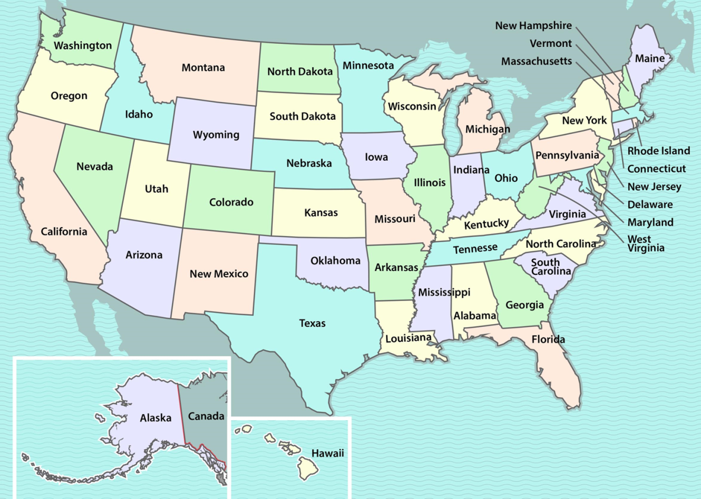
Let’s Review!
Last time, we compared the weather for Detroit and Pomona in January.
Detroit
Pomona
Courtesy of BSCS

Slide 3
Let’s Review!
What did we notice about weather patterns for Detroit and Pomona in January?
Courtesy of Cal Poly Pomona
Courtesy of Pixabay.com

Slide 4
Let’s Review!
Detroit and Pomona have different weather patterns in January.
Detroit is mostly cool or cold and snowy.
Pomona is mostly cool or warm and sunny, with some rainy days.
Courtesy of Cal Poly Pomona

Slide 5
Today’s Focus Question
How can we use what we know about weather patterns to make predictions?
Courtesy of Clipart-Library.com

Slide 6
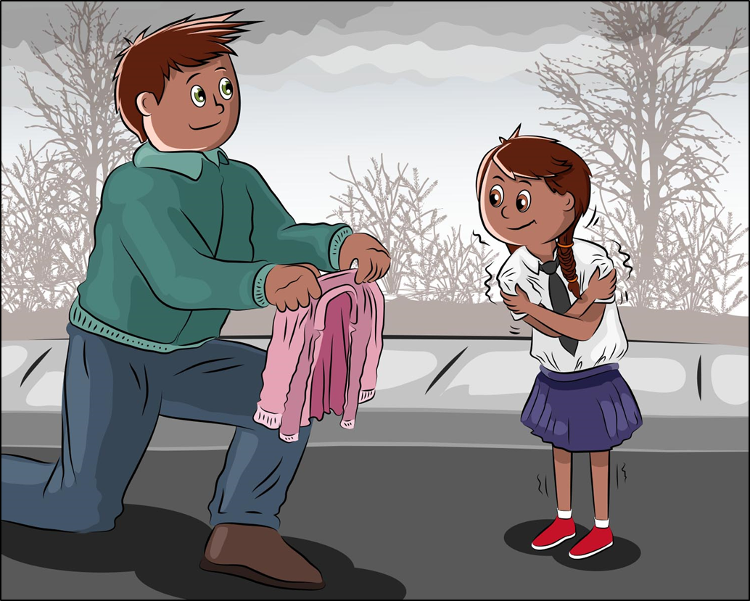
Alisa’s Trip to the Zoo
Courtesy of BSCS
Courtesy of BSCS

Slide 7
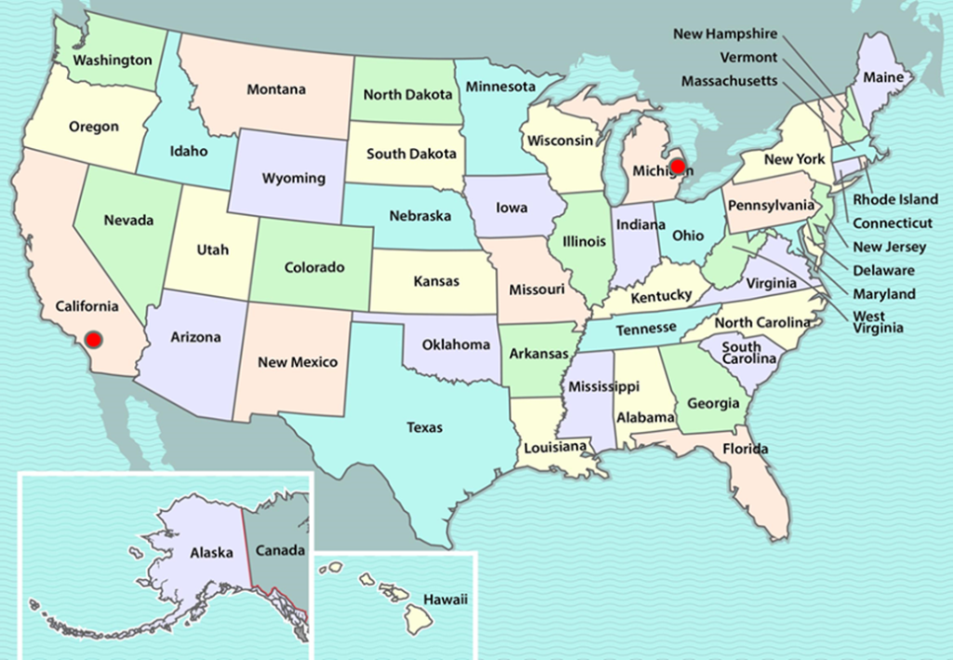
Have You Ever Wondered?
Where does the story take place?
Courtesy of BSCS
When does the story take place?

Slide 8
What Clues Did We Find?
Where does the story take place?
Could it be Detroit or Pomona or someplace else?
When does the story take place?
Could it be September, December, or January. Could it be some other month?
Courtesy of Clipart-Library.com

Slide 9
Let’s Make a Claim!
Make a claim about …
where the story takes place and
when the story takes place.
A claim is a sentence or statement that says what you think about something.
Support your claim with evidence from our weather calendars and graphs.

Slide 10
Let’s Make a Claim!
Where does the story take place?
Sentence starter:
My claim is that the story takes place in ______. My evidence is ______.
Courtesy of BSCS

Slide 11
Let’s Make a Claim!
When does the story take place?
Sentence starter:
My claim is that the story takes place in the month of ____. My evidence is ____.

Slide 12
What Is Our Claim and Evidence?
One claim we can make is that the story takes place in Detroit in January.
Our evidence from our weather calendar is that it snowed in Detroit in January.

Slide 13
Let’s Summarize!
Our focus question: How can we use what we know about weather patterns to make predictions?
Courtesy of Clipart-Library.com

Slide 14
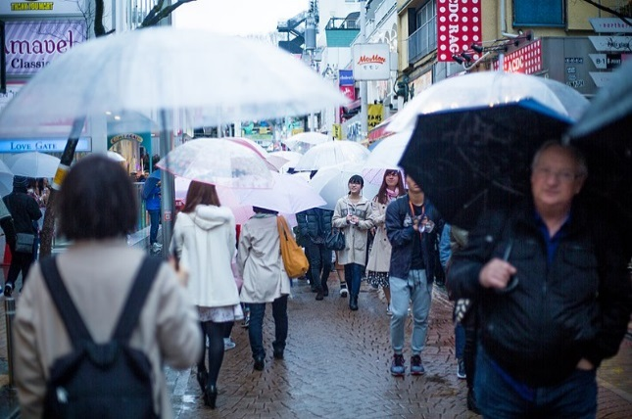
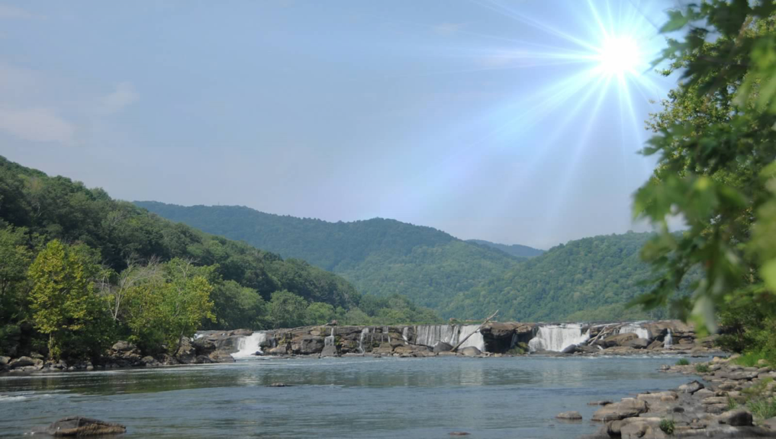
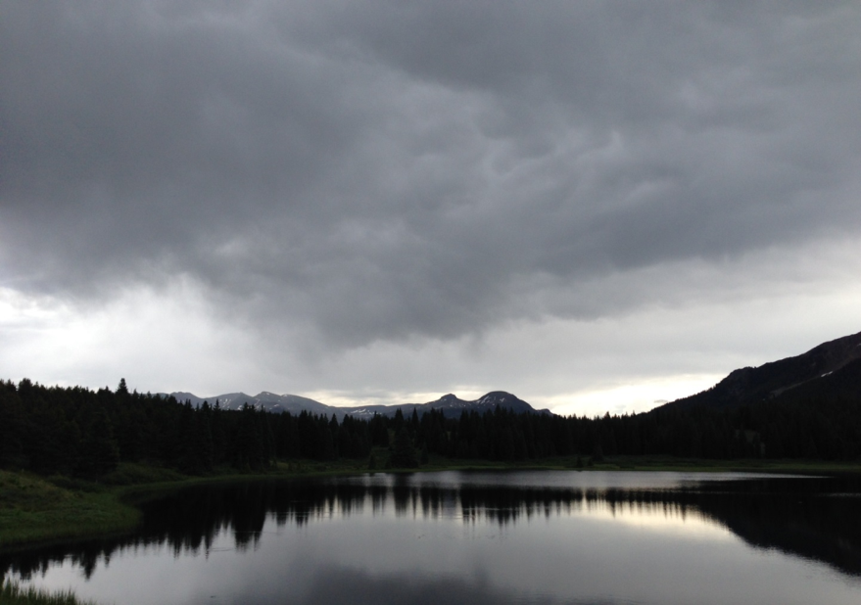
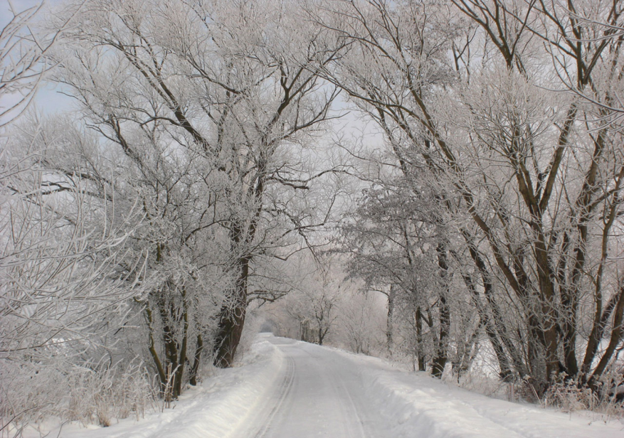
Could These Be Pomona in January?
1
2
Photograph by Dick Thomas Johnson
Photograph by Carey Woods
3
4
Photograph by Audrey Mohan
Photo courtesy of publicdomainpictures.net

Slide 15
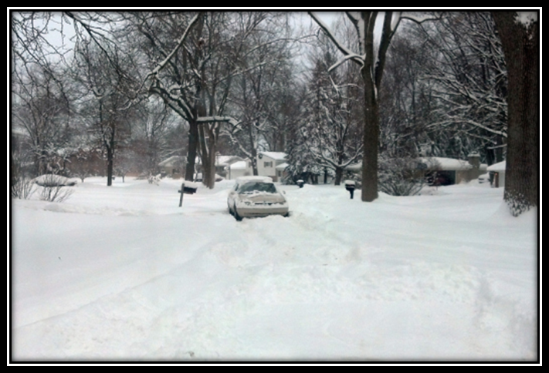
Let’s Summarize!
Weather patterns are different in different places at the same time of year.
We can use what we know about weather patterns to make predictions.
Photo used with permission from BSCS
Photo used with permission from BSCS

Slide 16
Next Time
We’ll use what we know about weather patterns to investigate another mystery city.
Courtesy of Cal Poly Pomona
Courtesy of Pixabay.com

Slide 17
What’s the Weather Like Right Now?
Let’s see what the weather is like right now in other cities around the United States.
Weather-cam links:
http://www.earthcam.com/usa/florida/miamiandthebeaches/?cam=miamibeach7
http://www.earthcam.com/usa/missouri/stlouis/?cam=stlouis_hd
http://www.earthcam.com/usa/newyork/skyline/?cam=skyline_g
https://www.earthcam.com/events/wintercams/

