Slide 1
Weather and seasons Lesson 5
How Can We Use What We Know about Weather Patterns to Decide Whether a Mystery City Is Pomona?

Slide 2
Our Unit Central Question
Is weather the same everywhere all of the time? How do you know?
Courtesy of Clipart-Library.com

Slide 3
Let’s Review!
Weather is what it looks like and feels like outside.
Weather changes from month to month.

Slide 4
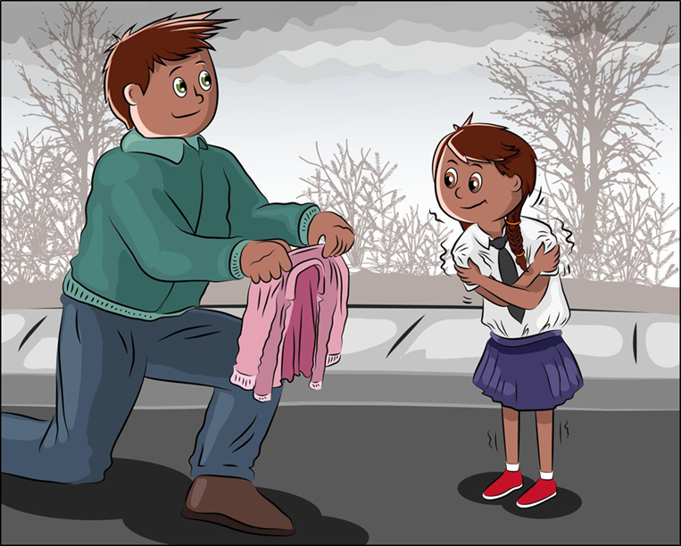
Let’s Review!
Weather changes during the day.
Morning
Afternoon
Courtesy of BSCS
Courtesy of BSCS

Slide 5
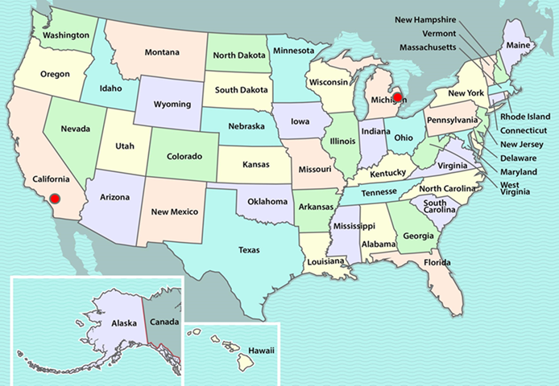
Let’s Review!
Weather patterns are different in different places at the same time of year.
Courtesy of BSCS

Slide 6
Let’s Review!
What did we predict about where the story took place?
What did we predict about when the story took place?
Used with permission from the Ezra Jack Keats Foundation

Slide 7
Let’s Review!
Based on what we already know about weather patterns, we decided that the story might have taken place in Detroit in January.
Used with permission from the Ezra Jack Keats Foundation

Slide 8
Today’s Focus Question
How can we use what we know about weather patterns to decide whether a mystery city is Pomona?
Courtesy of Clipart-Library.com

Slide 9
The Same or Different?
How can we find out if the weather patterns in two different places are the same or different?
Courtesy of Cal Poly Pomona
Courtesy of Pixabay.com
Notes:
Write student ideas on board.

Slide 10
What Is Evidence?
Courtesy of Cal Poly Pomona
Courtesy of Pixabay.com
Notes:
Write student ideas on board.

Slide 11
What Evidence Could We Look For?
What kinds of evidence could we look for to help us decide whether our mystery city is Pomona?
Courtesy of Cal Poly Pomona
Courtesy of Pixabay.com
Notes:
Write student ideas on board.

Slide 12
Is Our Mystery City Pomona?
Compare the graphs for our mystery city and Pomona. Look carefully at all of the evidence.
Decide whether the mystery city is Pomona and make a claim. Support your claim with evidence from your graphs.
Sentence starters:
We claim that the mystery city is Pomona. Our evidence is _______.
OR
We claim that the mystery city is NOT Pomona. Our evidence is _______.

Slide 13
Let’s Hear Your Claims and Evidence!
Presenters: Use one of these sentence starters.
We claim that the mystery city is Pomona. Our evidence is _______.
OR
We claim that the mystery city is NOT Pomona. Our evidence is _______.
Listeners: Be ready to share comments and ask questions.
I agree because ______.
I disagree because _______.

Slide 14
Our Evidence
Mystery City | Pomona

Slide 15
Our Mystery City Is … Seattle!
Courtesy of BSCS

Slide 16
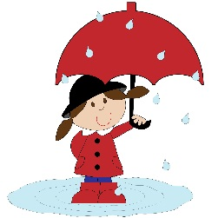
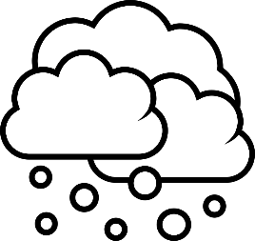
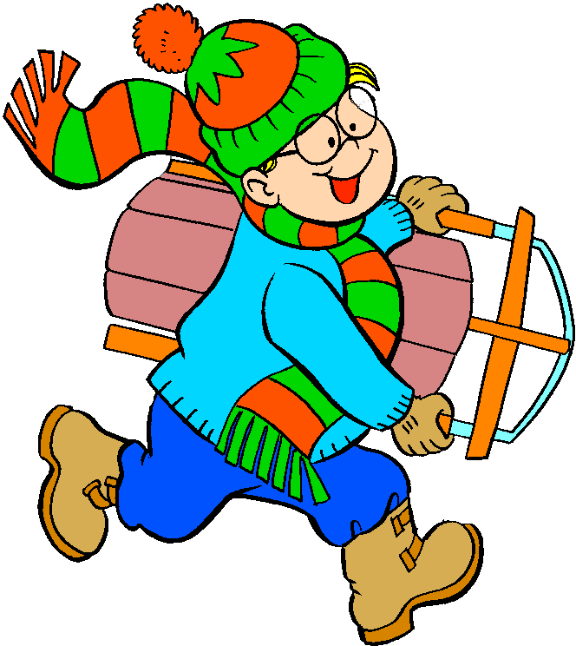
Your Pictures of Pomona and Detroit
Pomona
Detroit

Slide 17
Let’s Summarize!
Draw a picture to show what the weather is like in Seattle during January.
Draw children outside in the clothes they’d wear.
Seattle

Slide 18
Let’s Summarize!
Our focus question: How can we use what we know about weather patterns to decide whether a mystery city is Pomona?
Courtesy of Clipart-Library.com

Slide 19
Let’s Summarize!
Courtesy of Clipartmag.com
Courtesy of Clipartmag.com
Courtesy of Pixabay.com

Slide 20
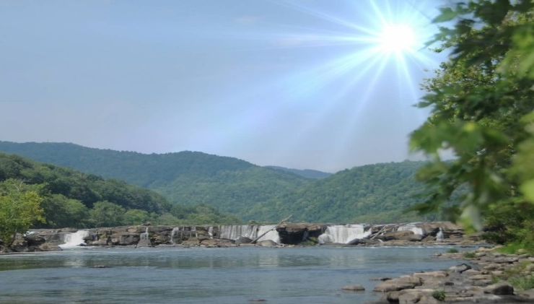
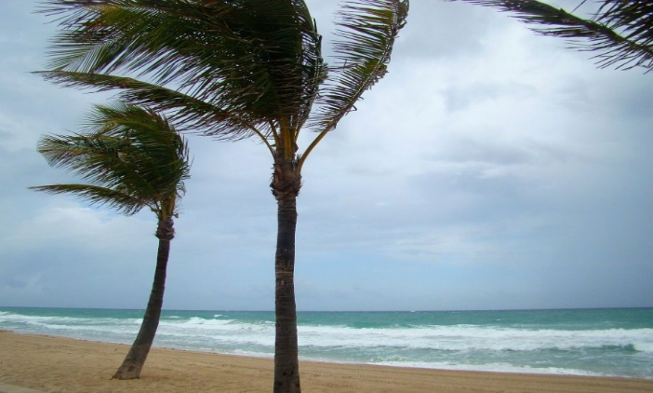
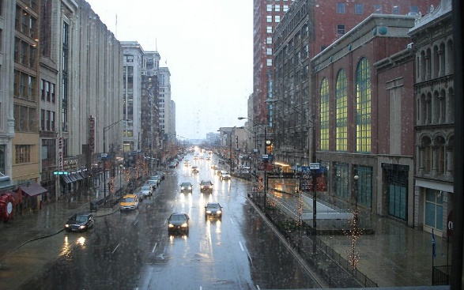
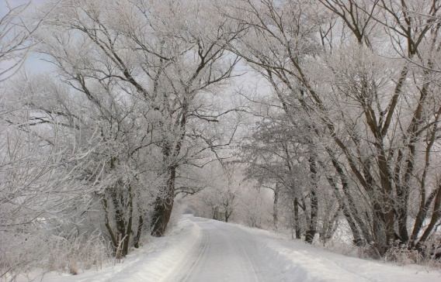
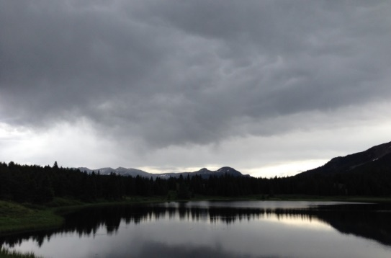
Let’s Summarize!
Photograph by Carey Woods
Photo courtesy of Publicdomainpictures.net
Photograph by Cyndy Sims Parr/ Wikimedia Commons
Photo courtesy of Publicdomainpictures.net
Photograph by Audrey Mohan

Slide 21
Let’s Summarize!

Slide 22
Let’s Summarize!
Courtesy of BSCS
Courtesy of BSCS

Slide 23
Let’s Summarize!
Courtesy of BSCS

Slide 24
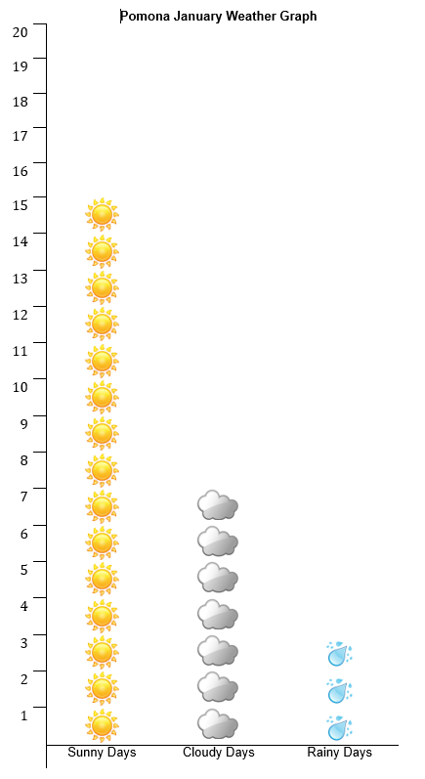
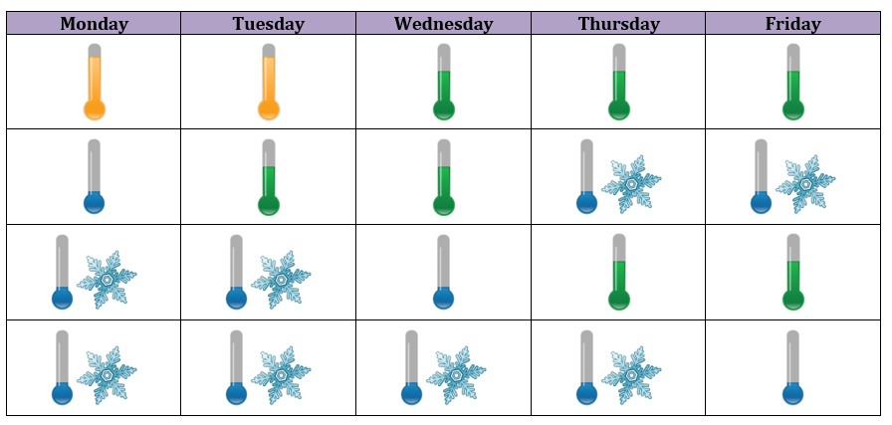
Let’s Summarize!

Slide 25
Our Unit Central Question
Is weather the same everywhere all of the time? How do you know?
Courtesy of Clipart-Library.com

