Slide 1
Provost’s Report to the Academic Senate
Sylvia A. Alva, Ph.D.
Provost & Vice President for Academic Affairs
Wednesday, September 12, 2018
Office of the Provost

Slide 2
Inclusive Polytechnic University
Office of the Provost

Slide 3
Tenure-Track Faculty Promotions
41 tenure-track faculty members promoted
20 awarded tenure and promoted to associate professor
21 promoted to full professor
Office of the Provost

Slide 4
Tenure-Track Faculty Hiring
Commitment to increasing tenure density by 2% per year
Campus investment in tenure density significantly more than CSU allocation in GI 2025 funds
34 new tenure-track faculty joined us in 2018-19
46 new tenure-track searches approved for 2018-19
Office of the Provost

Slide 5
Inclusive Faculty Recruitment
Michael Page, Provost Fellow for Inclusive Faculty Recruitment
Close collaboration between Martin Sancho-Madriz, Michael Page, Linda Hoos, College Deans, and faculty search committees
Proactive and comprehensive recruitment strategies supported by Foundation funds
Faculty retention
Faculty success and student success are closely intertwined
Office of the Provost

Slide 6
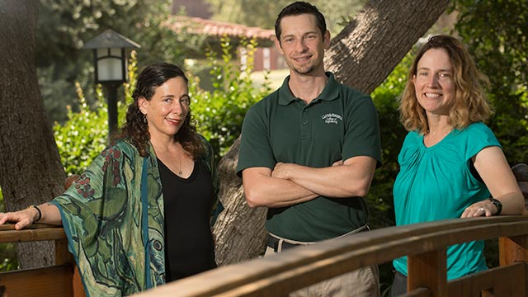
Faculty Accomplishments
CSU Faculty Innovation and Leadership Award
Faye Wachs, Paul Nissenson and Juliana Fuqua
Office of the Provost

Slide 7
Faculty Accomplishments
Paul M. Beardsley, Arlo Caine, Angela C. Shih, Victoria Bhavsar, Viviane Seyranian
NSF HSI AWARD: “Building Capacity: Polytechnic for All: STEM Undergraduate Success via an Inclusive Institution”
2018 – 2023; $1,479,959
Office of the Provost

Slide 8
Faculty Accomplishments
Alex Rudolph
NSF S-STEM grant to support the Cal-Bridge program
2018 – 2023; $5,000,000
Hosted at Cal Poly Pomona; 15 CSUs and 9 UCs
Office of the Provost

Slide 9
Additional Investments in Faculty Success
Professional development fund for tenure-track faculty
Faculty Workload and Student Success Program for Large Classes
Funds will be allocated soon after Fall census (September 20)
Student Success Analytics – Culture of evidence
Teacher-Scholar and other internal grant opportunities
Office of the Provost

Slide 10
Upcoming Funding Opportunities
Research, Scholarship, and Creative Activity (RSCA) grants
Lottery funds
Teacher-Scholar awards
Special Projects for Improving the Classroom Experience (SPICE) grants (instructional innovation & classroom modernization)
Office of the Provost

Slide 11
Upcoming Events
Academic Master Plan college town hall meetings in Fall 2018.
Institutional Report will be submitted to WSCUC in December
Assessment workshops through the Faculty Center for Professional Development
Faculty Recruitment; Professional Leaves workshops this Thursday and Friday
Academic Affairs Connections - Newsletter
Office of the Provost

