Slide 1
E&P Report Results of Referenda on Constitutional Changes, &c.
CPP Academic Senate Meeting

Slide 2
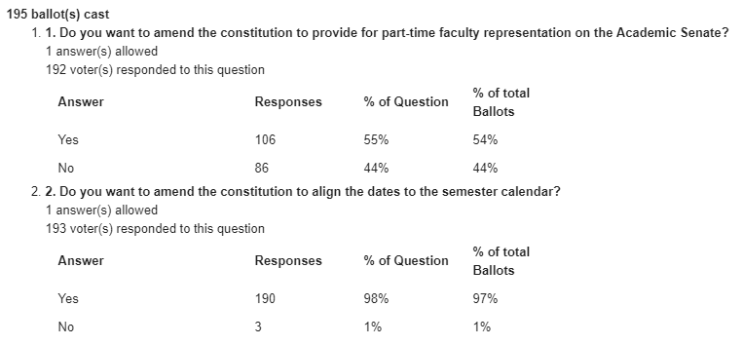
Results of Referenda
Revised and reformatted versions of Constitution and Bylaws have been published on the Academic Senate website.

Slide 3
What’s Next?
Top-to-bottom revision of Constitution and Bylaws is underway (a responsibility of the E&P Committee)
Committee membership for PT-lecturer reps. Is currently unrestricted (though cannot chair a committee or serve on the EC.)
Stipend based on verifiable time commitment?
First elections for PT-lecturer seats to be held Spring 2019
Want to formalize election/referendum procedures in appendix to Bylaws

Slide 4
The End
Questions
(short, direct)

