Slide 1
THE EVOLUTION OF CPP COURSE MATERIALS: INSTANT ACCESS >> EQUITABLE ACCESS FALL 2023
Jared Ceja, MBA, CASP
Executive Director & CEO
Cal Poly Pomona Enterprise Foundation
Thomas Sekayan, M.Ed., CASP
Associate Executive Director & COO
Cal Poly Pomona Enterprise Foundation
Clint Aase
Director of Bronco Bookstore
Cal Poly Pomona Enterprise Foundation
Suzanne Donnelly
Sr. Associate Director of Bronco Bookstore & ALS Coordinator
Cal Poly Pomona Enterprise Foundation

Slide 2
IA GROWTH TIMELINE
2018-19
2019-20
2017-18
IA pilot still limited to ME dept.
Expands to 7 courses
IA Program opened to all.
50 courses in Fall
100 courses by Spring
IA continues to lead in course material savings to students.
2020-21
1500 total sections
2021-22
2400 sections
80% of students have at least one IA course material
2022-23
2900 sections
Majority of sections are using a materials in IA
IA pilot launched w/ME dept.
4 courses / term

Slide 3
IA GROWTH cont'd: Increased Savings, Decreased Out of Pocket Costs
Ay 2019-2020
Ay 2021-2022
Ay 2020-2021
Total print & digital units:
63,320
IA units provided:
11,007
Estimated IA savings:
$740K
Average per item cost to students:
$55.20
Total print & digital units:
72,325
IA units provided:
48,372
Estimated IA savings:
$1M
Average per item cost to students:
$51.60
Total print & digital units:
105,338
IA units provided:
72,849
Estimated IA savings:
$1.3M
Average per item cost to students:
$46.50

Slide 4
Preliminary IA Data for 2022-2023
Fall 2022:
1452 sections
21623 students with at least one IA course.
52% of courses using materials now participate in IA
81.7% of students stay opted in

Slide 5
INSTANT ACCESS EVOLVING>>UC DAVIS CREATES "EQUITABLE ACCESS" PROGRAM
UC Davis updated their IA program in 2020 to launch a comprehensive subscription model they called "Equitable Access" or "EA":
ALL enrolled students automatically receive access to ALL required materials for ALL classes on day one at one flat subscription charge.
Students can opt out of the whole program, but not individual classes
Digital first, provided via LMS whenever possible
Print copies provided when digital not available
Factors in OER and library provided materials to compute total costs
Goal to ensure low fixed costs for students acquiring course materials

Slide 6
Rationale for Equitable access
The information delivery and consumption landscape has evolved; EA meets today’s generation of student where they’re at and beyond
Course material costs are predictable and stable
A recruitment & retention tool for University
Automates access to course materials on “Day 1”
All students start out with accessing the same course material in the classroom
(30-35% of students report doing without at least one required material last year, according to recent Student Watch surveys from On Campus Research.)
Faculty continue to have freedom to choose course materials

Slide 7
EA Model growing in CA:
UC DAVIS
Announced program in 2019 and launched in Fall 2020, with EA charge of $199/undergraduate student for required materials.
First year results allowed campus to reduce per term cost to $169
SAN DIEGO STATE UNIVERSITY
Program approved in 2021, Launched Fall 2022
Cost is $22/credit hour- for a student taking the recommended 30 units a year, the EA cost will be @ $330/semester $660/year (USED HEERF funds to subsidize $4.75 per unit, students paid $17.25)
Coming in 2023
SONOMA STATE
CAL STATE NORTHRIDGE

Slide 8
CPP Equitable Access Program: FALL 2023
We plan to expand current IA program to comprehensive digital first program priced at $250 per CPP undergraduate student per semester.
Pricing based on VitalSource reviewing over 2 years of our adoption history and our IA catalogs for EA viability
Pro-rated rate for Summer under consideration
85% of our adoptions are available in a digital format which can be delivered via Canvas, w/remaining 15% are only available in print
Classes with OER materials or with multi-user Library e-book licenses included
Charges posted prior to start of term, refunded on opt-out.
Students may opt out of entire program through the end of drop-add period and acquire materials individually from us or other sources.

Slide 9
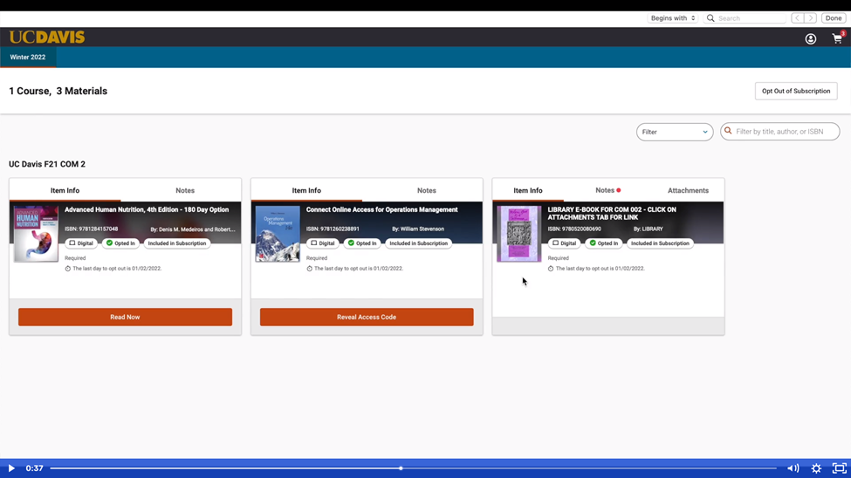
CPP INSTANT ACCESS COMPLETE:FALL 2023
What it will look like to students:
All materials displayed in one place, with instructions for accessing content
Opting Out is easy, just one click:

Slide 10
"Complete" change takes teamwork!
What the program needs to succeed:
Support from faculty, administration, academic affairs, student affairs, ASI, et.
Multi-channel communication campaign from institutional leaders, advisors and faculty as well as the bookstore/Foundation marketing efforts
Timely adoption information will be crucial to price negotiation process

Slide 11
Questions?

