Slide 1
INSTANT ACCESS COMPLETE AY 23-24 PROGRAM RESULTS & UPDATES
Jared Ceja, MBA, CASP
Executive Director & CEO
Cal Poly Pomona Enterprise Foundation
Suzanne Donnelly
Sr. Associate Director of Bronco Bookstore & ALS Coordinator
Cal Poly Pomona Enterprise Foundation

Slide 2
CPP Instant Access Complete Program: Launched FALL 2023
Program provides access to all required materials for all classes
Classes with OER materials or with multi-user Library e-book licenses included
Program Charge is flat fee per term, which is determined by enrollment status:
$250 per semester for undergraduate students taking 7+ units per semester.
$150 per semester for undergraduate students taking 6 or fewer units, and for all graduate students
Charges posted prior to start of term, refunded on opt-out, scholarships disbursed.
More than $25K+ in scholarships provided and funded by IAC.
Average opt in rate approximately 77% across both Fall and Spring Terms.
Program launch successful due in part by Faculty support.

Slide 3
General Takeaways - Instant Access Complete
IAC met today’s generation of student where they were at start of term.
Course material costs became predictable and stable for our students.
IAC became recruitment & retention tool (an amenity) offered by CPP.
Automated access to course materials on “Day 1”.
All students started out with accessing the same course material in the classroom.
Faculty continued to have academic freedom to choose required course materials
*Note: defaulting to digital delivery as much as possible is what enables automatic access. Print delivery inherently is less efficient/convenient.

Slide 4
Deeper Dive - IAC Results for AY 23-24
Fall 2023:
Participation rate was 76.5% of enrolled students, 80% when adjusted for students who had no content
Provided 101695 total course materials to 19,951 students (compared to providing 58917 units Fall 2022)
11047 print units provided (10.8% of total) (of these only 7819 actually picked up or ~71%)
90648 digital units provided (89.2% of total)
Total billed to students: $4.8M
Estimated savings based on AY 22-23’s average cost per student of all required materials: $2.2M or $112.87 per student – every penny counts for our students!

Slide 5
Deeper Dive – IAC Results: Spring 2024 preliminary results
77.7% participation rate, 81.7% when considering only these students who had content.
Provided 95,023 course material units to 18,939 students.
89% of units were digital, 11% print.
Of the 10,736 print units that are eligible, only 7200, or ~67%, have been picked up as of the beginning of March.
Preliminary savings estimate is $2.1million
Total of 150 Bookstore IAC Scholarships awarded, totaling $29,750

Slide 6
IAC PRELIMINARY SUSTAINABILITLY IMPACT FALL 2023
Notes:
Between July 1 – Dec 31 2023, providing materials digitally removed 351 tons of CO2 emissions

Slide 7
LESSONS LEARNED FROM FALL 2023
Lots of “hidden” adoptions came to light at the last minute
Lots of “optional” books turned out to be required after all!
The “opt out” from Canvas option isn’t available for students until LMS administrators make a semester’s Canvas courses available to students so we had to add instructions for requesting their portal link prior to that.
Most faculty who previously had not participated in IA accepted the program and the default to provide digital materials, but there were some challenging conversations, and we made exceptions as needed.
About 30% of print units that were eligible for distribution were never picked up.
This was true even for classes where we made an exception to the “digital default” mode at faculty request

Slide 8
FALL STUDENT EXPERIENCE SURVEY RESULTS: OPTED IN STUDENTS

Slide 9
FALL STUDENT EXPERIENCE SURVEY RESULTS: OPTED IN STUDENTS

Slide 10
FALL STUDENT EXPERIENCE SURVEY RESULTS: OPTED IN STUDENTS

Slide 11
FALL STUDENT EXPERIENCE SURVEY RESULTS: OPTED OUT STUDENTS

Slide 12
FALL STUDENT EXPERIENCE SURVEY RESULTS: OPTED OUT STUDENTS

Slide 13
FALL STUDENT EXPERIENCE SURVEY RESULTS: OPTED OUT STUDENTS

Slide 14
FALL STUDENT EXPERIENCE SURVEY RESULTS: OPTED OUT STUDENTS

Slide 15
Highlights from the Student Watch Survey by the National Association of College Stores
Of the 2,071 responses to the survey conducted by NACS, only 9.3% exclusively preferred print only materials.
Other NACS Survey Results:
39.6% of students indicated digital format was preferred; 30% said their preference varied by course; 4% had no preference; 16% preferred print with digital component.
% of students who did without at least 1 required material decreased from 33% to 23% compared to 2022-23

Slide 16
CPP INSTANT ACCESS COMPLETE:FALL 2023 – OTHER FEEDBACK
Lots of discussion on Social Media – some positive, some negative, most pragmatic.
Typical Reddit post, which was very reasonable: smashmonster1268Materials Engineering
“My opinion on this is mixed. I much prefer the old system where you can opt out by class, but I understand that Instant Access Complete can be useful for some students. Ultimately, you’re gonna have to do the math and decide if purchasing IAC is better than getting course materials from other sources. If you find that IAC is cheaper than buying or sourcing everything manually, then go for it. If you find that getting your course materials alacarte is cheaper, then by all means opt out of IAC. It also depends on your use case and what the professor will require. Online homework access can probably be bought manually at a cheaper price. if you actually need a physical textbook then you can get it used from Amazon/eBay/another student who took the class. In the end, you will be the one to make that decision.”
:

Slide 17
CPP INSTANT ACCESS COMPLETE:FALL 2023 – OTHER FEEDBACK
Poly Post coverage Article 2/13/24- Student experiences
“Freshman starting in fall 2023 had the opportunity to begin their college experience with the program available.”
“Axel Sernas, a business student, shared how Instant Access made his semester easier by allowing him to find all his course materials in one place.”
“Isabel Recinos, a child development student, echoed how it was better she didn’t have to go scavenging for textbooks or buy each one individually.”
“Stephanie Sanchez, a graduate student in education, said the program has been vital to her current educational career.”
:

Slide 18
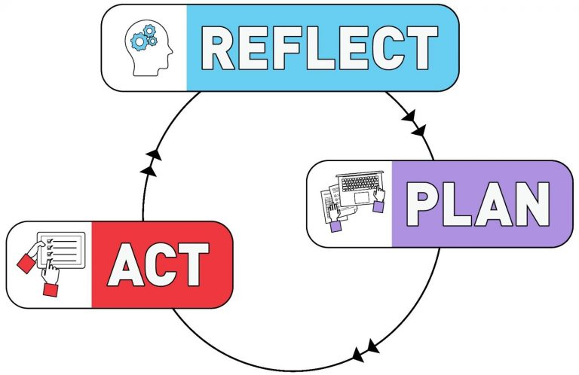
CPP INSTANT ACCESS COMPLETE: What’s Next?
Expand partnership with library and promote OER adoption to keep program costs down, receive faculty feedback, and continue building IAC’s future TOGETHER.
Improve print pick-up rates! We need your help!
Be EVEN MORE transparent:
Hold in-person “How to Opt Out of IAC/How to Access Materials” workshops during Welcome Week.
Explore feasibility of adding “flexible access” option that would allow opted out students to still get IA discounting on the items they do need (a la carte).
Ex.: perfect for a student who only has one class with a textbook or course material to avoid paying the full IAC price, and only pay the discounted IA rate!
Other ideas? We’re open to your feedback.

Slide 19
Questions?

