Slide 1
Academic Senate Training and Refresher
August 14, 2025

Slide 2
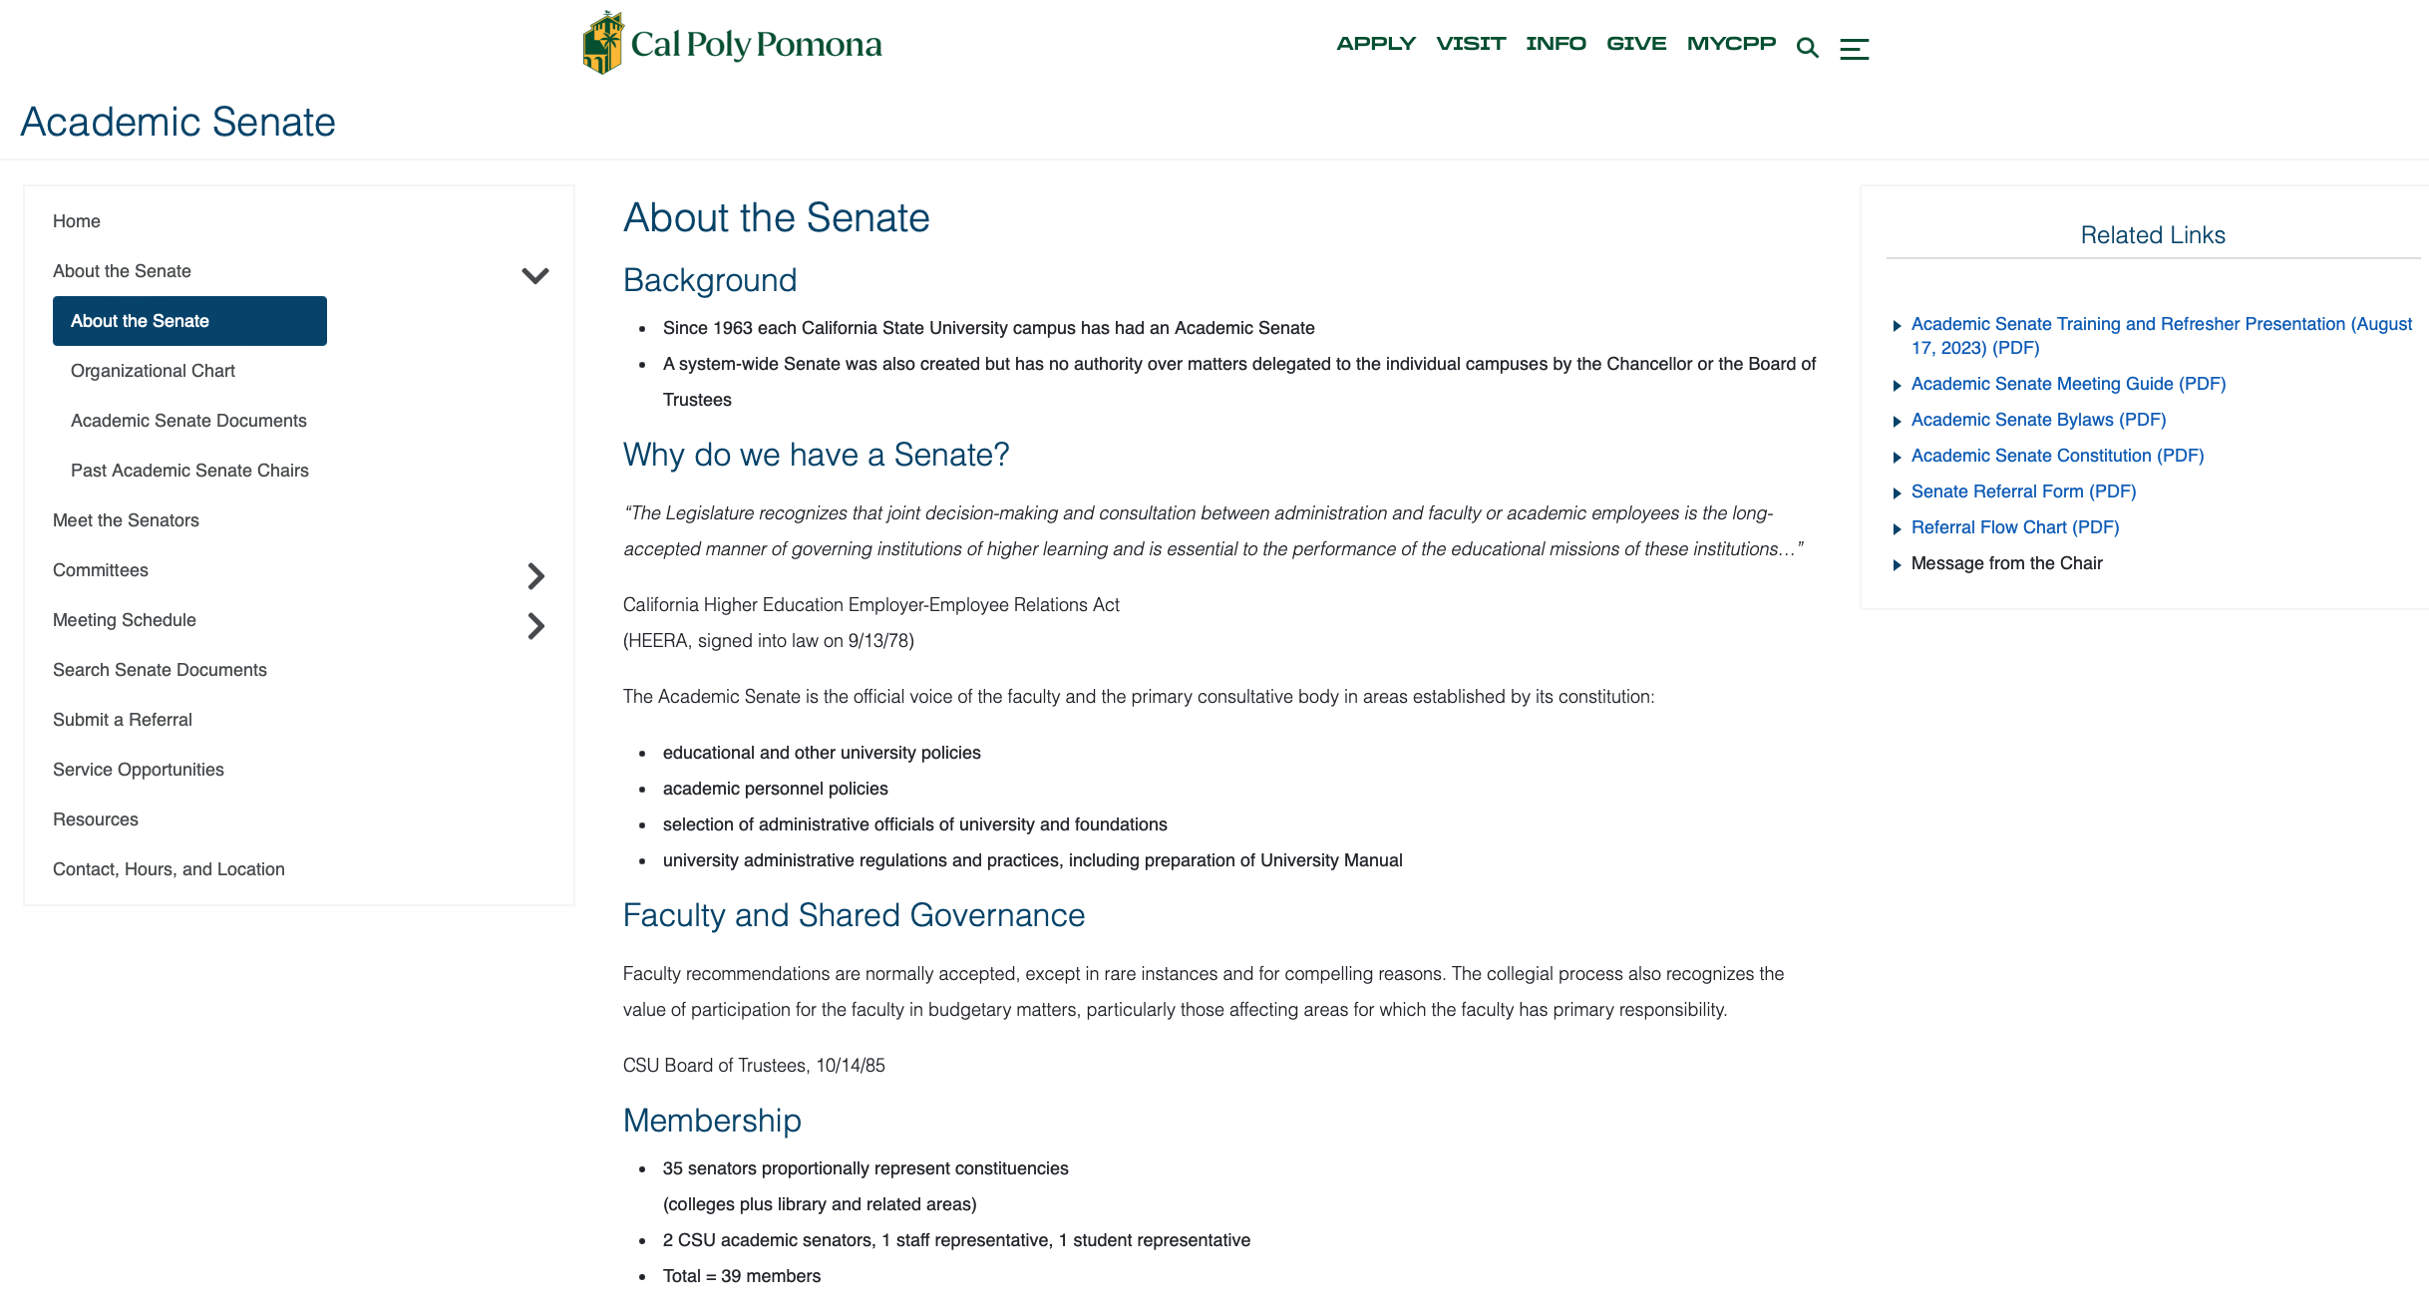
www.cpp.edu/senate

Slide 3
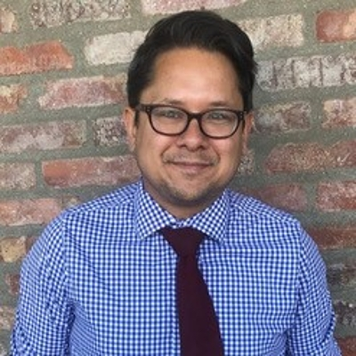
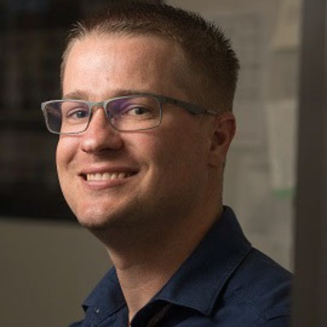
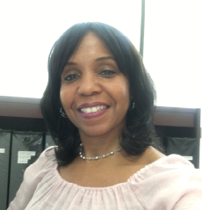
Contact the Academic Senate
Peter Hanink
Chair
pahanink@cpp.edu
Greg Barding
Vice Chair
Office:
Building 98-P2-8
Email: senate@cpp.edu
gabarding@cpp.edu
Casandra Horner Administrative Support Coordinator
clhorner@cpp.edu

Slide 4
Why do we have a Senate?
“… joint decision-making and consultation between administration and faculty or academic employees is the long-accepted manner of governing institutions of higher learning and is essential to the performance of the educational missions of these institutions...”
California Higher Education Employer-Employee Relations Act (HEERA, signed into law on 9/13/78)

Slide 5
Role of the Academic Senate
The Academic Senate is the official voice of the faculty and the primary consultative body in areas established by its constitution:
educational and other university policies
academic personnel policies
selection of administrative officials of university and foundations
university administrative regulations and practices, including preparation of Academic Manual

Slide 6
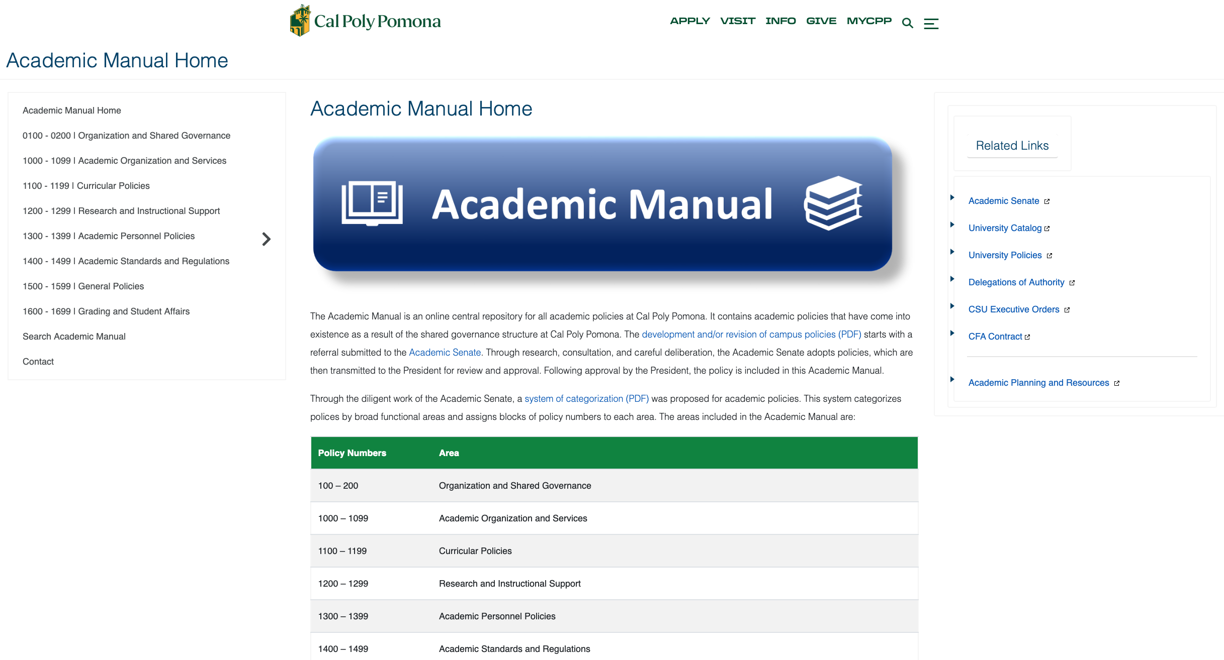
www.cpp.edu/academic-manual

Slide 7
Membership
35 senators proportionally represent constituencies (colleges plus library and related areas)
2 CSU academic senators, 1 staff representative, 1 student representative
Total = 39 members
www.cpp.edu/senate/meet-the-senators/

Slide 8
Duties and Responsibilities of Senators
Governed by Article X of the Bylaws
Senators shall
consider opinions and interests of their entire constituency
attend all senate meetings or designate a proxy
Senators submitting a proxy shall be considered absent for the purpose of attendance
communicate and consult with constituency
provide feedback to the senate from their constituency
A senator will be removed for
more than three consecutive absences from regular senate meetings
five absences from regular senate meetings in an academic year
taking a university-approved leave of one term or more
Senators should resign if planning on taking a sabbatical

Slide 9
Standing Committees

Slide 10
Executive Committee
Name | College | Email
Greg Barding, Vice Chair | Science | gabarding@cpp.edu
Peter Hanink, Chair | CLASS | pahanink@cpp.edu
Aaron Cayer | ENV | acayer@cpp.edu
David Edens | Agriculture | dredens@cpp.edu
Ghada Gad | Engineering | gmgad@cpp.edu
Rita Kumar | Past Chair | adkumar@cpp.edu
Kelly Min | COL | min@cpp.edu
Brian Newman | CLASS | bsnewman@cpp.edu
Dennis Quinn | CEIS | dquinn@cpp.edu
Julie Shen | Related Areas | jshen@cpp.edu
Faye Wachs | ASCSU | flwachs@cpp.edu
Gerd Welke | Business | gmwelke@cpp.edu

Slide 11
Committees
Academic Affairs (Chair: Jeff Roy)
The AA Committee is responsible for ensuring high faculty morale, maintaining academic freedom, and overseeing the academic calendar to serve the university's best interests. It also focuses on promoting teaching excellence, efficient use of class time, and upholding high standards in grading, student scholarships, and honors. Overall, the committee aims to foster an environment of academic and operational excellence.
Academic Programs (Chair: Mohammad Husain)
The AP Committee is responsible for all non-GE matters, such as, but not limited to, program reviews, new course and program proposals, and the Academic Masterplan.

Slide 12
Committees (continued)
Budget Committee (Chair: Stephen Osborn)
The Budget Committee is the deliberative body on the general fund budget and resource use, including instructional, academic support, student support, and institutional support budgets, as well as special funds like lottery funds. It assists in formulating policies and guidelines for resource allocation and ensures annual budget and financial reports are provided to the AS and campus community. The committee also brings reports and recommendations to the AS.

Slide 13
Committees (continued)
Elections and Procedures (Chair: Sean Monemi)
The E&P Committee is responsible for conducting all elections and referenda related to the AS, ensuring nominees are qualified, and certifying election results. It handles disputes regarding candidate qualifications or election outcomes and resolves ties through additional elections. Additionally, it periodically reviews the AS Constitution and Bylaws to ensure compliance and relevance. The E&P Committee is also responsible for re-apportionment of senate seats among colleges and schools every three years.

Slide 14
Committees (continued)
Faculty Affairs Committee (Chair: Berit Givens)
The FAC standardizes procedures for RTP, hiring, and evaluation of faculty to ensure high-quality faculty members are retained and recruited. It also protects continuing faculty’s interests in summer appointments, and fosters good relationships between faculty, administration, and the public. Overall, the committee aims to uphold and enhance faculty standards and relationships.
General Education (Chair: Mario Guerrero)
The GE Committee oversees the implementation of all policies related to general education.

Slide 15
The Referral Process

Slide 16
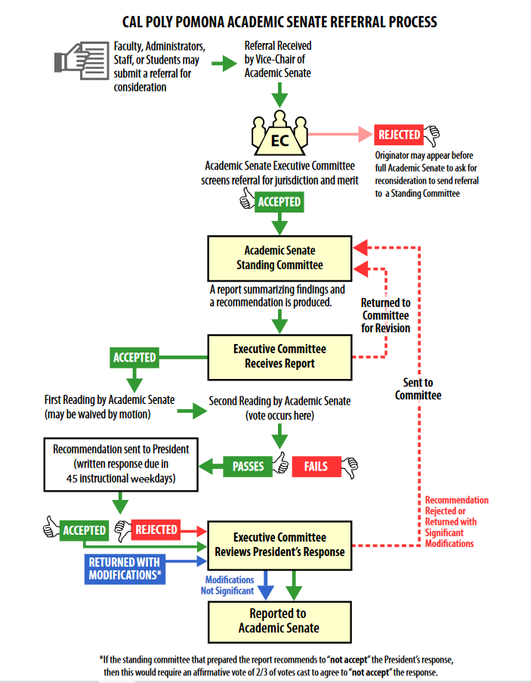
Cal Poly Pomona Academic Senate Referral Process
www.cpp.edu/senate/about/referral_flowchart_revised.pdf

Slide 17
Referral Process
Referrals are submitted to the Academic Senate
Academic Senate Referral Request Form is located at www.cpp.edu/senate/forms/senate-referral-request.shtml
Referrals are numbered with two letter committee designation (AA, AP, EP, FA, GE, BC), a sequential number and the three-digit academic year designation
AA-001-256 = the first Academic Affairs referral of the 2025-26 academic year
Senate standing committees write reports on referrals with recommendations
Standing committee chairs present reports to EC which either sends the report to the AS or returns it to committee.

Slide 18
Referral Process (cont)
Per the AS Bylaws, Article IX, item (E):
During the First Reading of an item, only the following motions are appropriate:
Receive and file the report
Waive first reading
Postpone indefinitely
Postpone definitely
Return to committee
Return with a special recommendation to committee
Limit debate
Voting shall occur during the Second Reading
Adopted reports are sent to President as a Senate Report which is numbered AS-XXXX-256, where XXXX is a sequential number

Slide 19
Referral Process (cont)
President can accept, modify or reject and has 45 instructional days to respond (Constitution, Article II, §3E)
For modified or rejected reports, the EC shall determine if the modifications are significant and may refer the report back to the originating committee for further consideration.
Committee recommendations regarding returned reports shall be adopted by the Senate by a 2/3 vote.
note: this is not equivalent to ”over-riding a veto” as in the U.S. Congress. The President has the ultimate decision-making authority regarding university policies.

Slide 20
Cal Poly Pomona Academic Senate Referral Process
www.cpp.edu/senate/about/referral_flowchart_revised.pdf

Slide 21
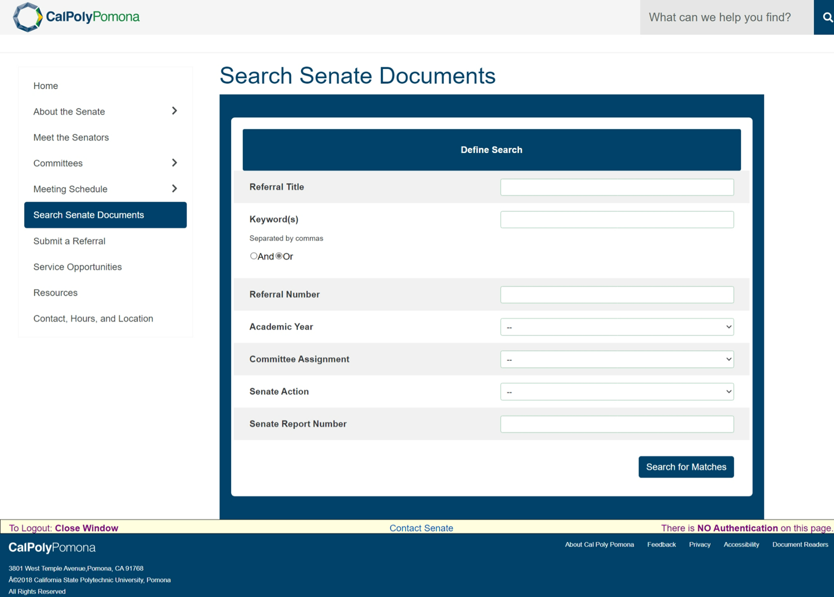
Search Senate Documents (cpp.edu)
Notes:
Important page on Academic Senate website

Slide 22
Forming and Recruiting Faculty for University Committees

Slide 23
Constitution of the CPP Academic Senate
All other standing and ad hoc Committees shall be appointed by the Executive Committee. All Committees must have at least two senators as members. Each Committee shall be chaired by a senator who is appointed by the Executive Committee. No senator may serve on more than one standing Committee. Faculty membership on Committees will be appointed by the Executive Committee. Duties and procedures of standing Committees will be stated in the Academic Senate Bylaws.
Policy 121, Article III, §12

Slide 24
Information to Include When Requesting Faculty Representation on a University Committee
Provide a brief background
Committee member make-up
Number of faculty to be recruited
If any, specific requests
Charge of committee
Term of service

Slide 25
Information about Volunteering for a University Committee
Eligibility for Committee Service
Full time tenured faculty, tenure track faculty, full-time lecturers with an annual contract, and FERP faculty with a 0.5 base for two semesters are eligible to serve.
RTP Committees are the exception. Per Policy 1328, faculty members who serve on DRTPC must be full-time tenured or FERP, faculty members on CRTPC must be full-time tenured and at full professor rank, and faculty on URTPC must be full-time tenured and have the rank of professor, librarian, or counselor.
Information to Provide on Statement of Interest
Individuals should submit their name and a brief statement (minimum of 200 words and maximum of 500 words) detailing 1) interest to serve on this committee and 2) qualifications and experiences that can best serve the work of the committee 3) rank (no CVs please). This information is what the Executive Committee uses to assess candidates for committees.
All Service Opportunities are located on the Academic Senate website at:
www.cpp.edu/senate/service-opp-new.shtml.

Slide 26

Questions or Comments

