Slide 1
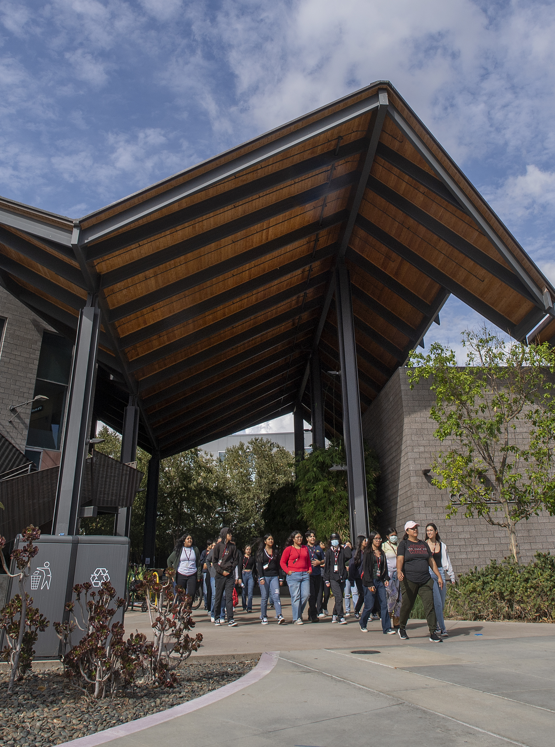

Lanterman Update
Academic Senate
Wednesday, October 15, 2025

Slide 2
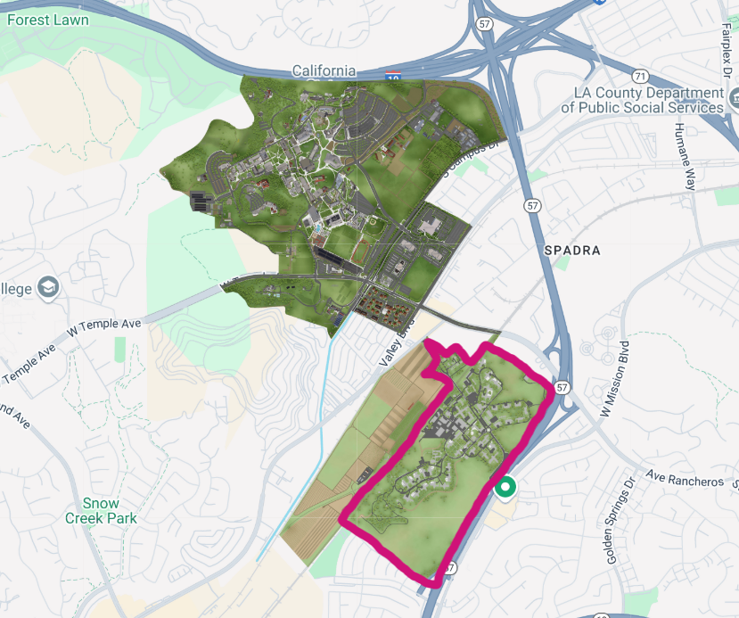
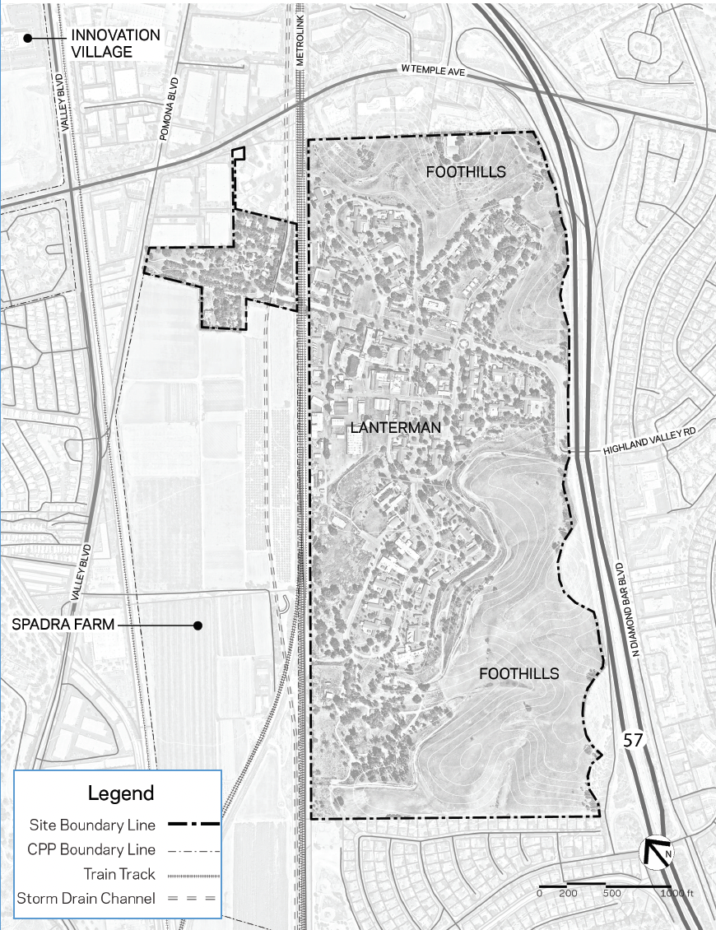
Quick Recap: The Lanterman Site

Slide 3
Quick Recap: Lanterman History
1927-2014 – Operated by State as developmental center
2015 – CSU BOT negotiates MOU with State, transfers ownership to CPP
2016-2017 – Feasibility studies by ULI & HOK
2017-2020 – Selection of & negotiations with developer #1 (FivePoint)
2020 – Negotiations with FivePoint terminated due to leadership change
2021-2023 – Selection of & negotiations with developer #2 (ERG)
Dec 2023 – CPP/ERG pause negotiations due to financial market conditions
Jul 2024 – CPP issues RFP for public financing consultant
Oct 2024 – Kosmont selected to present new financing options
Mar 2025 – Negotiations with ERG are terminated

Slide 4
Lessons Learned
Market conditions → heightened developer risk aversion
  Need strategic reassessment, including market analysis
Interest rates + construction costs + CSU entitlement process = developer risk & uncertainty
  Historic preservation / adaptive reuse
  Hazardous materials remediation
  Seismic upgrades
  Infrastructure improvements
  EIR approval + entitlement process
Upside: CPP takes control of the pre-development process
  Following Kosmont recommendations & previous CSU experience

Slide 5
A New Approach
Pre-development has begun!
New market analysis
New development concepts
New financial feasibility analysis
Phase I environmental assessment
Assessment of historical significance of existing buildings & consultation with SHPO
Utility infrastructure improvement assessment & cost estimation
Conceptual land-use plan(s)
Keyser Marston Associates
Michael Baker International
Forthcoming RFP

Slide 6
Strategic Campus Asset/Regional Economic Impact
“Live, work, learn, play” mixed-use community
Academic research: “Innovation Alley”
  Hands-on learning
  Industry partnerships for R&D
Faculty/staff housing
Amenities: retail, open space, recreation, historic structures to preserve heritage
Ongoing, sustainable source of annual revenue
Regional economic development hub

Slide 7
The Upfront Investment
Ongoing maintenance costs
Pre-development costs
  $750k from CSU Chancellor’s Office (Market/Financial, Pre-EIR, Land Use Plans/Utility Infrastructure)
  Future costs: Project EIR, negotiations with developer, site infrastructure/utilities (phase I)

Slide 8
Stakeholder Engagement
President’s Cabinet
Academic Senate
Poly Post
ASI
Provost’s Council
CPP Enterprise Foundation Board
CPP Philanthropic Foundation Board
City/County Elected Officials
Local Transit Agencies
Campus Legislative Delegation
Campus Survey – Market Assessment
Campus Listening Sessions – Land Uses

Slide 9
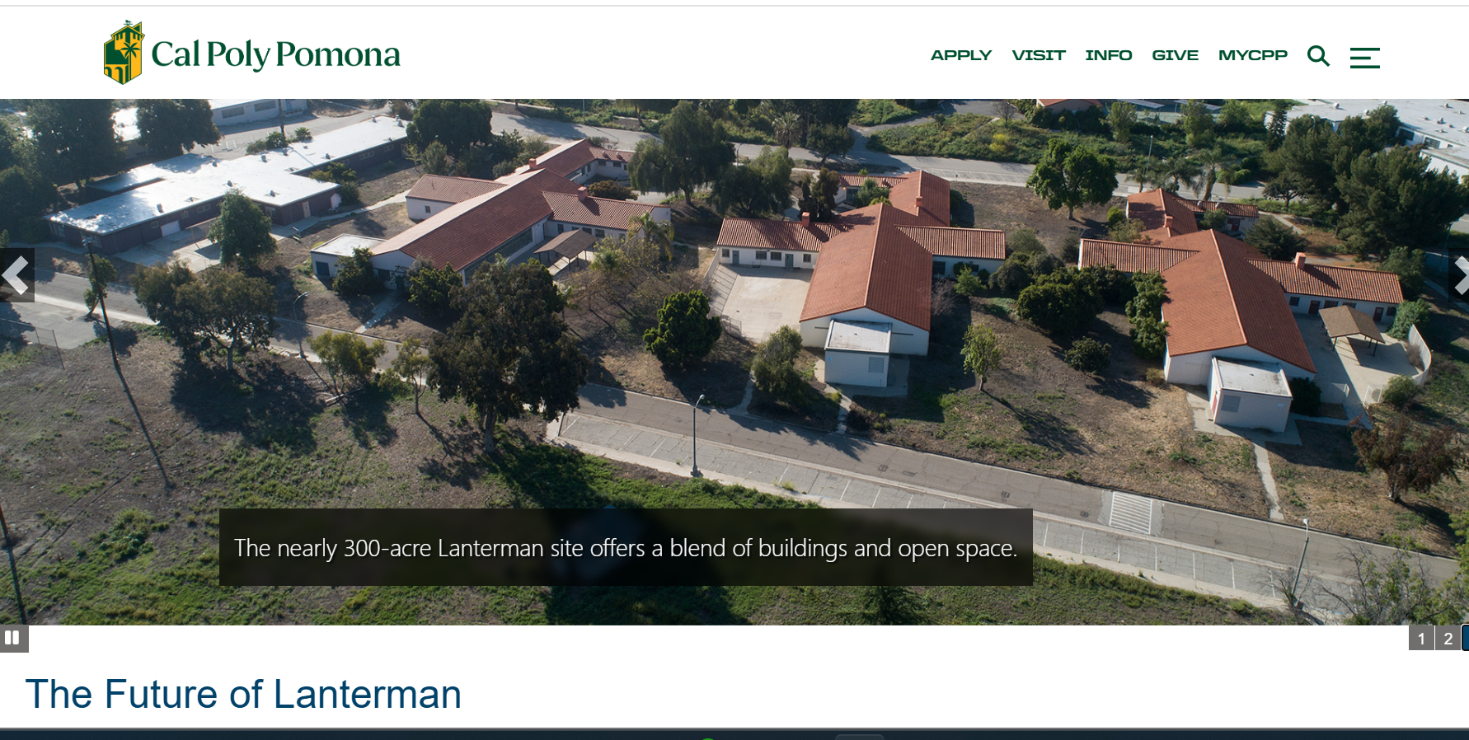
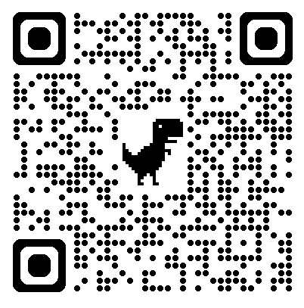
CPP Lanterman Website
https://www.cpp.edu/lanterman
Email Anthony @ aworlando@cpp.edu

