Slide 1

Financial Budget Presentation
Academic Senate – Budget Committee 10/29/2025

Slide 2
Quick Overview of CPPE
We are a 501c3 non-profit corporation that aims to act like a for profit to optimize returns either financially or intrinsically to the University.
We are completely self-supporting, legally independent, but governed by a Board of Directors.
We exist to mitigate risk exposure to the University.
We exist to manage certain funds on behalf of the University.
We exist to provide expected campus amenities/support (Dining, Bookstore, support programs, etc.) to the University that is not funded by the State.

Slide 3
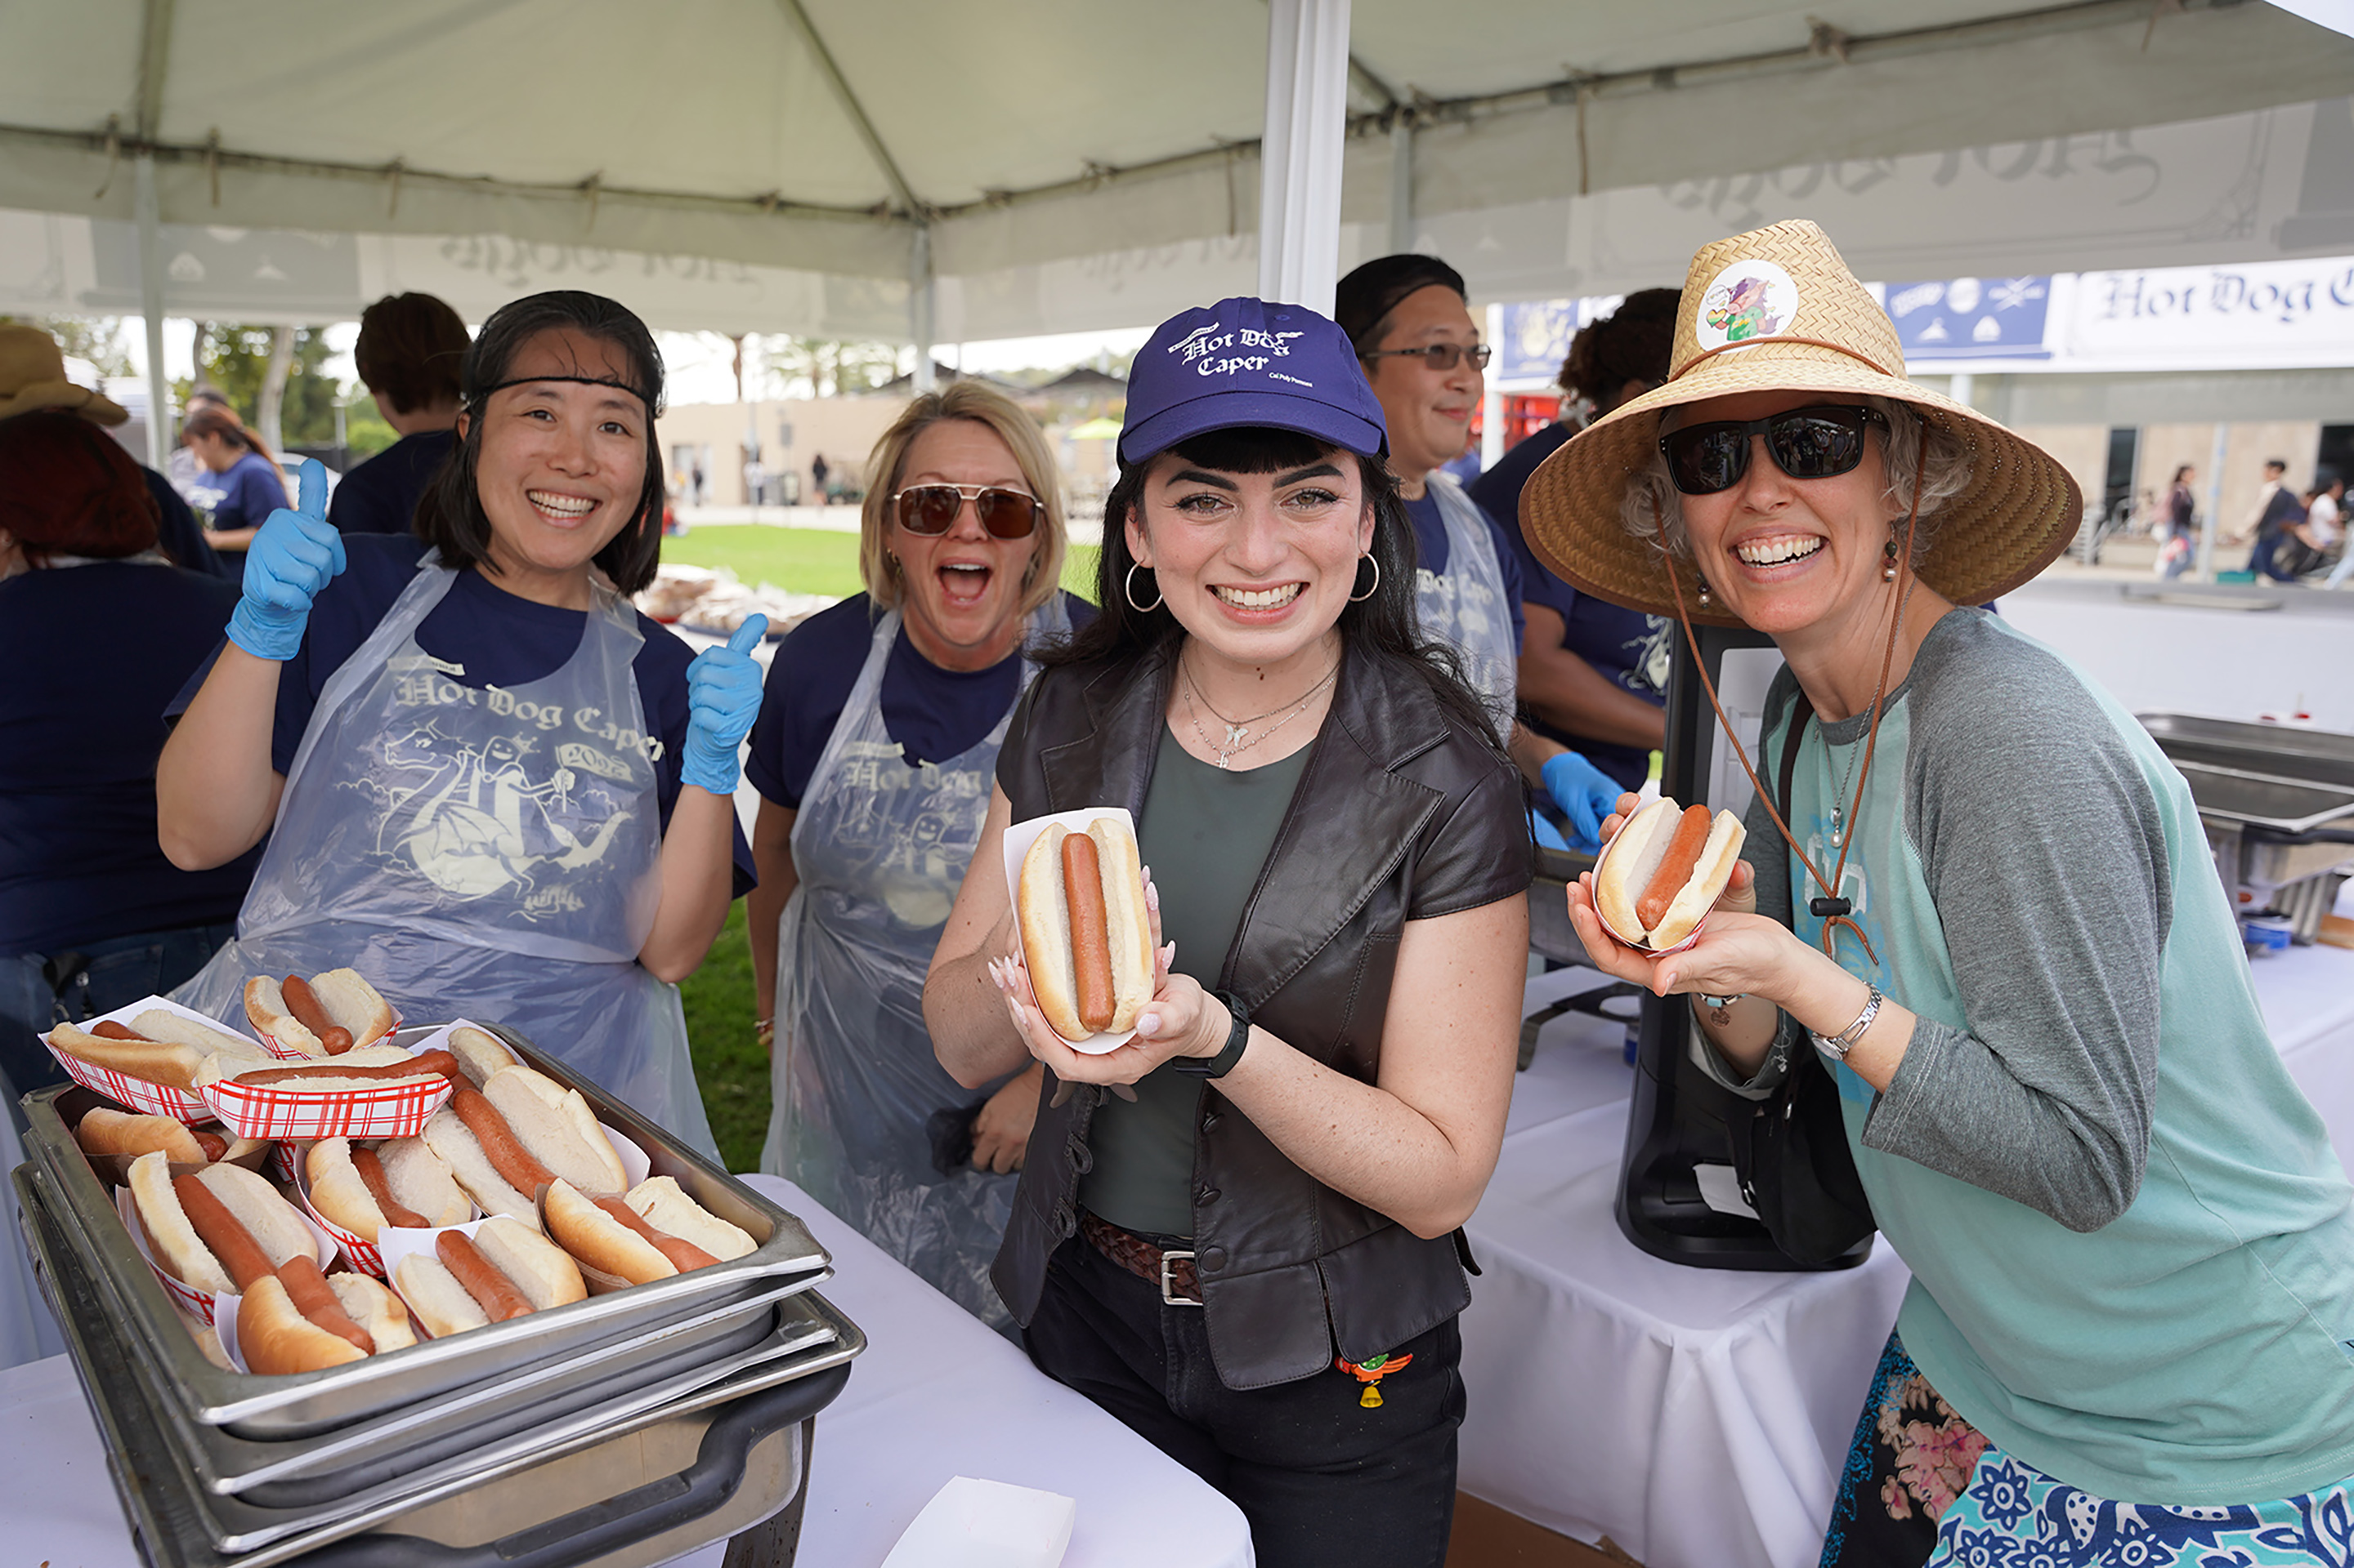
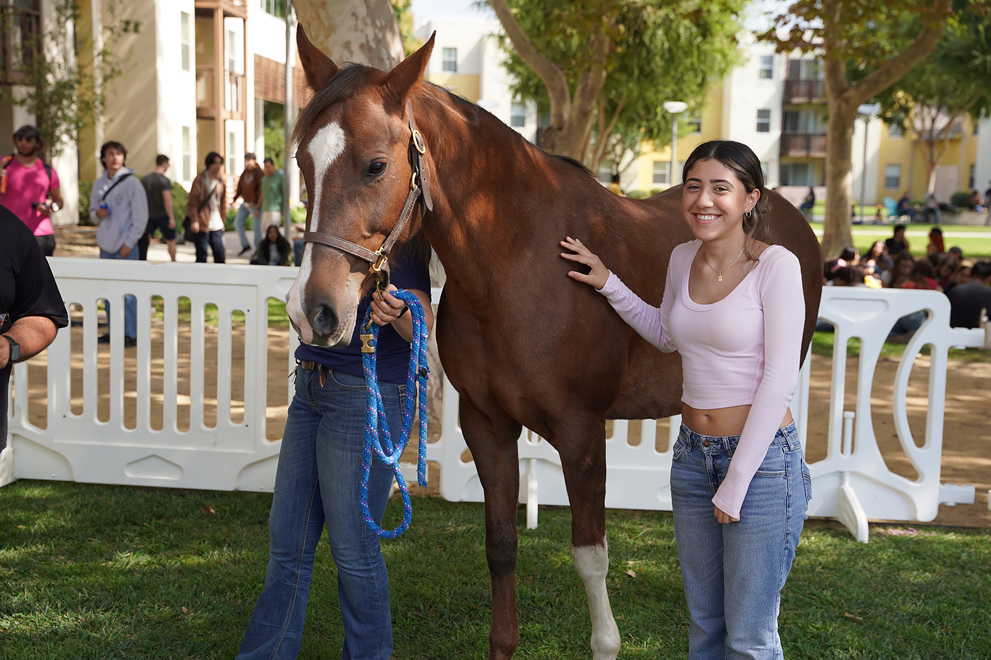
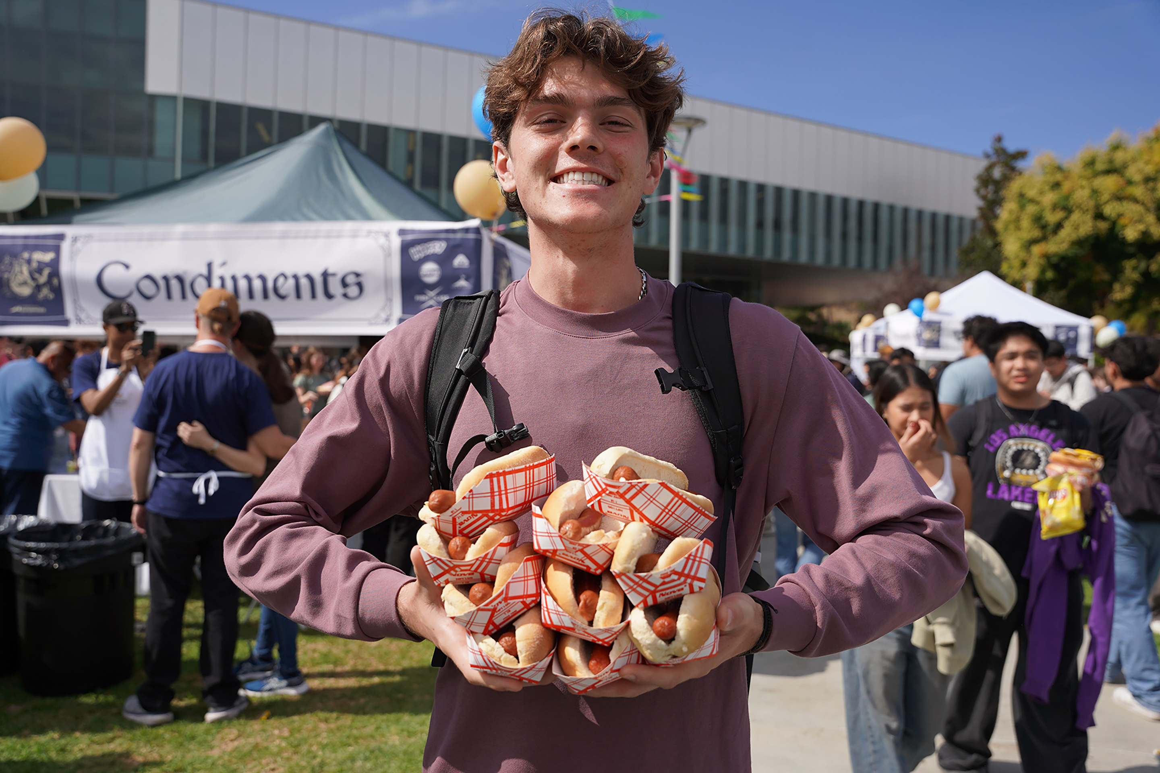
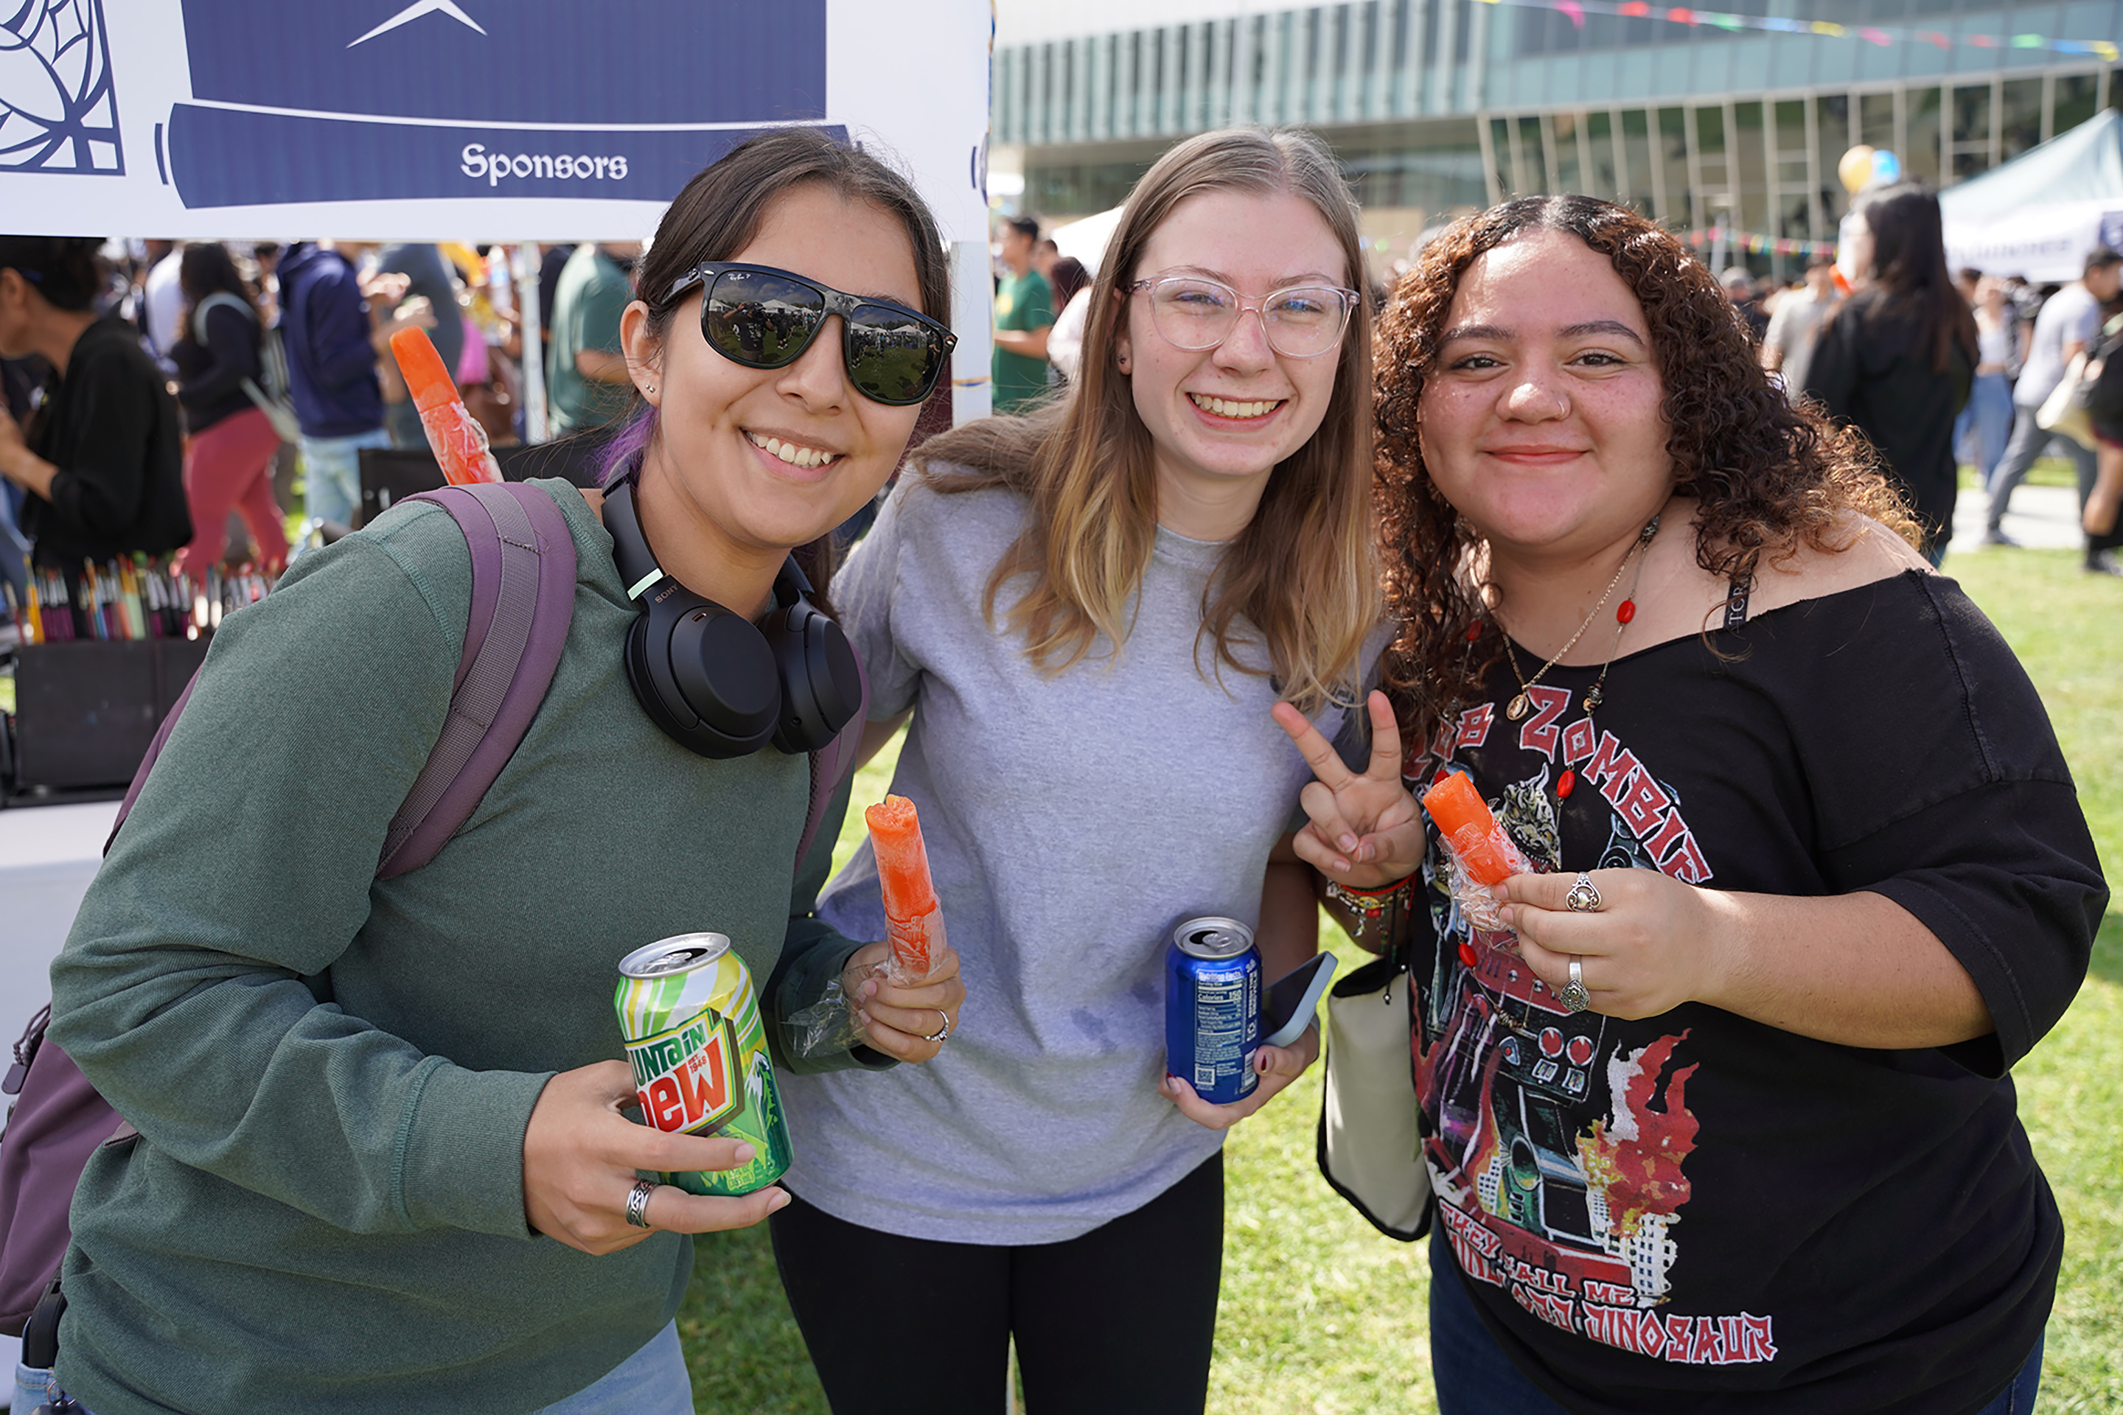
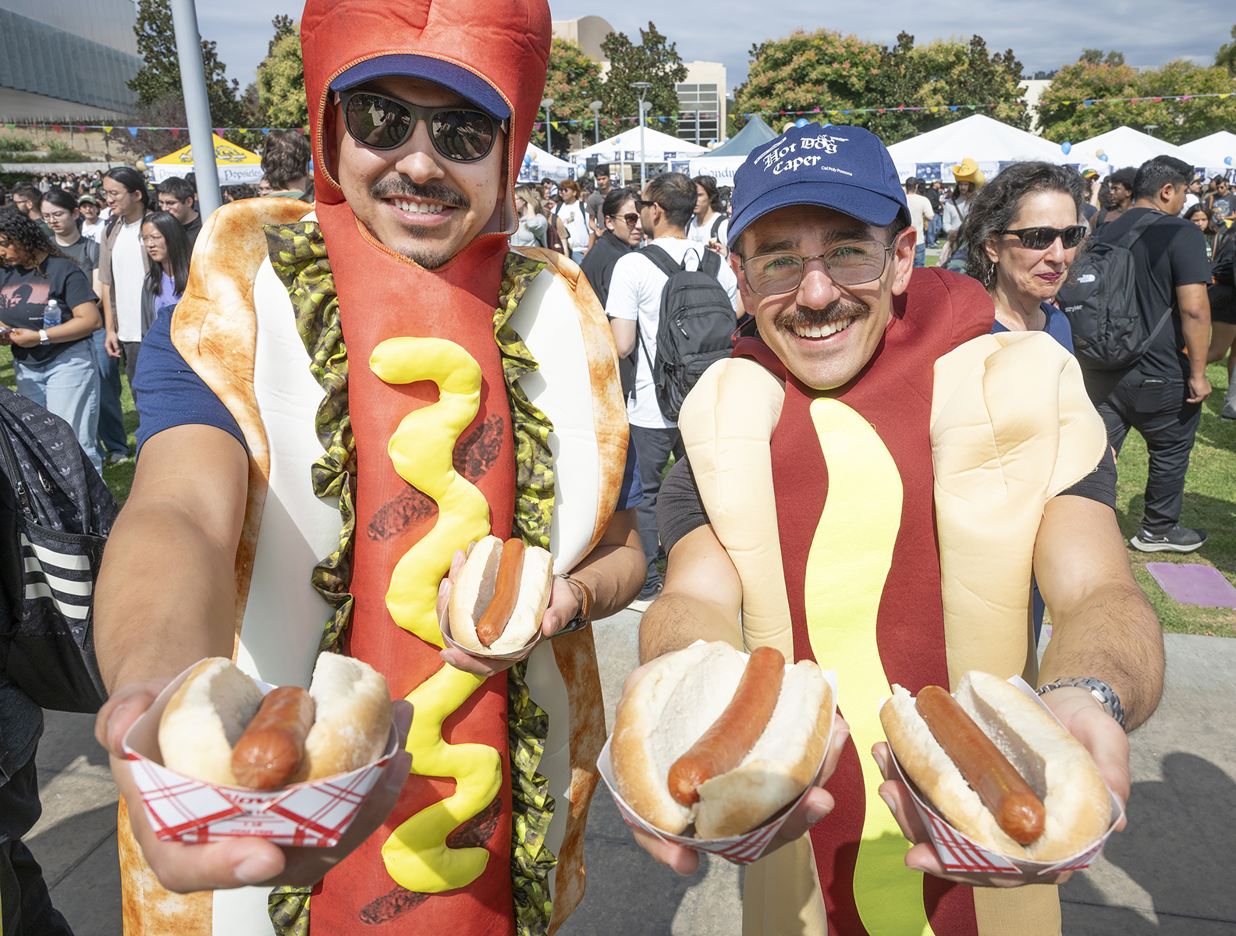
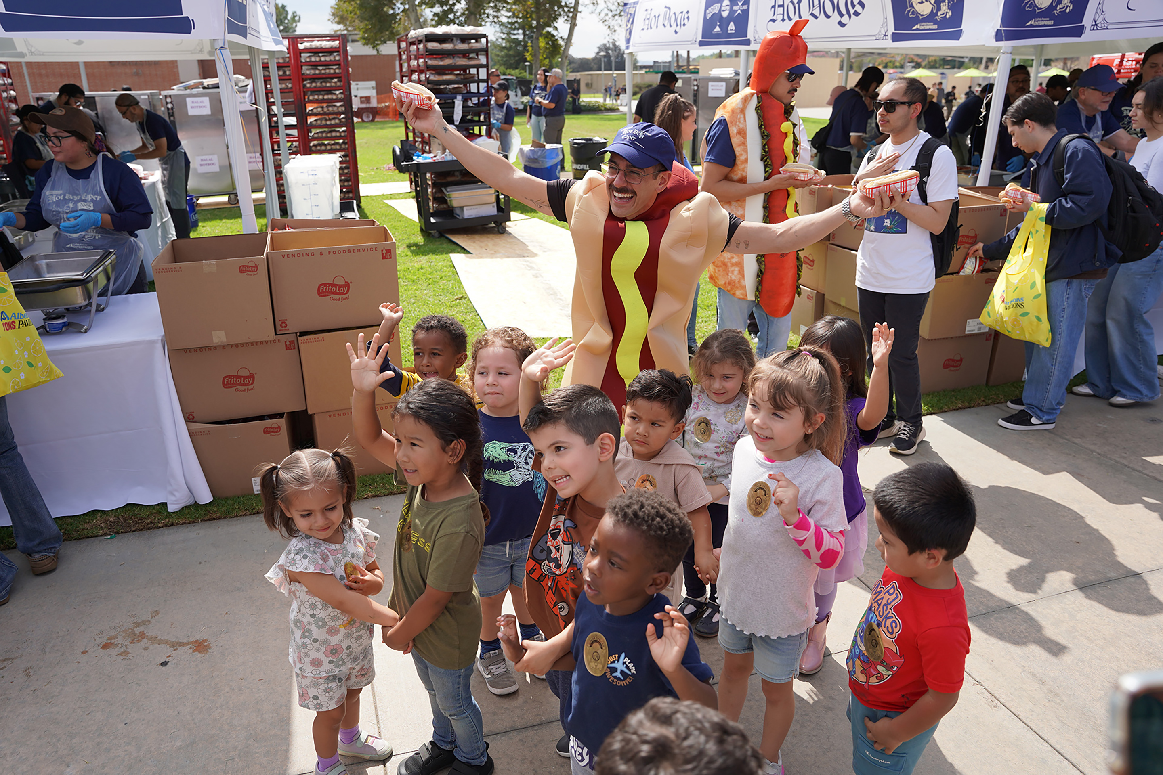
In other words…
We exist for you, for me, for us. Moving at the speed of student & industry.

Slide 4
Our Mission -
“Enhance the university and community experience through optimized solutions and resource generation that empower student success.”
Being co-curricular where applicable:
Restaurant Property Development course in Collins College of Hospitality
MSBA project within the College of Business
Micro-Internships w/CPPE HR
Apparel Merchandising and Management Collaboration
Fixing the clock on building 66!
Asking ourselves – “Does this support recruitment or retention, and generate revenue for the institution?”

Slide 5
Main Revenue Streams Include
Commercial Services Group:
CPP Dining Services
Bronco Bookstore
Kellogg West Hotel & Conference Center
CPPE Housing Services & Real Estate
2nd Year+ Student Housing (University Village and the Current Apartments)
Faculty / Staff Housing
Innovation Village
Filming
Indirect Cost Recovery
Sponsored Programs
*Agricultural Enterprises & Continuing Ed (CPGE) are considered as revenue streams, but we act as administrative oversight entity.

Slide 6
Budget Process
Our budgeting process differs slightly from the traditional process most of us are used to from the University perspective - - in that we factor in, but isn’t limited to, student economic trends, broader economic outlook, price elasticity, and anticipated university needs or budgetary constraints.
However, we are generally aligned and follow the University with a July through June fiscal year.
Budgets are largely focused around the revenues generated from the prior/current year, and assumptions we can make for the upcoming year.

Slide 7
Budget Process Cont’d
Budgeting Steps / Timeline
Operating Budget vs. Capital Budget
Budget Schedule
Division Meetings
Draft Budget
Committee and Board Approval
Submissions to University – two stages

Slide 8
Budget Process Cont’d
Budget Timeline
Tasks | December |  |  |  | January |  |  |  | February |  |  |  | March |  |  |  | April |  |  |  | May
 | WK 1 | WK 2 | WK 3 | WK 4 | WK 1 | WK 2 | WK 3 | WK 4 | WK 1 | WK 2 | WK 3 | WK 4 | WK 1 | WK 2 | WK 3 | WK 4 | WK 1 | WK 2 | WK 3 | WK 4 | WK 1 | WK 2 | WK 3 | WK 4
Capital Budget
Capital Budget kick-off
Budget Preparation (Division)
Budget Review
F&I Committee review
Board review/approval
Operating Budget
Operating Budget kick-off
Budget Preparation (Division)
Budget Meetings by Division
Draft update
Meeting with CFO/CEO
Draft finalization
F&I Committee review
Board review/approval

Slide 9
Board Approved Capital Expenditures FY25-26
ADA Related
Contractual/Legal
Deferred Maintenance
Health & Safety
Programmatic
Schedule Renewals/Security
…in general, it’s CPPE reinvesting one way into the University.
Over 70 capital projects approved by the Board last May 2025 – totaling to ~$6.3M
These projects underwent scrutiny by our Board’s Program Committee, and the Finance & Investment Committee.
About $1.6M of the total for this year was carryover from last year.

Slide 10
Budget Process Cont’d
General Budget Assumptions For Current Year - operating
Enrollment at 23,459 for FY25-26 with remaining flat up to FY30-31
Village occupancy at 95% (1,200 beds) during highest occupancy months, Current occupancy 99% with 1% credit risk allowance.
Overall inflationary increase for general expenses at 3.5%.
Compensation
California minimum wage will increase to $17.00 per hour, effective January 1, 2026 and exempt employees must earn at least twice the minimum wage or $34 per hour.
CA Fast Food Workers Min Wage at $20.00 per hour.

Slide 11
Budget
Board Approved Budget Outlook FY25/26
Total Revenues: $110.3 million ( down from $118.8M)
Total Expenses: $104.8 million (down from $108.4M)
Budgeted Surplus: $5.5 million (down from $10.4M)
“The budget remains balanced and forward-looking but may change as first-quarter revenues trend lower.”
Notes:
Commercial Services:
Revenues: 74.2M
Expenses: 67.4M
Net Income: $6.8M

Slide 12
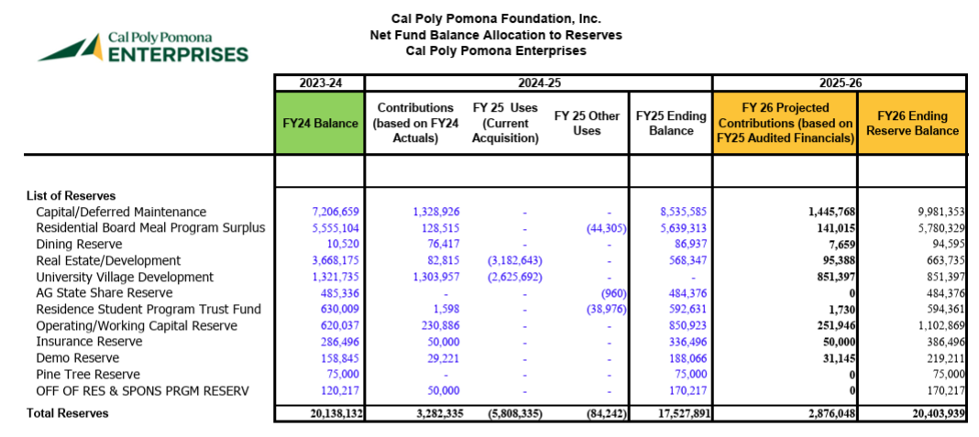
SUMMARY OF RESERVE FUNDS

Slide 13
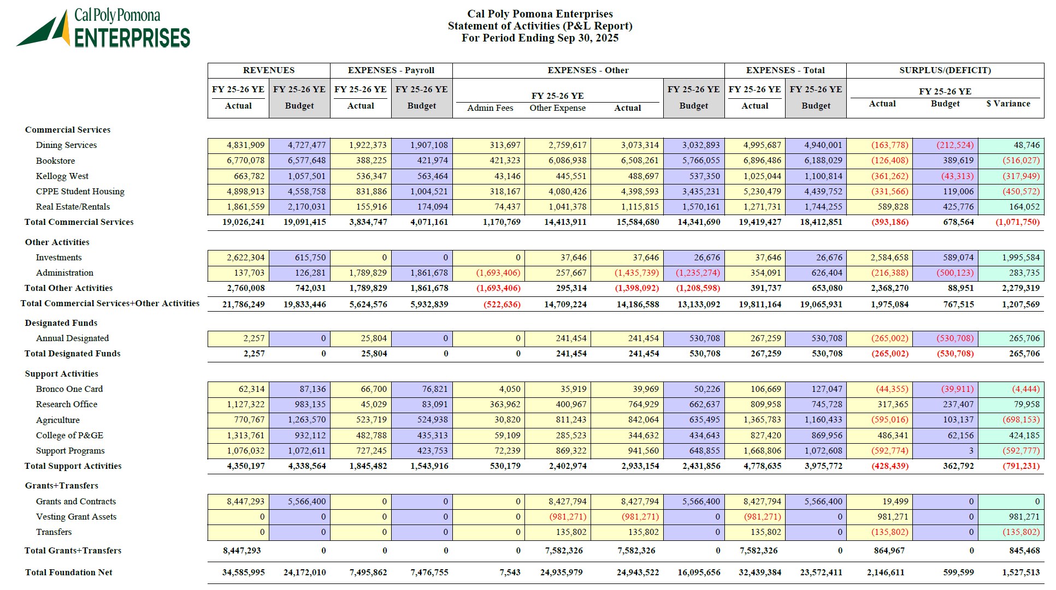

Slide 14
Q1 FY25/26 Draft Financial Results
Commercial Services
Net loss of $398k, trending $1.07M below budget.
Impact of higher costs, construction delays and vacancies.
Campus Programs
Net loss of $428k, trending $791k below budget.
Higher spending of campus programs, losses in Agriculture
Investments
Net profit of $2.6M, trending $1.9M over budget.
Unrealized = $2.3M, Realized=$70k, Dividends= $200k
“We are beating budget by $1.5M due to our investment earnings; however, our core business cost and support program spend is rising higher than anticipated"

Slide 15
Budget Process Cont’d
Assumptions largely held true with a few curve balls…
How the revenue situation is evolving this year:
The Big One – Federal Government Policy Shifts, resulting in losing a collective $3.2M opportunity in Grants & Sponsored Programs
Larger than expected publisher price increases – jeopardizing textbook and course material affordability, resulting in at least $300K in additional costs for the same textbooks & course materials.
Government Shutdown might be delaying our hotel reopening, resulting in a budgeted revenue loss of at least $100K per month.
Unanticipated vacancies (96% occupancy) and costs (turnover, repairs, financing) incurred at the Current vs our preliminary estimates.

Slide 16

- Direct Funding - Designated Gift - Program & Event Support - Indirect & Overhead Funding - Reimbursement to University - Program Subsidies - Student Compensation - Employment & Internships - Direct Student Financial Support - Scholarships & Subsidies
CPPE Financial Support to the University

Slide 17


Designated Gift
Program & Event Support
Pre-pandemic - $1M to $2M
2020-2021 (pandemic low) - $213,231
This year (budget) - $2.15M
$3.76M in filming revenue
Over $200k in programs/events
Additional $50k+ in-kind
Student Financial Support
Direct Scholarships: $50,000
Regalia partnership: $7,000
Instant Access Complete subsidy: $40,000+

Slide 18


Reimbursements & Subsidies
$11M – $15M annually
Bond payments
Building & grounds maintenance
Utilities
Scholarships & stipends
Salaries reimbursement
Revenue share
Grant Post-award “subsidy”
2017 analysis @ 11.08%
Currently receive 4.5%
Subsidy = $1.87M for 24/25

Slide 19
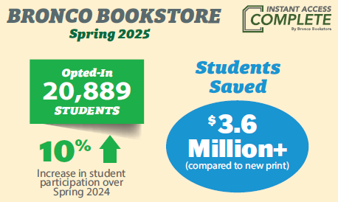
Instant Access Complete – Day One Access
This not only our program. This is an institutional program where we partner down to the faculty level to deliver adopted textbooks, and course materials to our students.
Notes:
FY23 76%,
FY24 86%,
FY25 89%

Slide 20
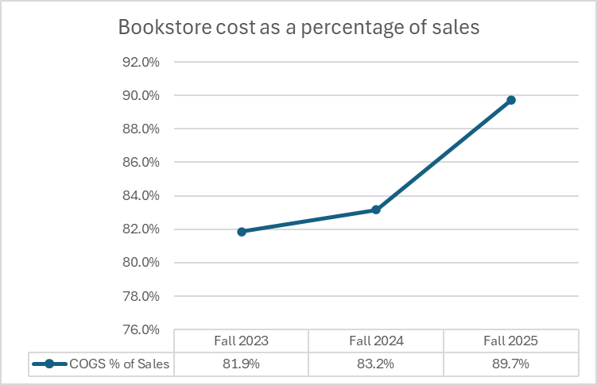
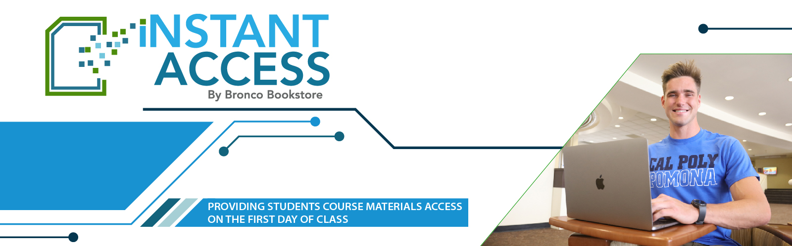
Bookstore inflationary pressures

Slide 21
Quick Take Aways & Reminders
We are a 501c3 non-profit corporation that aims to act like a for profit to optimize returns either financially or intrinsically to the University.
We exist to mitigate risk exposure to the University.
We exist to manage certain funds on behalf of the University.
We exist to provide expected campus amenities/support (Dining, Bookstore, support programs, etc.) to the University that is not funded by the State.
Therefore - - -
Take advantage of our partnership to enhance the classroom experience however we can.
Bring forward ideas for optimization of our services.
Partner with us to manage external and unanticipated changes to mitigate disruptions.

Slide 22
Thank you.
Financial Budget Presentation
Academic Senate – Budget Committee 10/29/2025

