Slide 1
Chair’s Report
December 3, 2025

Slide 2
Welcome to the November Academic Senate Meeting
Quick reminders
Senators and guests – please sign in

Slide 3
Time Sensitive Matter
AA-003-256 - Academic Calendar with 5-Year Projections
If there is a motion and a second to waive the first reading, we can consider doing so.

Slide 4
Service Opportunities
https://www.cpp.edu/senate/service-opp-new.shtml
Standing Committee Volunteer form (for At-large vacancies)
https://www.cpp.edu/senate/forms/senate-commitee-volunteer.shtml
Senator Vacancies (ENV)

Slide 5
Feedback and Suggestions are Welcome!
Executive Committee Meeting Minutes available at
• EC meeting minutes
Contact
• senate@cpp.edu
• Chair office hours Wednesdays 12 – 2 pm

Slide 6
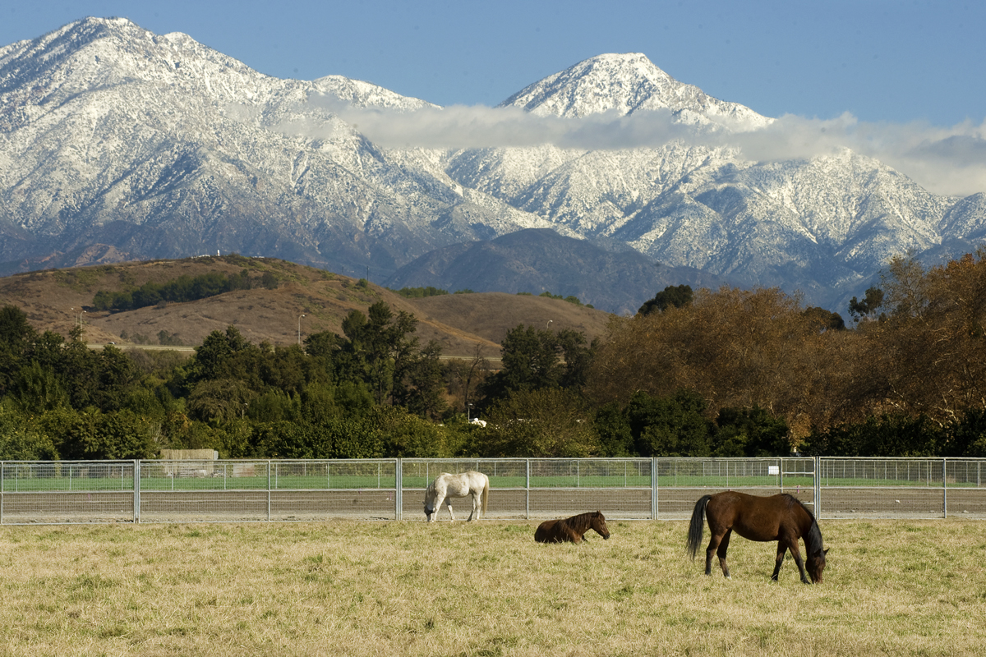
Happy
Holidays!

