Slide 1
CSU Systemwide NAGPRA Policy and Its Implications for CPP
Desireé Reneé Martinez, MA, RPA
Tribal Relations and NAGPRA/CalNAGPRA Director
Academic Senate
December 3, 2025

Slide 2
NAGPRA Update
What are NAGPRA and CalNAGPRA?
Why Is Repatriation Important?
The CSU and CPP NAGPRA Teams
CSU Campuswide Systemwide NAGPRA Policy
2025 Campuswide Physical Survey

Slide 3
What are NAGPRA and CalNAGPRA?
Native American Graves Protection and Repatriation Act (NAGPRA)
US federal law enacted in 1990.
return Native American cultural items – including human remains, funerary objects, sacred objects, and objects of cultural patrimony – to lineal descendants, culturally affiliated Indian Tribes, and Native Hawaiian organizations.
Oversight by National Park Service (National NAGPRA)
California Native American Graves Protection and Repatriation Act (CalNAGPRA)
State law passed in 2001.
return of Native American human remains and cultural items to California Indian Tribes.
Oversight by the Native American Heritage Commission (NAHC)
3

Slide 4
Why is Repatriation Important?
Acknowledges the long history of the discriminatory treatment of Native Americans, their remains and cultural items
Acknowledges the scientific mis-use of Native American human remains and cultural items
Acknowledges the removal without consent of Native American Tribes
Protects civil and human rights

Slide 5
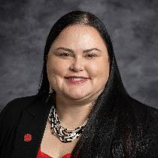



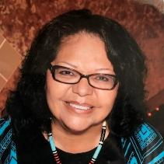
The CPP NAGPRA/CalNAGPRA Team
The CSU NAGPRA/CalNAGPRA Team
Samantha Cypret
Adriane Tafoya
Executive Director, Tribal Relations
CalNAGPRA/NAGPRA Project Manager
Nicole A. Hawkes
Desireé Martinez
Sandy Dixon
Vice President and Chief of Staff
President’s NAGPRA Designee
Tribal Relations and NAGPRA/CalNAGPRA Director
Tribal Liaison NAGPRA Campus Committee Member

Slide 6
Systemwide NAGPRA Policy Development Timeline
Late 2023- June 2025
August –Oct. 2025
October 2023
July 1, 2025
Nov. 12, 2025
CalNAGPRA Update Required CSU To Adopt A Systemwide NAGPRA Policy By July 1, 2025
Work Group Creates Draft Policy
Initial Tribal Outreach Sessions and Consultations
Adopted Interim Systemwide NAGPRA Policy
NAHC Requested Additional Tribal Consultation Period
Additional Tribal Outreach Sessions and Consultations
Incorporate Feedback
Final CSU Systemwide NAGPRA Policy
nagpra.calstate.edu/csu-policy

Slide 7
Policy Sections
Scope and Purpose
Policy Statement
Definitions
Note on Language
Background
Guiding Principles
CSU Systemwide Oversight and Responsibilities
CSU Campus Oversight and Responsibilities
Compliance
  Responsibilities
  Prohibition on Teaching and Research
  Duty to Safeguard and Protect Native American Human Remains and Cultural Items
  Campus Searches
  Missing, Loans, and Reunifications
  Field Schools
  Hazardous Substance Contamination Histories
  Tribal Outreach and Communication
  Consultation
  Confidentiality
  Cultural Affiliation
  Inventories and Summaries
  Repatriation and Repatriation Time Frames
  Appeals
  Reburial
  Tribal Requests: Research and Testing, Acceptance of Collections, Request for Assistance and Held-in-Trust Requests
  Agency, Institution and Private Holdings and Collections
  Deaccession and Voluntary Deaccessioning
Tribal Requests: Research and Testing, Acceptance of Collections, Request for Assistance, and Held-in-Trust Requests
Noncompliance Enforcement
Policy History and Updates
Resources

Slide 8
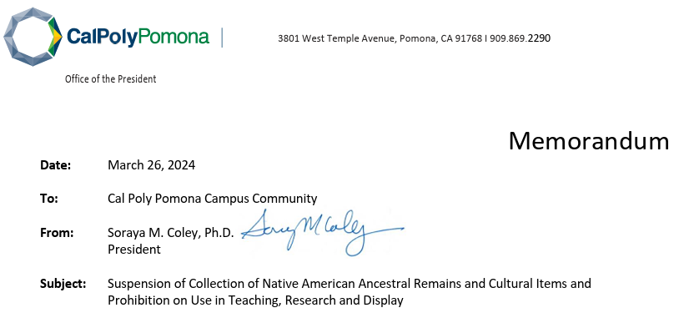
Prohibition on Teaching and Research

Slide 9
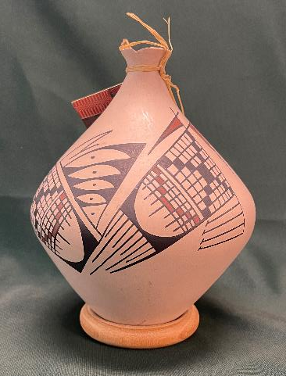
Prohibition on Teaching and Research
"Obtain free, prior, and informed consent from lineal descendants, Indian Tribes, or Native Hawaiian organizations prior to allowing any exhibition of, access to, or research on human remains or cultural items.
Research includes, but is not limited to, any study, analysis, examination, or other means of acquiring or preserving information about human remains or cultural items.”
Any potential Human Remains and Cultural Items that have unclear provenance or provenience information must not be used for teaching or research.
As a best practice, obtain free and informed consent in writing from lineal descendants, all culturally affiliated or potentially culturally affiliated federally recognized Indian Tribes or NHOs before using, reproducing, or distributing images or replicas of Human Remains or Cultural Items that are or were in campus holdings or collections.

Slide 10
No New Collections
“…campuses must not create, accept, or acquire new holdings or collections that contain or may contain Human Remains or Cultural Items”.
The CO and all campuses must review their policies for alignment with NAGPRA/CalNAGPRA
  CSU Systemwide Art Collection Management Policy
  Philanthropic Foundation Gift Policy
  College of Environmental Design Donation Policy for Gifts of Art to the University Permanent Collections
  Police Policy (Policy 343; regarding response to human remains on)
Contact NAGPRA/CalNAGPRA Director for review and recommendations on potential collection donation

Slide 11
Field Schools
Campuses shall not initiate any field school on any site identified as a sacred or burial site or place of cultural significance as determined by a California Indian Tribe.
“Any short-term academic program or course with a field work component that involves any ground-disturbing activity, led, assisted and/or supervised by CSU faculty or staff, that takes students or non-CSU affiliated individuals into the field to conduct research in a specific discipline (e.g., archaeology, geology, paleontology, environmental studies, marine biology, anthropology and geography).”
“Ground-disturbing activity: Ground-disturbing activities shall include, but are not limited to, moving dirt or rock with heavy equipment or hand tools, demolition, pavement removal, potholing, augering, grubbing, tree removal, boring, grading, excavation, drilling, and trenching”.

Slide 12
Field Schools- Tribal Consultation
“Campuses must engage in meaningful consultation with culturally affiliated or potentially culturally affiliated Indian Tribes and California Indian Tribes without federal recognition prior to initiating field schools or conducting any activities related to field schools that involve Tribal ancestral territories, cultural resources, or areas of potential Tribal significance.”

Slide 13
Why Consultation?
Consultation ensures Tribal perspectives, concerns, and cultural protocols are respected and incorporated into the planning and execution.
Consulting parties may reject or approve of a campus's proposed field school.
Failure to conduct Tribal consultation and provide proper documentation may result in the suspension or cancellation of field school activities.
Process may take 1-6 months. Plan accordingly.
Contact NAGPRA/CalNAGPRA Director for review and consultation guidance.

Slide 14
Noncompliance
NAGPRA Law States:
Civil penalties can be applied broadly to the entire NAGPRA process.
Base penalty of $7,475 per incident but can be more based on the ceremonial, cultural, archaeological, historical or commercial value of the materials involved, as well as the damages (economic and otherwise) suffered by direct descendants.
CSU NAGPRA Policy States:
Any CSU employee in violation of repatriation laws will be subject to disciplinary actions under state and federal law, criminal and civil law, and collective bargaining agreements.

Slide 15
2025 Campus Physical Survey
1250
Responses received as of 12/2/2025
Conducted from November 3-December 1, 2025. Responses submitted by online form.
POCs from each college/division appointed
No Native American human remains identified on campus
New cultural items identified and undergoing review
Survey to be conducted annually.
Cultural Items controlled by CPP (before this survey)
197
Cultural Items controlled by other entities (before this survey)
69

Slide 16
Questions?
Desireé Reneé Martinez
Tribal Relations and NAGPRA/CalNAGPRA Director
drmartinez2@cpp.edu
(909) 997-3005

