Slide 1
3D Printing Orientation and Guide
Student Innovation Idea Labs
ilab@cpp.edu

Slide 2
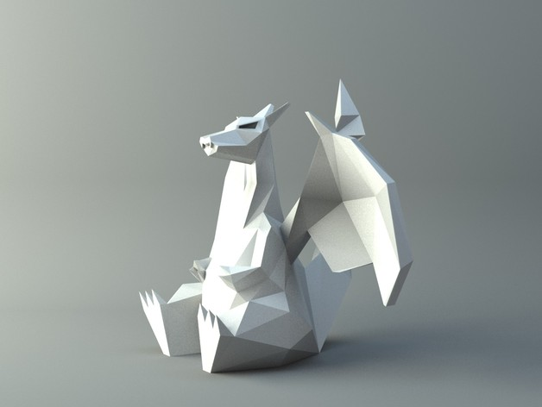
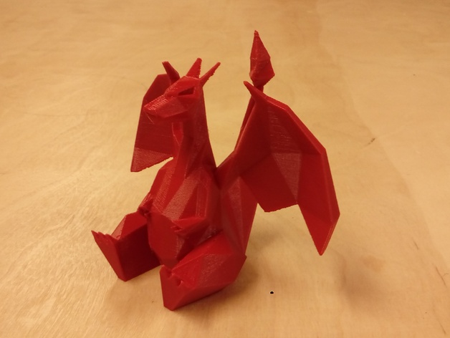
What is 3D Printing?
Notes:
Ask Majors and prior knowledge to 3D printing
Take 3D file (cad, etc) make it into a physical object
3D printing is marketed so you can print anything, which is true, but there are some basic tricks/ a little bit of a learning curve to each type of 3D printing

Slide 3
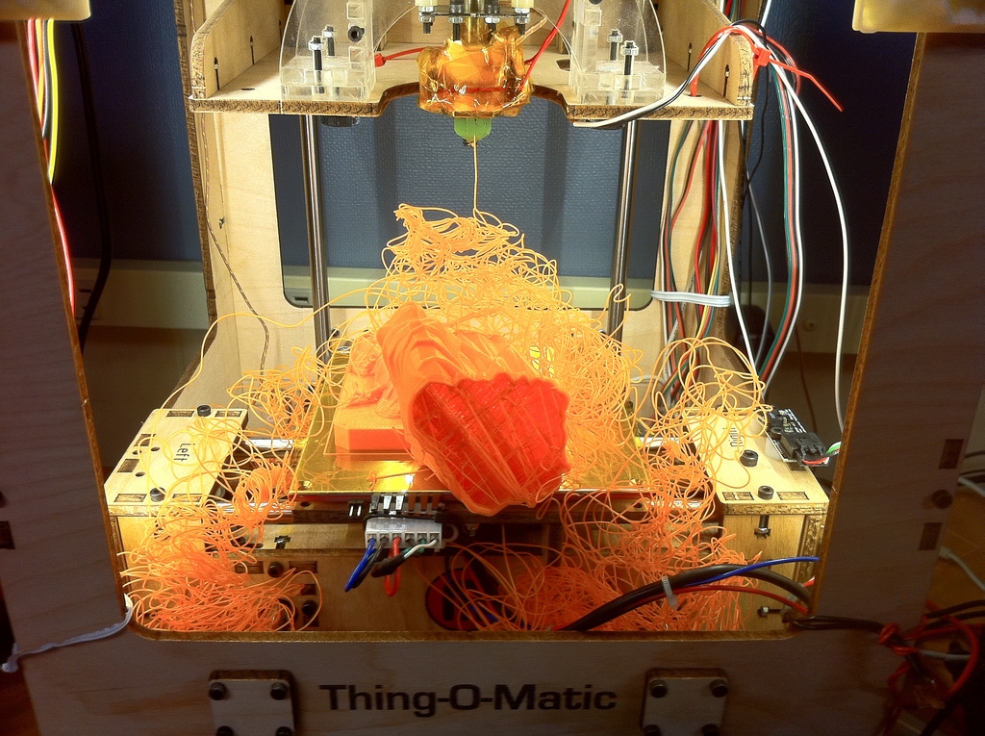
Notes:
When I first printed i got a bowl of spaghetti
Simple tricks to ensure the success of your 3D prints

Slide 4
Topics to Help You Succeed in 3D Printing
5. How FDM/FFF Printing Works
6. Types of Filament and Uses
7. Printable Type Files
8. Cura Slicing Software
9. Positioning of a Print
11. Support material
12. Layer Height
13. Bed Plate Adhesion
14. Infill
15. Wall Thickness
16. Tolerances
17. Hardware Issues
18. Cura

Slide 5
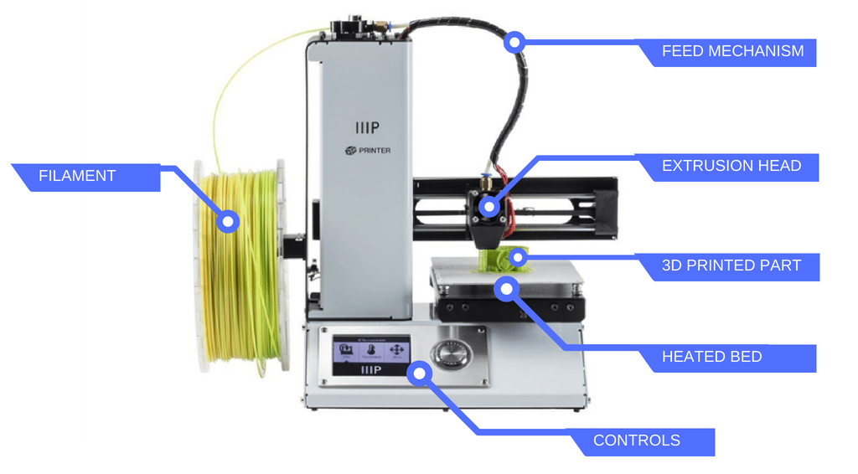
How FDM/FFF Printing Works

Slide 6
Types of Filament and Uses
 | PLA (Polylactic Acid) | ABS (Acrylonitrile butadiene styrene) | PETG (Polyethylene Terephthalate “glycol-modified”) | TPU (Thermoplastic polyurethane)
Difficulty to use | Low | Medium | Low | Medium
Printers | Monoprice, Ultimaker, Craftbot | Ultimaker, Craftbot | Ultimaker, Craftbot | Craftbot
Pros | Easy to Use | Acetone Soluble, Heat Resistance (100 C) | Layers Weld Together Well | Flexible
Cons | Brittle, not Heat Resistant (50 C) | Warping/Shrinkage, Best in Enclosure | Lower Heat Resistance (80C) | Hard to print on Bowden Tubes
Temperature | 180°C – 220°C | 210°C – 250°C | 220°C – 250°C | 210°C – 230°C
Bed Temp | 20°C – 60°C (Optional) | 80°C – 110°C | 50°C – 75°C | 30°C – 60°C (Optional)
Notes:
ABS: Can use acetone vapors to smooth of finishes very nicely

Slide 7
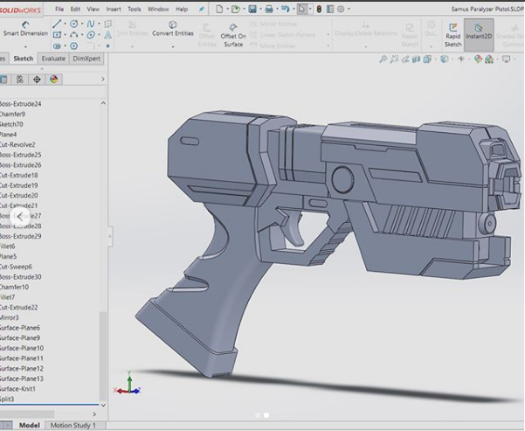
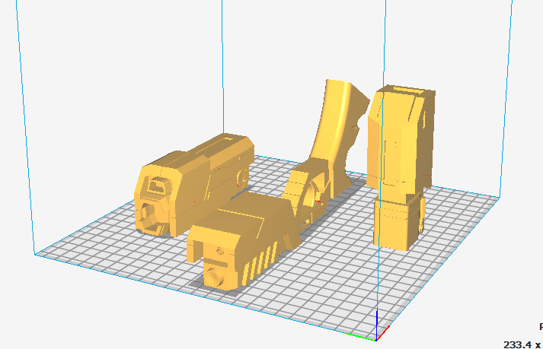
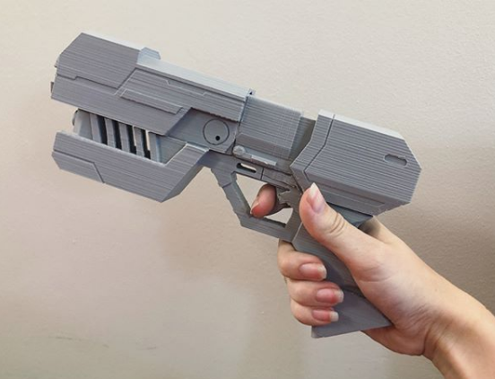
Printable Type Files
Notes:
STL: Stereolithography, triangles
OBJ:Object
X3D & 3MF(MFE) : Specified obj files
GCODE: Computer numeric control machines MUST BE GCODE TO PRINT

Slide 8
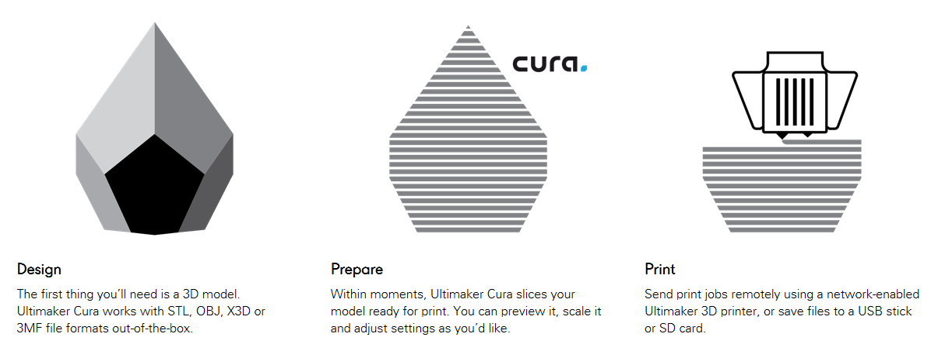
Cura Slicing Software
Notes:
Everything after this slide is Cura settings

Slide 9
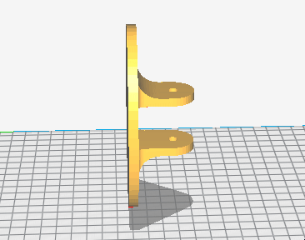
Positioning of a Print
Most Surface Area
No Islands
No Overhangs
May Need to Split Part
Notes:
Island: Seperate Part
Overhang: Greater than 45 degree angle

Slide 10
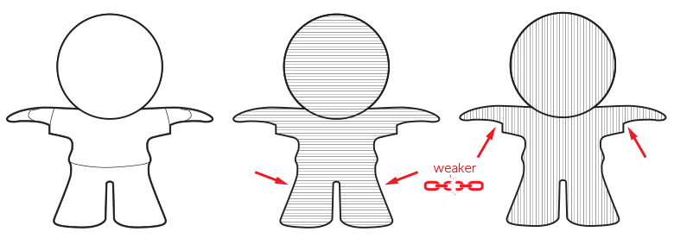
Notes:
Orientation affects strength

Slide 11
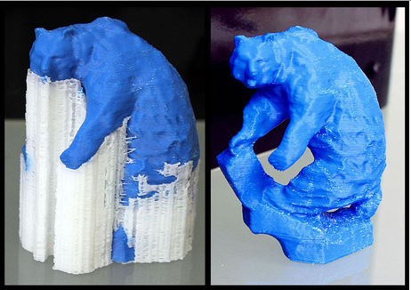
Support Material
Usage:
No Ideal Positioning
Floating parts
Overhangs/Islands
Organic parts
Cons:
Hard to Remove
May Break Part
Cosmetics
Notes:
Clear supports = PVA, water dissolvable filament

Slide 12
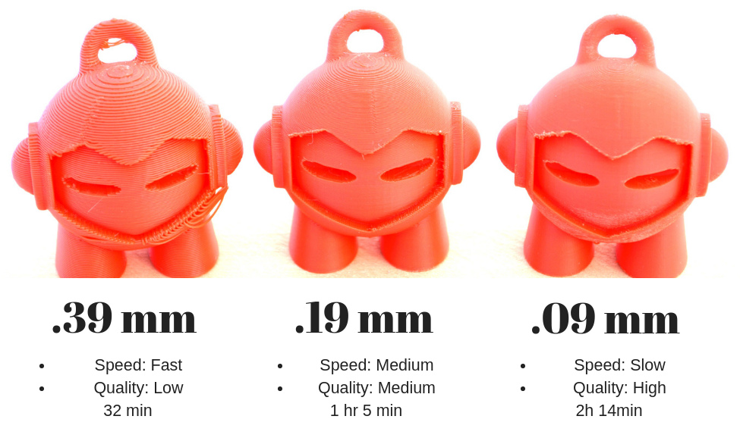
Layer Height/ Resolution
Note: I usually use .1 mm, .2 mm, or .3 mm
Notes:
Oddly specific settings due to my own laziness not wanting to print the Mavin 3 times for 3 and a half hours
-Based off a less customizable slicer than cura. Only given fine, medium, and coarse

Slide 13
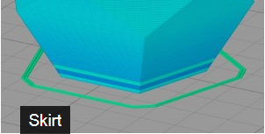
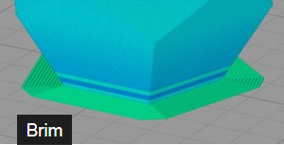
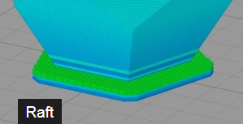
Bed Plate Adhesion
Uses:
helps prime your extruder
establish a smooth flow of filament
Filament use: Light
Print Speed: Fastest
Separation: N/A
Uses:
holds down the edges of your part
can prevent warping
helps with bed adhesion
Filament use: Medium
Print Speed: Fast
Separation: Easy
Uses: ABS Filament
helps with warping and bed adhesion
helps stabilize models with small footprints
creates a strong foundation
Filament use: High
Print Speed: Medium
Separation: Medium
Notes:
Raft to Skirt
Brim on non heated bed

Slide 14
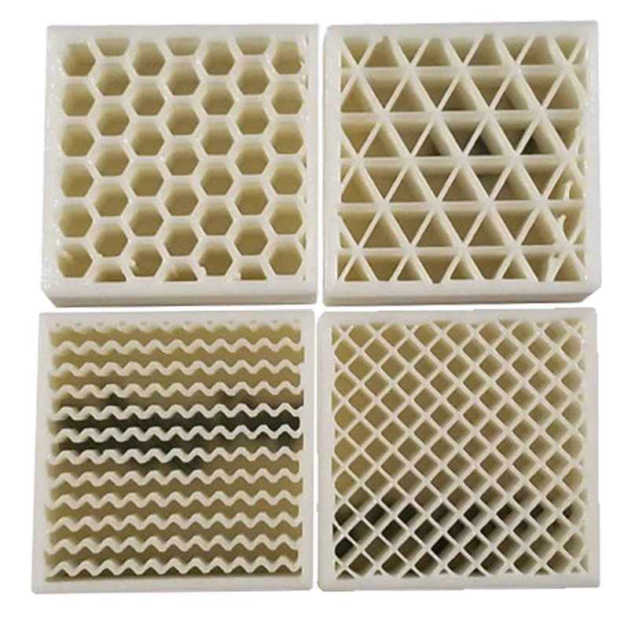
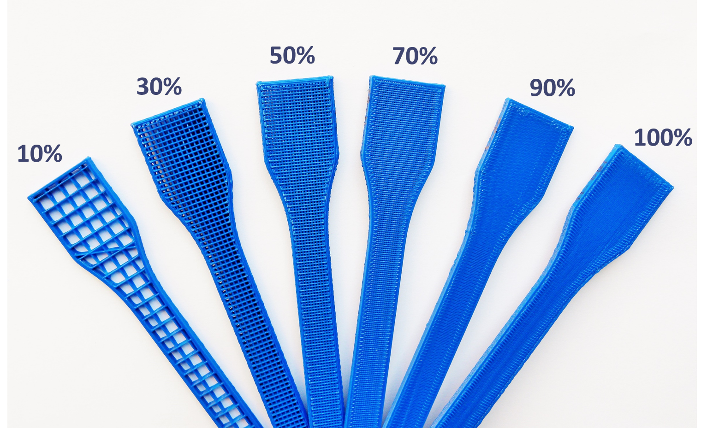
Infill
Choose the Shape of the Infill
Grid- easiest infill patterns to print
Triangular - High strength in the direction of the shell.
Zig zag-Great to use for flexible materials.
Honeycomb-greater overall strength in all directions than a rectangular pattern
Save on plastic and materials
Choose the Density of the Print
Higher percent takes more time
Higher percent = more strength
Notes:
Another important settings

Slide 15
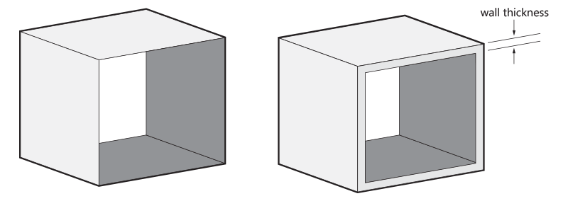
Wall Thickness
Most Printers: .4mm Nozzle => Multiples of .4 optimizes print time
.8mm
Mediocre Strength
1.2mm
Strong, Time Consuming
1.0mm
Same time as 1.2mm, not as high of strength
Notes:
Multiple of 4mm

Slide 16
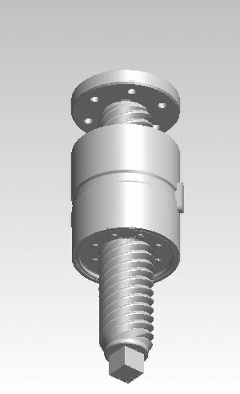
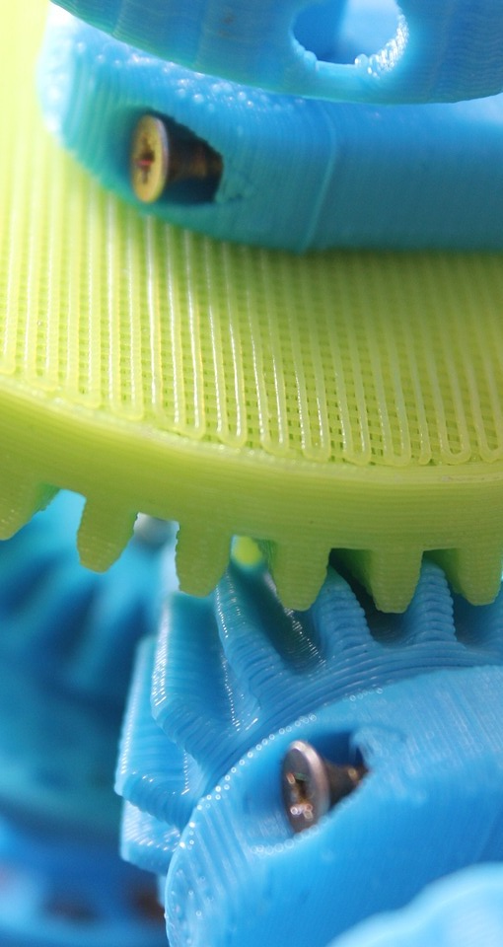
Tolerances
Printers are not 100% accurate to the model
Parts with interferences/interactions
Parts for exact dimensions
Combined Parts
Different for Every Printer
± .3 - .5 mm Safety
Notes:
Pls don’t print screw, who uses plastic screws
Gears are usually okay if printed at high quality (careful of elephant’s foot though!)

Slide 17
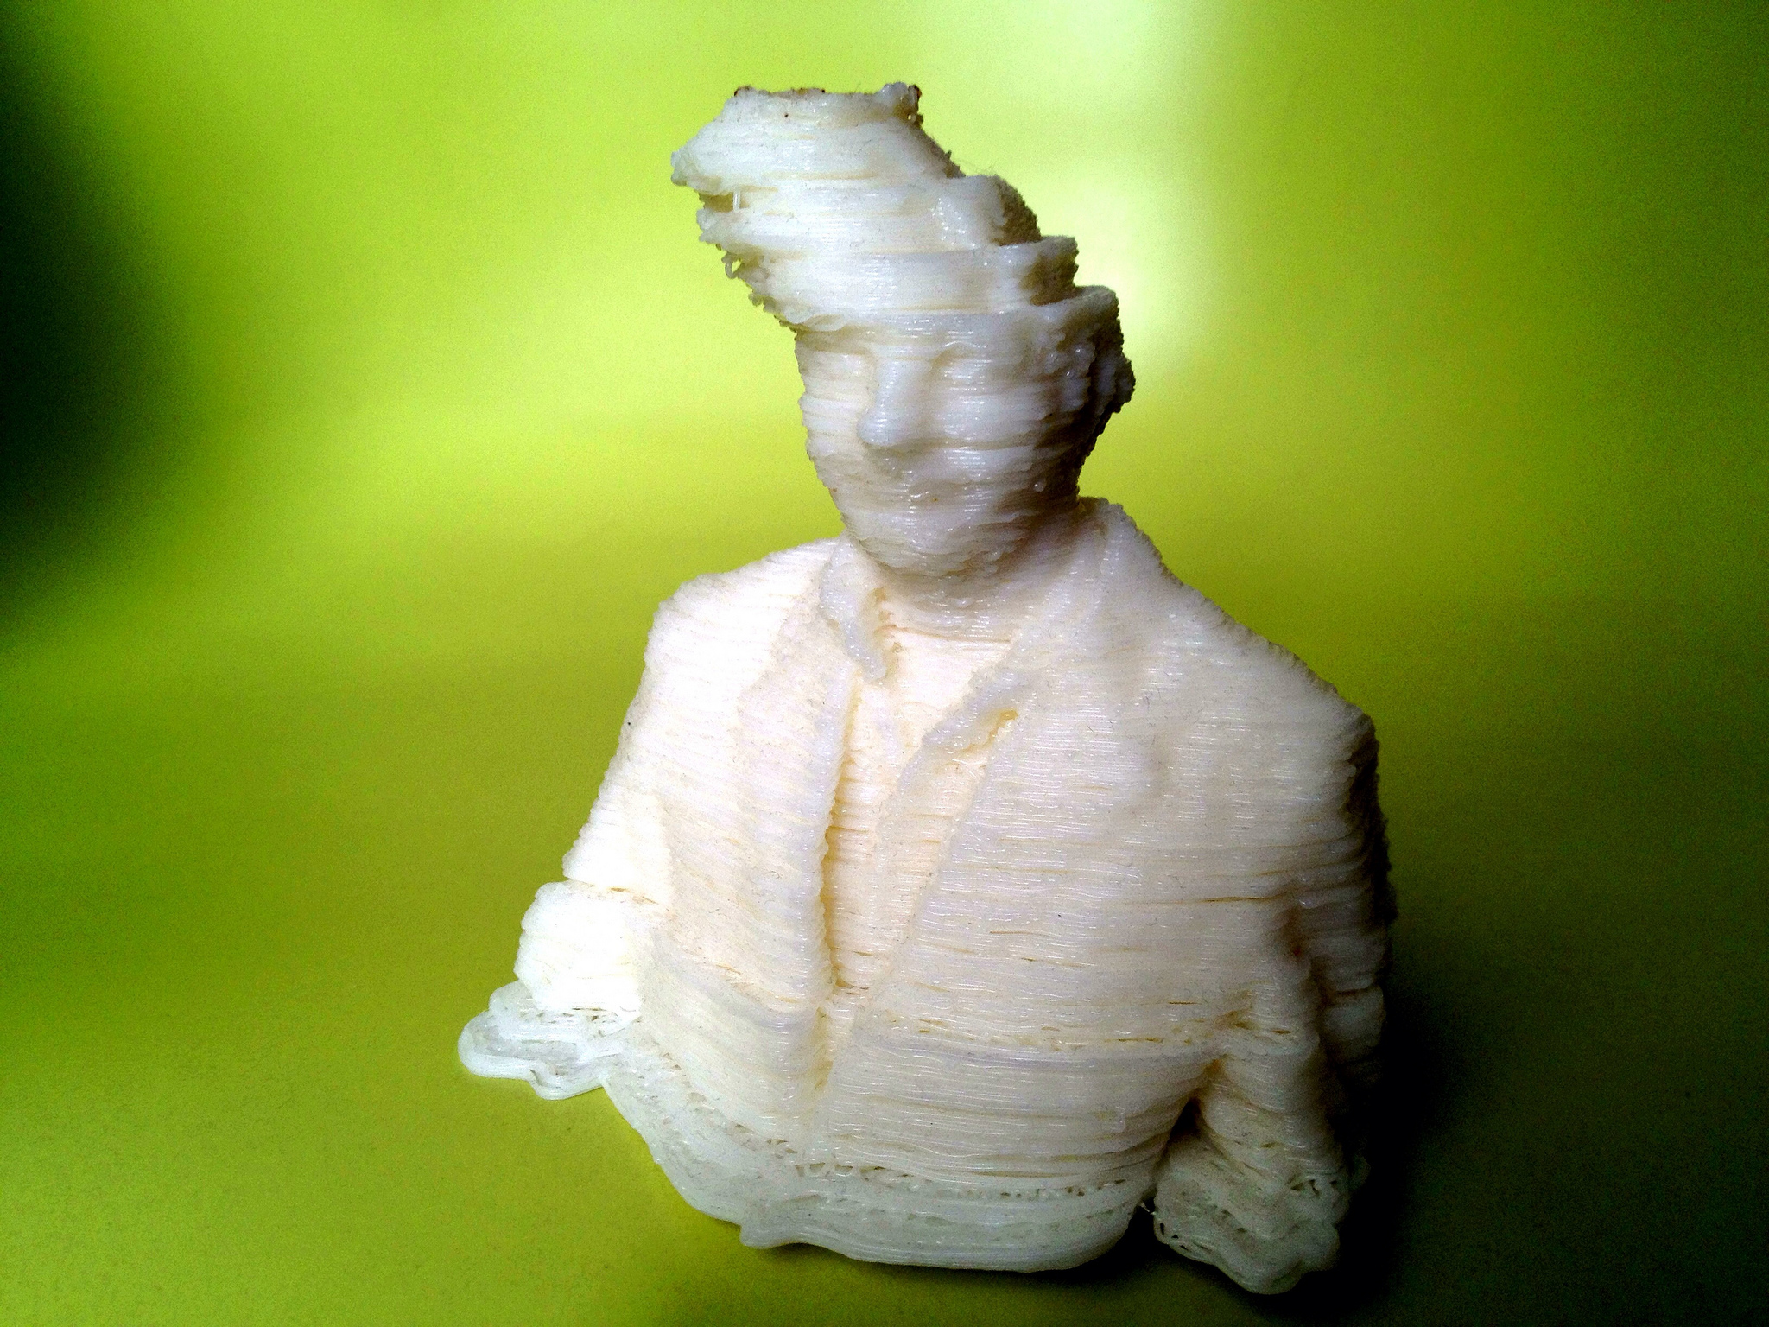
Hardware Issues
Bed Leveling
Clogged Extrusion Head
Moisture in Filament
Broken/ No Filament
Electrical
Cancel Button
Problems with Preheat/Starting Print
Micro SD cards
Other Issues Guide
Notes:
If any problem, feel free to email me: jcvalenti@cpp.edu

Slide 18
How to use Cura
Set up printer
Other: Monoprice Select Mini (V2)
Change Print Setup
Recommended to Custom
Adjust all of the settings to fit your part
Click Prepare to Slice your part
(if a time is already showing up than it may have auto-sliced)
Plug in a MicroSD/SD card with the converter
Click “Save to Removable Drive”
Plug in the MicroSD or SD card into the 3D printer
Press Print!
Notes:
USE THIS TO SET UP CURA!!!

Slide 19
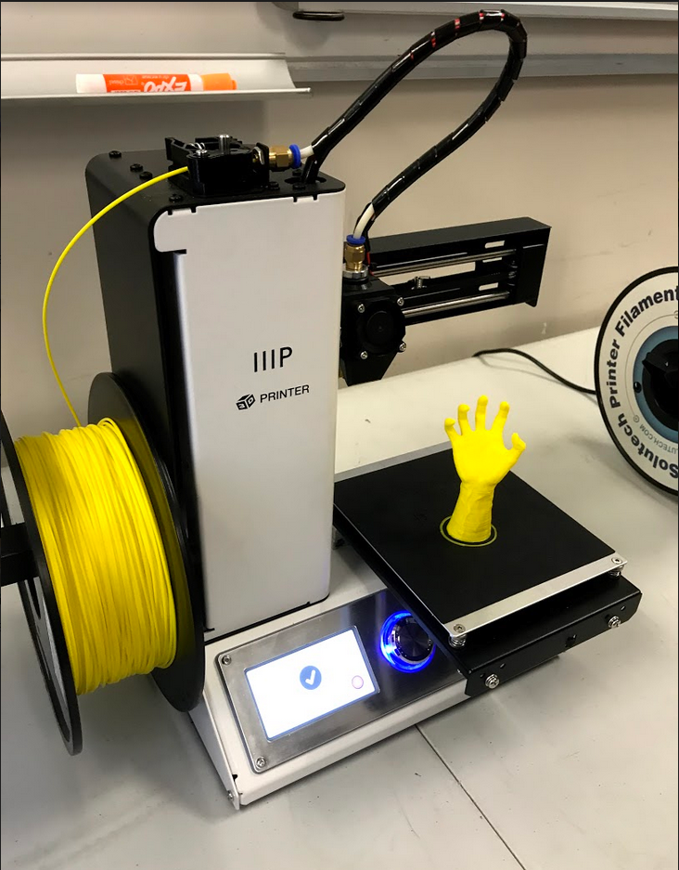
Test Your Knowledge!
Find a CAD file that you want to print
If you do not have a modeled file you can find one on Thingiverse.com
Import the .STL file to Cura
Adjust Cura settings for ideal print
Change your settings to the right 3D printer
Change the print to ideal positioning
Do you need any brims or support?
Choose infill density
Slice (make sure it’s within the time limit)
Import the .gcode onto a sd card
Print!
Notes:
A checklist if you want one of what you need to check to print ^^

