Slide 1
September 19, 2016

Slide 2
Strategic Planning Impetus
Occasion to develop a roadmap for the institution, particularly following recent additions to leadership team Additional benefits: Articulate a unified mission and vision Help prioritize finite resources through alignment with strategic planning goals and priorities Motivate processes for academic excellence, growth, efficiency, and impact Synchronize with Campus Master Plan and Academic Master Plan

Slide 3
Strategic Planning Approach
Process Design and Planning
Stakeholder Engagement
Identification of Strategic Issues & Opportunities
Development, Refinement, and Socialization
1
2
3
4
On-going input from the University community

Slide 4
Stakeholder Engagement Effort
Strategic Planning Website
Students and Parents
Faculty, Chairs, & Other Academic Leaders
Staff and Administrators in Other Divisions
Alumni
Interviews with leaders at other institutions and government representatives

Slide 5
Website Submissions
Community Members, Employers and Others 2.1%

Slide 6
Findings: Mission Statement Resonance
Mission Statement
“To advance learning and knowledge by linking theory and practice in all disciplines, and to prepare students for lifelong learning, leadership and careers in a changing multicultural world.”
Does this mission statement resonate with you?
Why Not?
Should be more distinctive or inspirational
Should emphasize learn-by-doing
Multicultural seems outdated
Make more concise

Slide 7
Findings: Core Values Resonance
Looking forward to the next 5 years, please rate each core value in terms of the extent to which it will represent the distinct identity of Cal Poly Pomona.
5-point scale where 5 means the value represents CPP’s distinct identity perfectly
88%
86%
79%
70%
64%
63%

Slide 8
Next Steps
Revisit mission statement and values Determine representative strategic options and priorities and unifying vision statement Draft strategic plan Solicit and incorporate feedback Seek leadership approval of plan

Slide 9
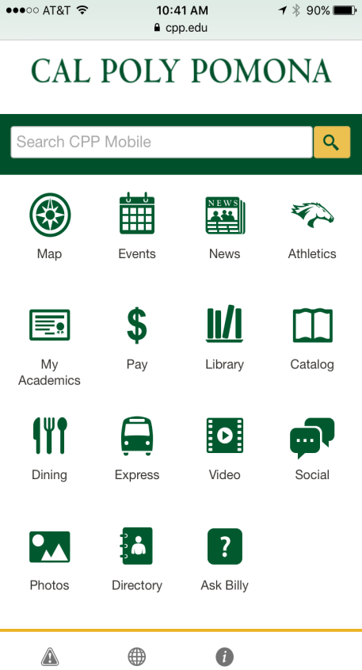
Navigate to m.cpp.edu to complete a brief questionnaire.
Conference Survey

