Slide 1
Administrative Fund Workshop

Slide 2
Purpose
The Administrative Fund is established annually to support Cal Poly Pomona student clubs, organizations and individuals with outreach programs and student activities including conference attendance, training, and workshops.

Slide 3
Sponsorship
Office of the President
Division of Academic Affairs
Division of Administrative Affairs
Division of Information Technology
Division of Student Affairs
Division of University Advancement

Slide 4
Group Applications
Currently chartered with OSL
ASI account in good standing
Copies of travel documents requested by the committee must be turned into VPSA
Reimbursement of all expenses will remain through ASI
Maximum award $1,000
Note: Visit ASI Financial Services for funding information & travel documents required for ASI

Slide 5
Individual Applications
Currently registered and in good academic standing (cumulative GPA of 2.0 or above)
Travel documents must be turned in within two weeks of return date to Office of VP for Student Affairs
Maximum award $1,000
Note: Requests from multiple individuals attending the same event will be treated as a group request

Slide 6
Group & Individual
Event/activity must take place within stated deadline
Faculty/staff advisor must sign application
Individual and group contribution & funding from other sources desirable
Evaluation is due within two weeks after event takes place

Slide 7
Not Eligible
Study abroad programs
Student group dances
Leadership retreats and banquets
Religious or political events
Job-related events for student asst.
Instructionally Related Activities (IRA)
Fundraisers
Class or senior projects

Slide 8
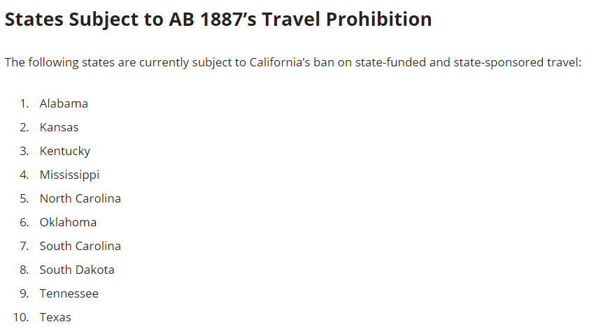
Banned States

Slide 9
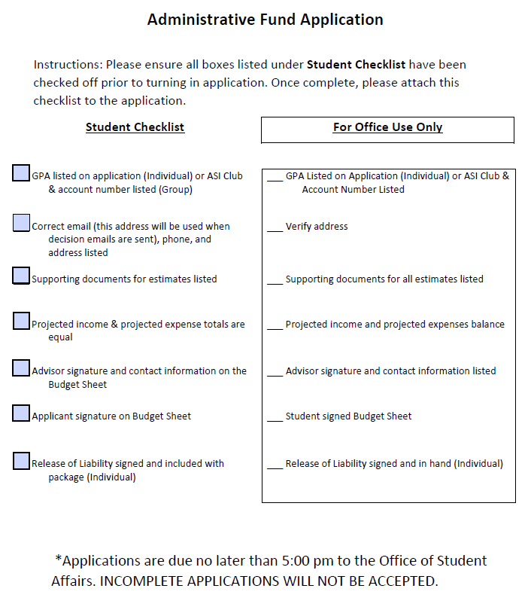

Slide 10
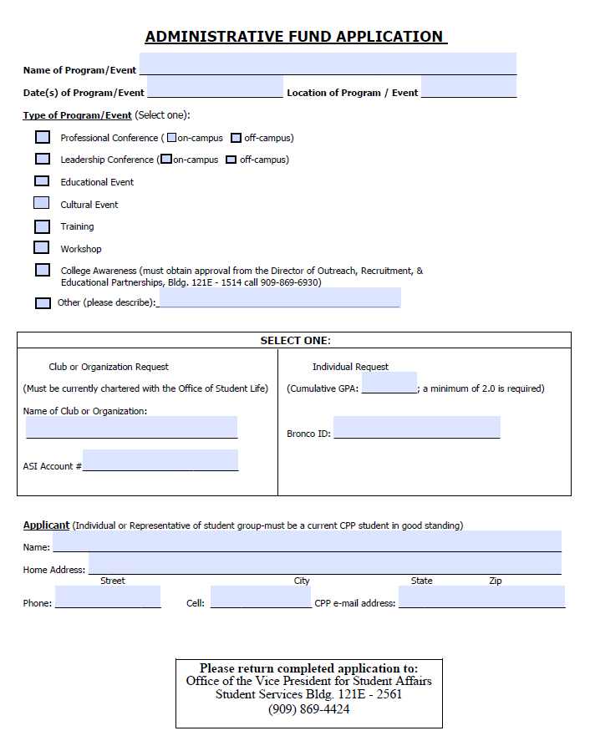

Slide 11
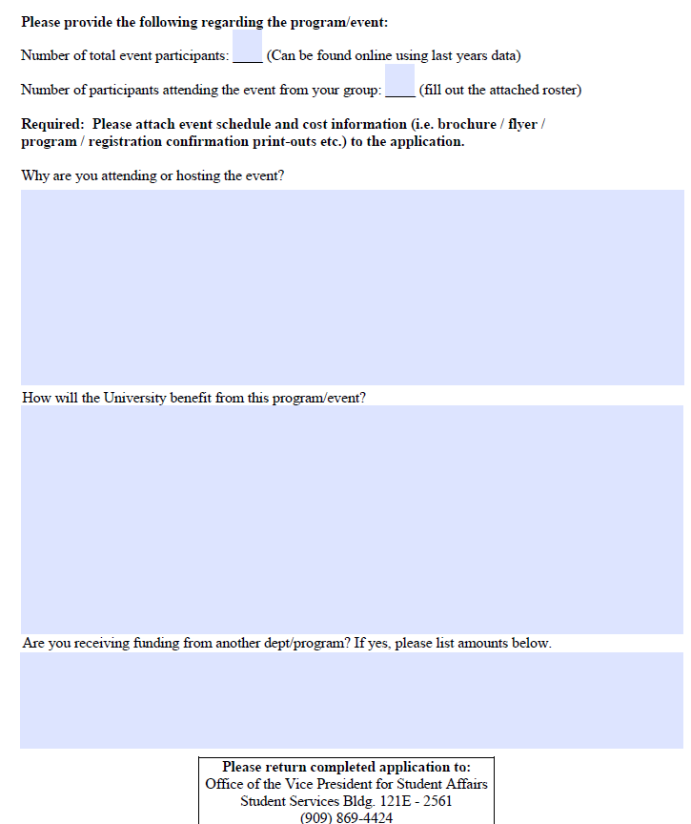

Slide 12
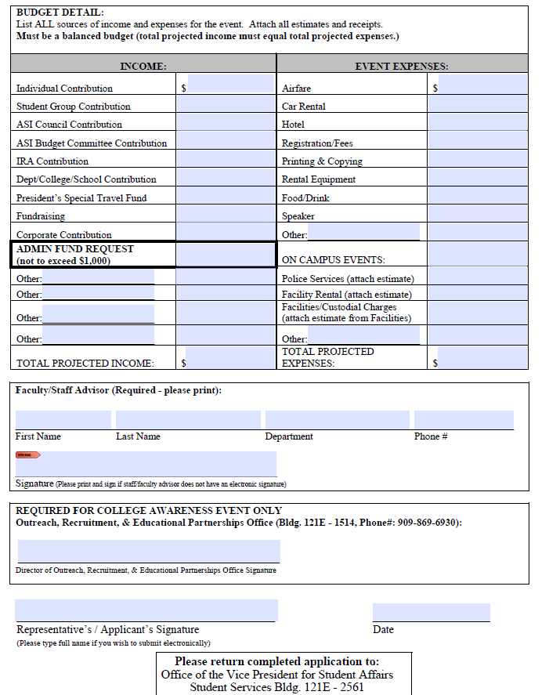

Slide 13
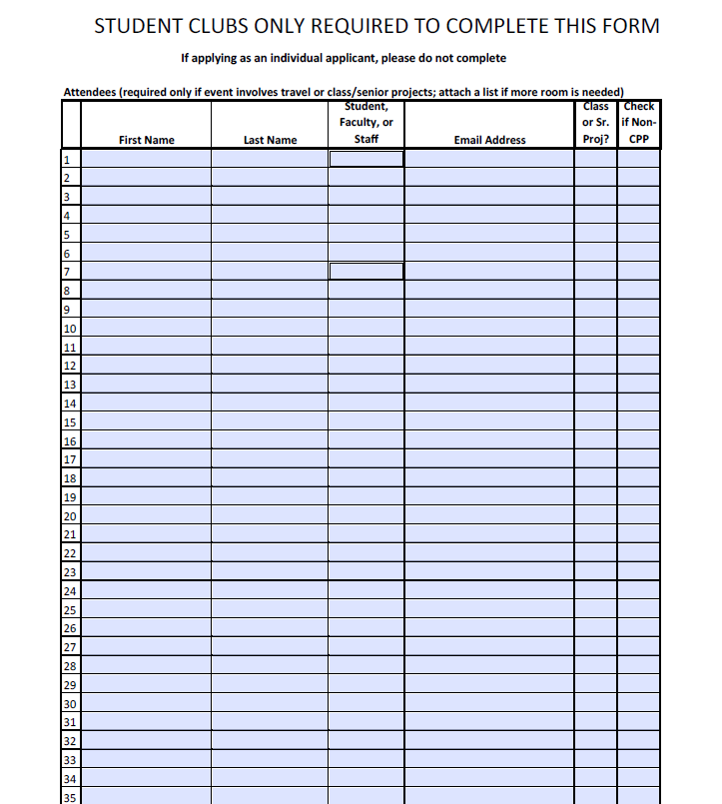

Slide 14
What we look for
How do you benefit from the event
How does the University benefit from the event
Supporting documents provided(flyer, conference schedule, travel estimates)
Funding from other sources
Budget balanced and showing a need

Slide 15
Timeline
Committee meets to make decisions about one week after deadline
Notifications are emailed out to the CPP address provided
Travel reimbursement meeting within two weeks of return
requests will receive funding after submission of all required travel documentation

Slide 16
Travel Requirements
Travel Expense Claim with original receipts
Lodging: receipt/folio showing zero balance
Airfare: Itinerary
Rental Car: Receipt showing zero balance
Conference Registration, agenda, flyer
Validation of your attendance/course material

Slide 17
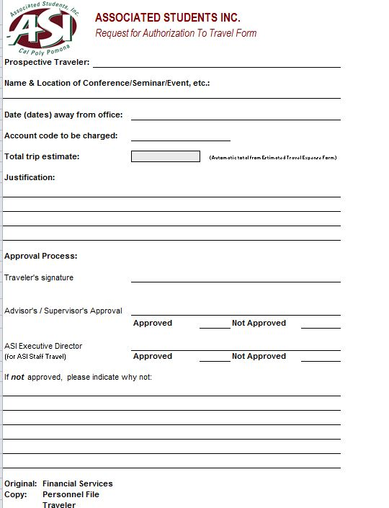
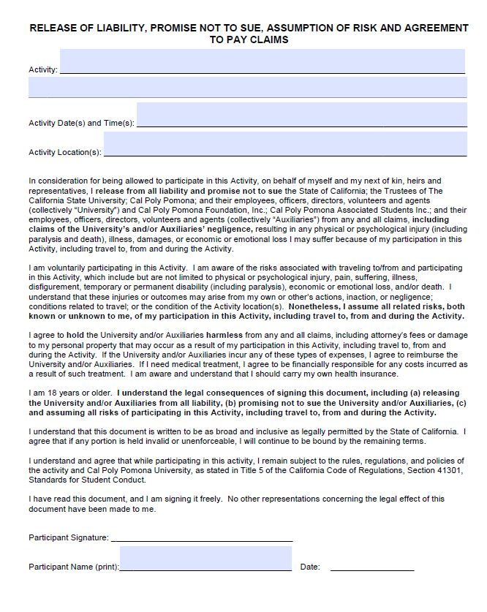
Travel Forms Required
Groups Only – retrieve from ASI Financial Services
Groups & Individuals

Slide 18
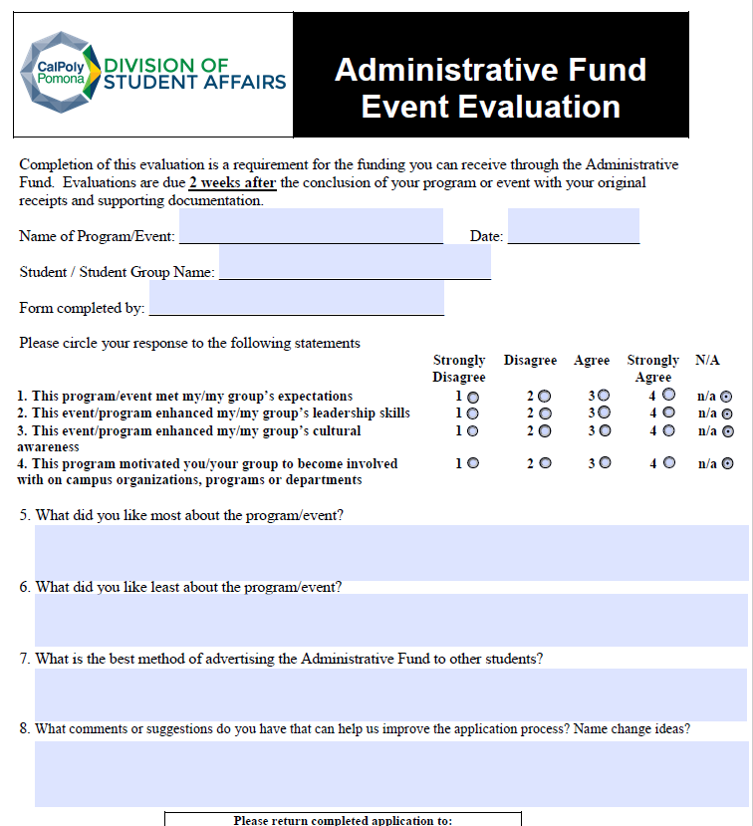

Slide 19
Questions?

