Slide 1
Mechanical Hazards
Notes:
1

Slide 2
Types of Mechanical Hazards
Controls for Mechanical Hazards

Slide 3
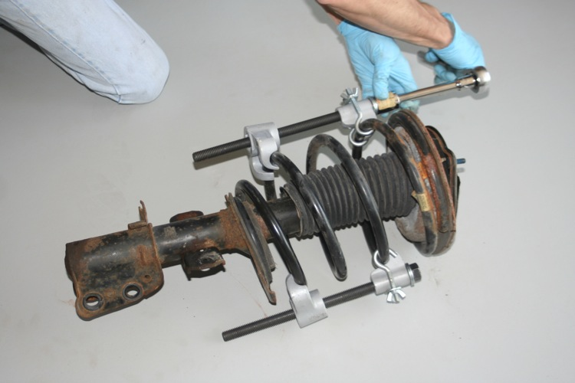
Unexpected Release of Stored Mechanical Energy
Springs

Slide 4

Dropped weights

Slide 5
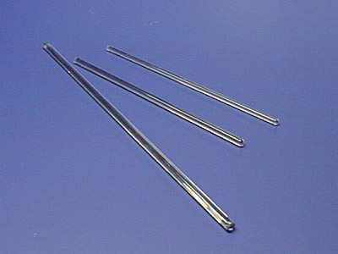
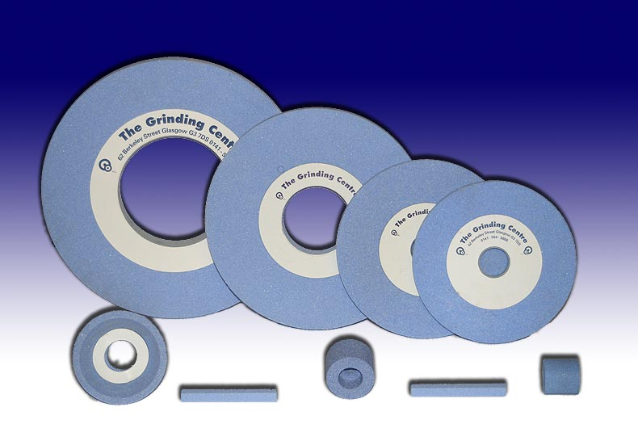
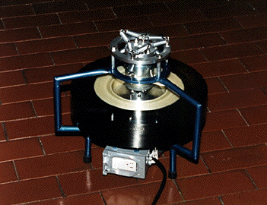
Linear Or Rotational Kinetic Energy (Projectiles)

Slide 6
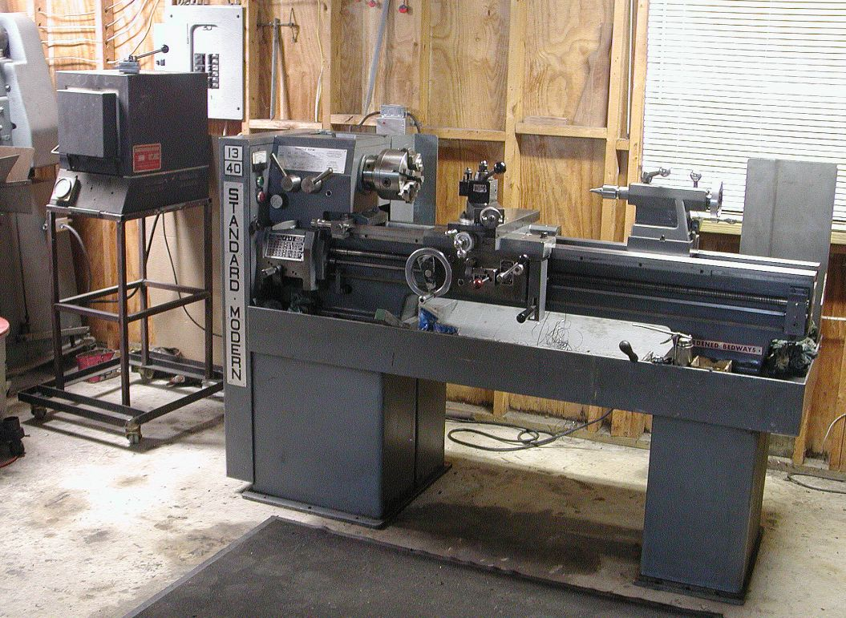
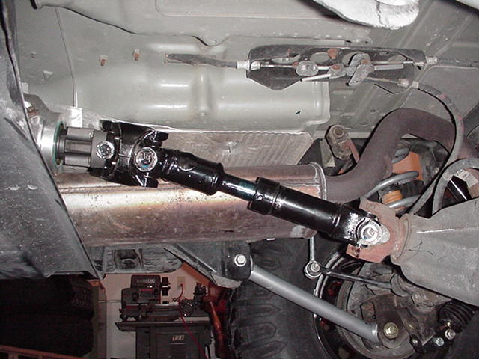
Rotating Machinery/Shafts

Slide 7
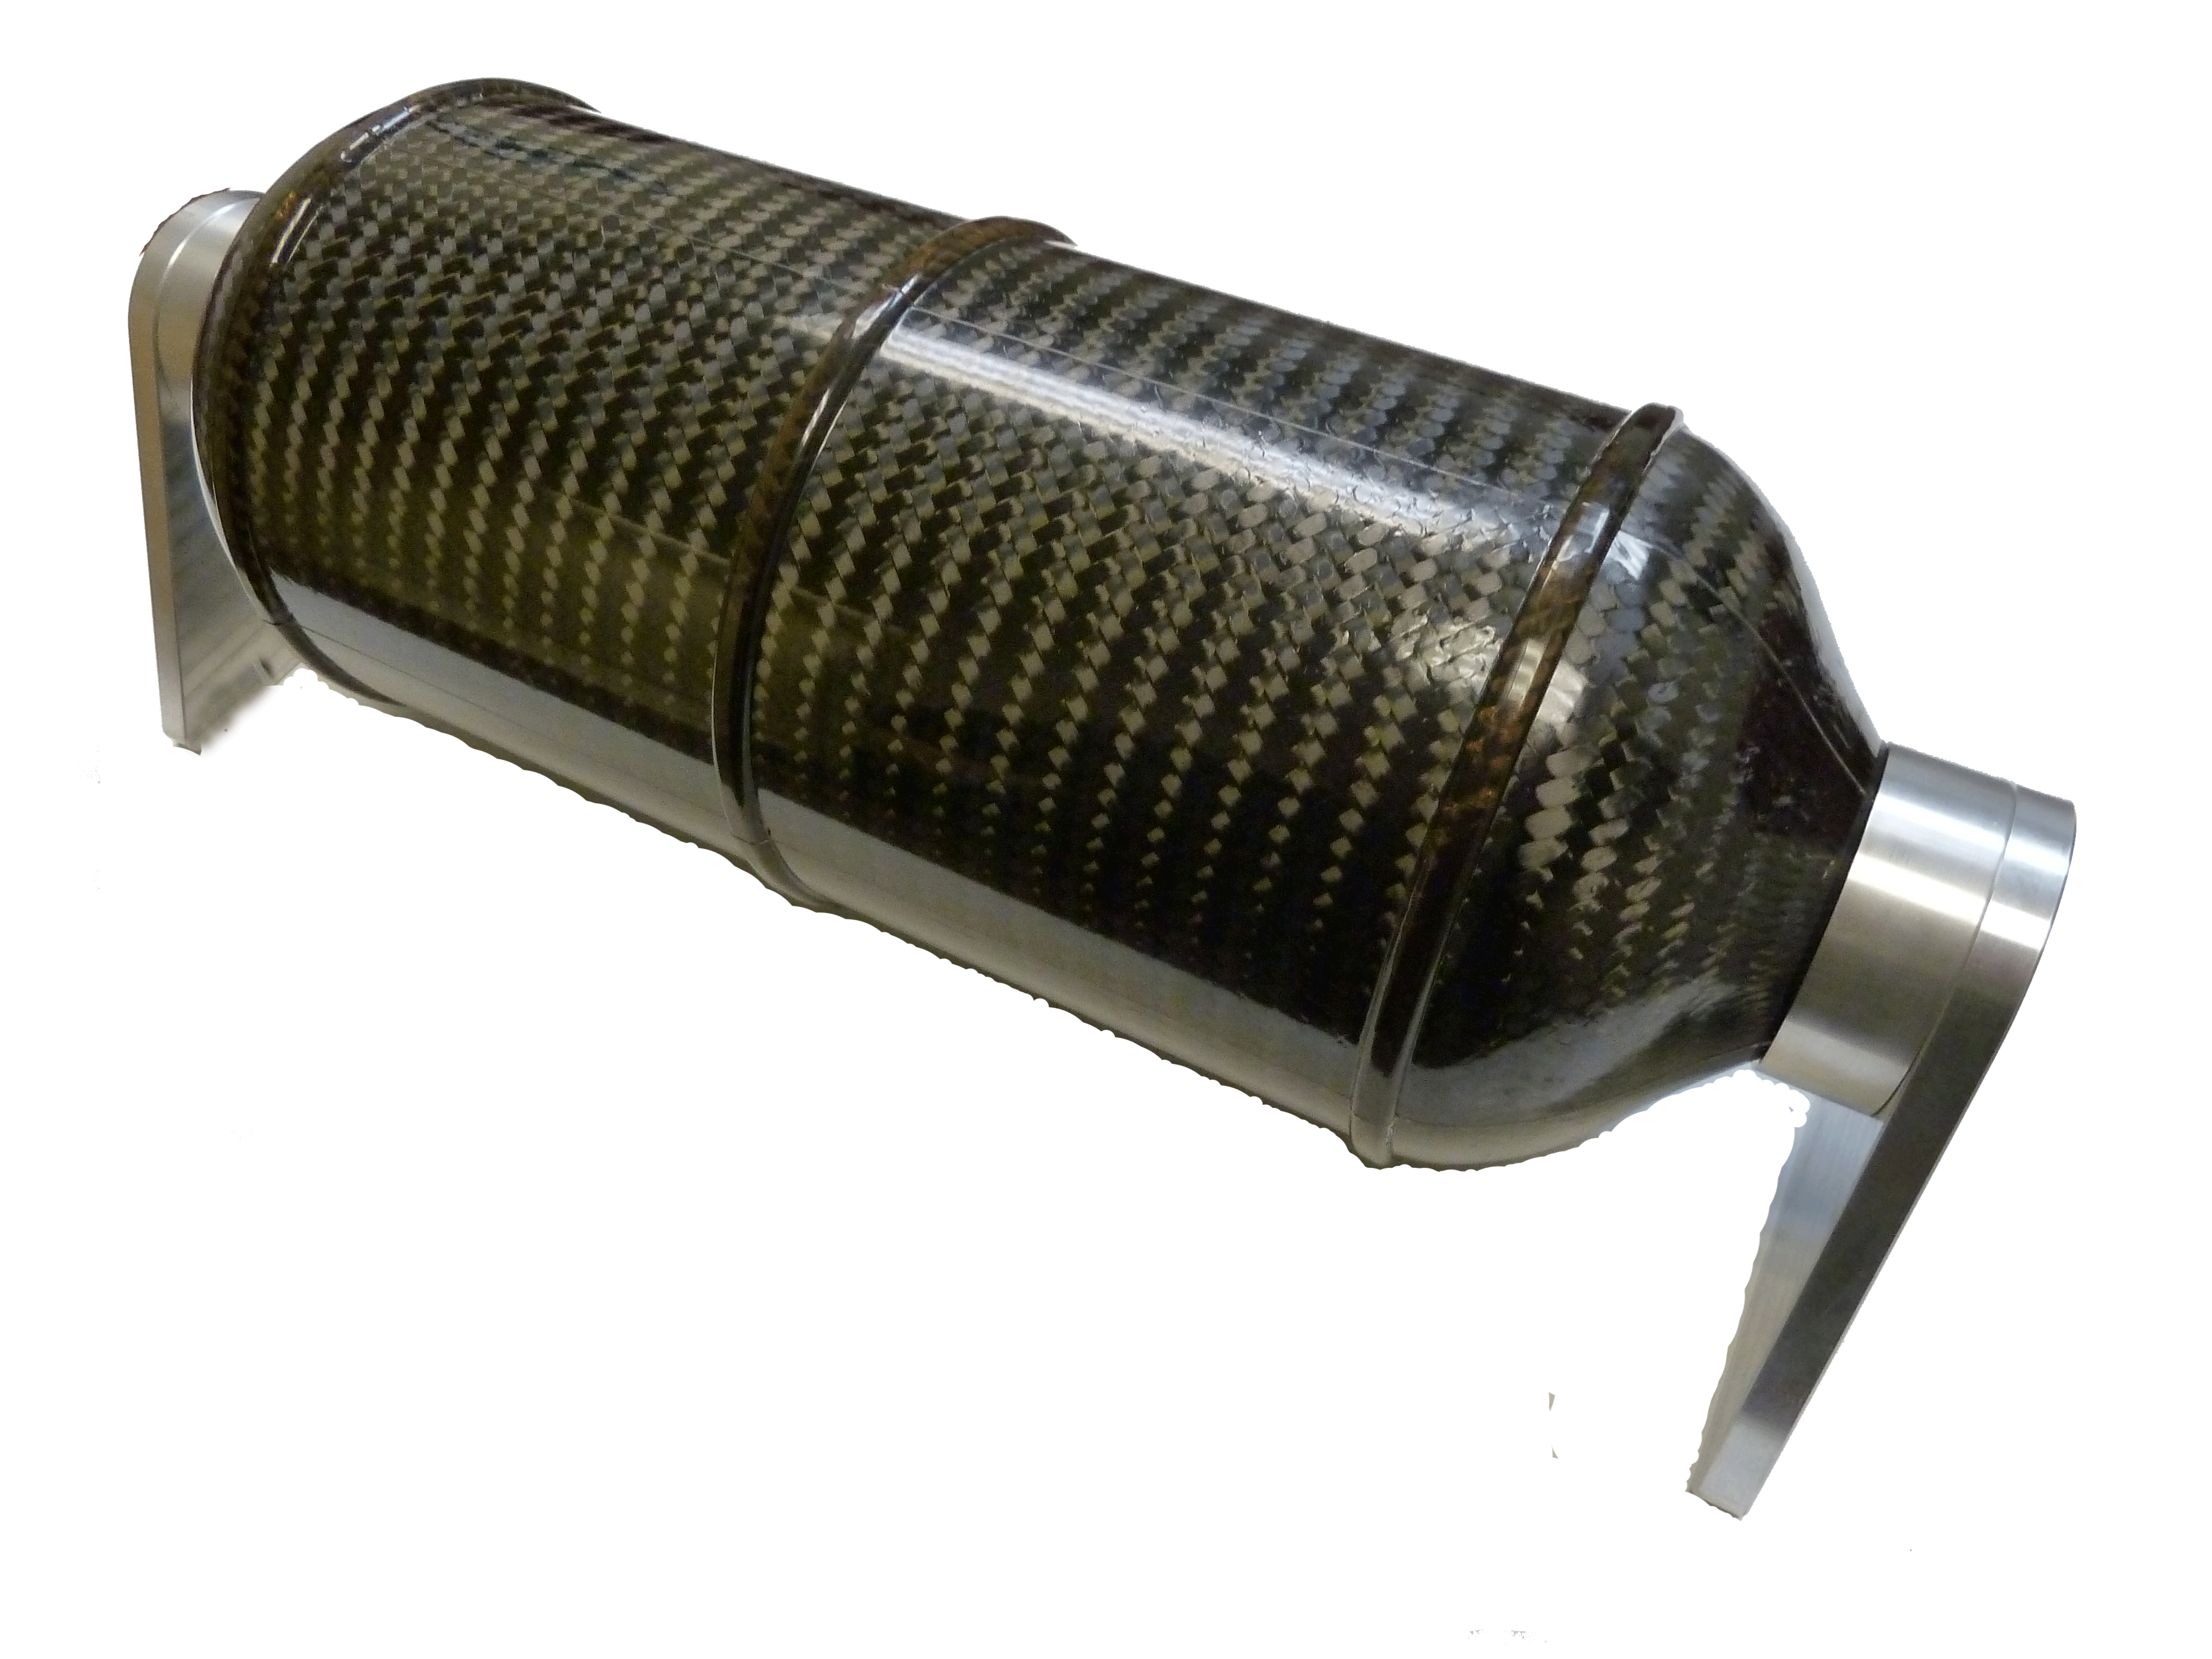
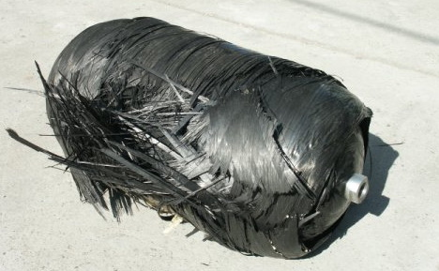
Compressed Fluids

Slide 8

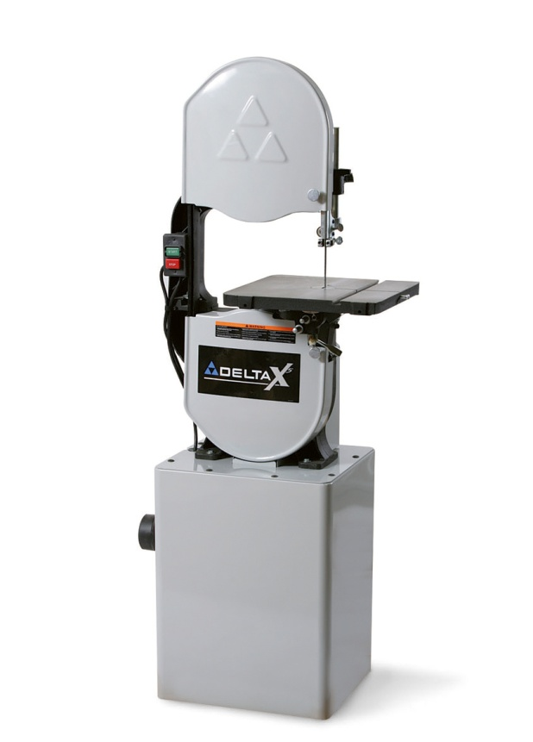
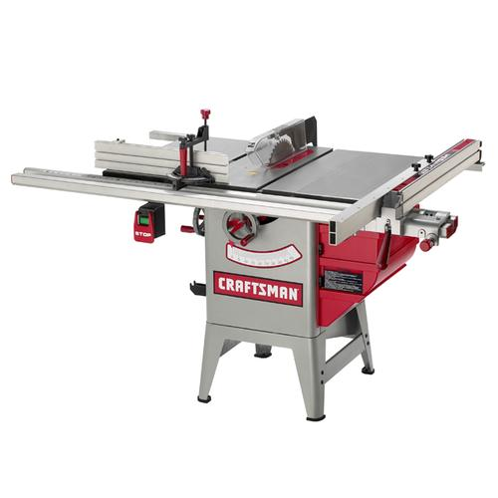
Blades, Sharp Edges

Slide 9
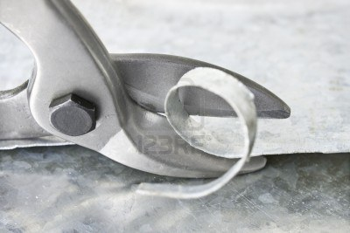
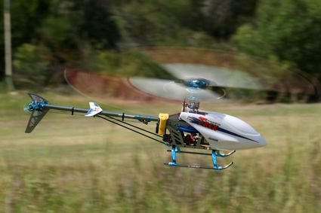

Slide 10
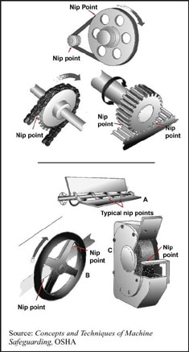
In-running Nip Points

Slide 11
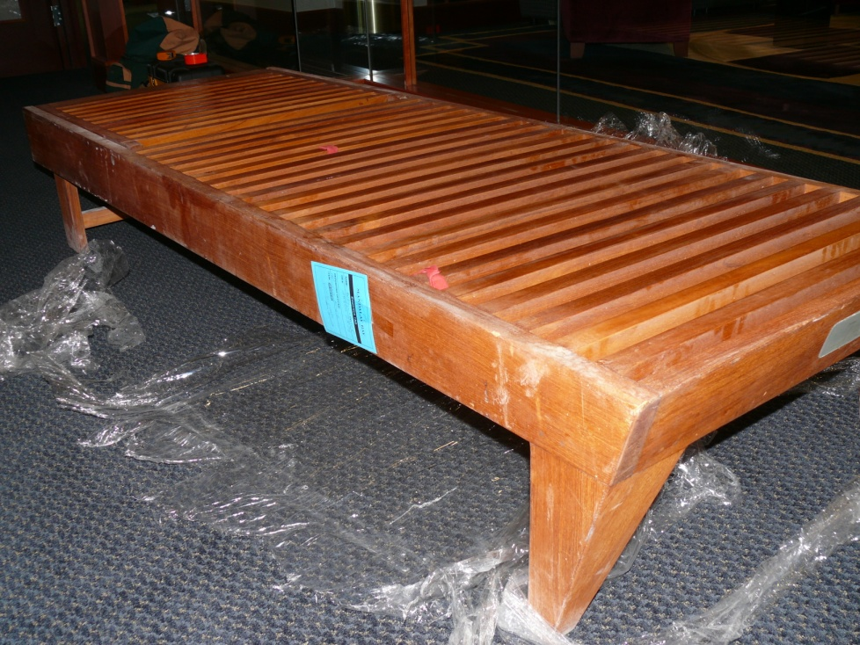
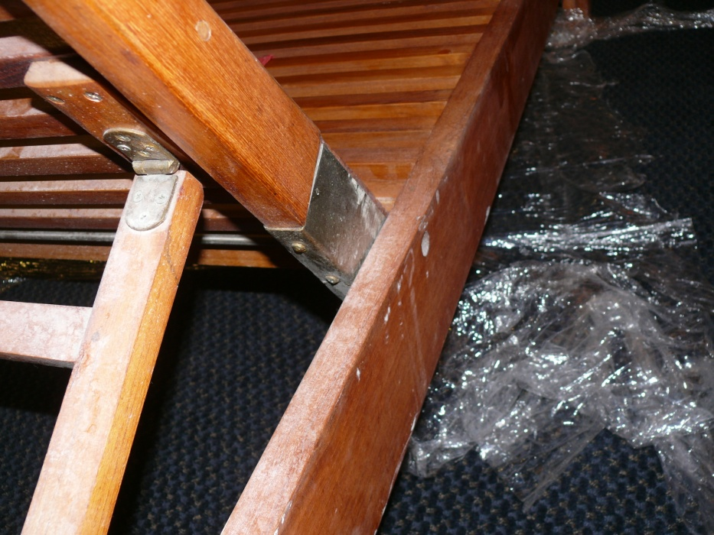
Pinch Points

Slide 12
Controls
If hazard is not essential to the experiment or project, eliminate it altogether or engineer it out
If it is not possible to eliminate the hazard, guard it
If it is not possible to guard it, must rely on training and personal protective equipment

Slide 13
A few options available in guarding a hazard
Fixed barrier guards
Adjustable guard
Retractable guard
Interlocked guard
Electronic presence sensing devices
References: ANSI B11 series of standards, particularly B11.19. Also OSHA: 29 CFR 1910 subpart O.

Slide 14
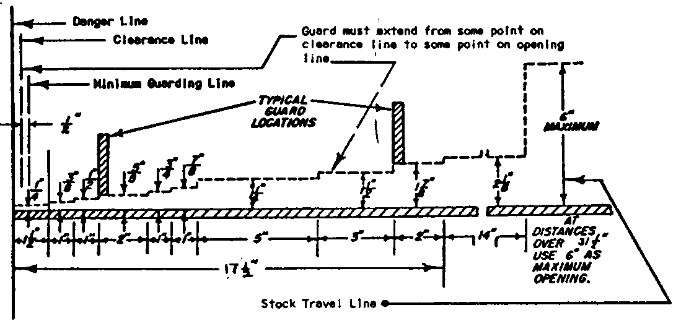
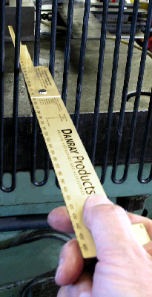
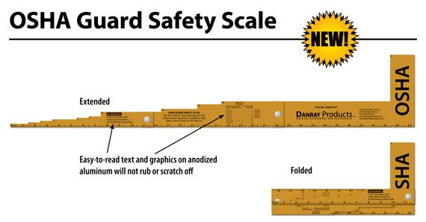
Acceptable Opening Sizes

Slide 15
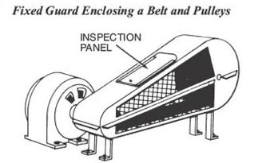
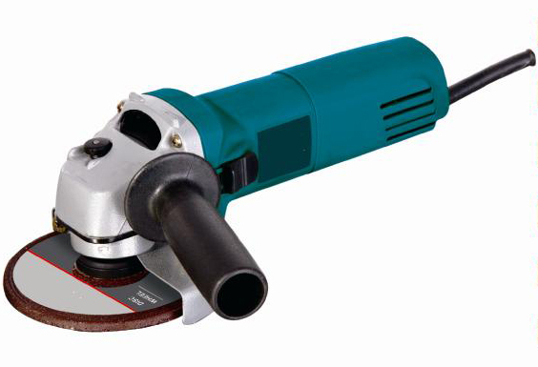
Fixed Barrier Guard

Slide 16
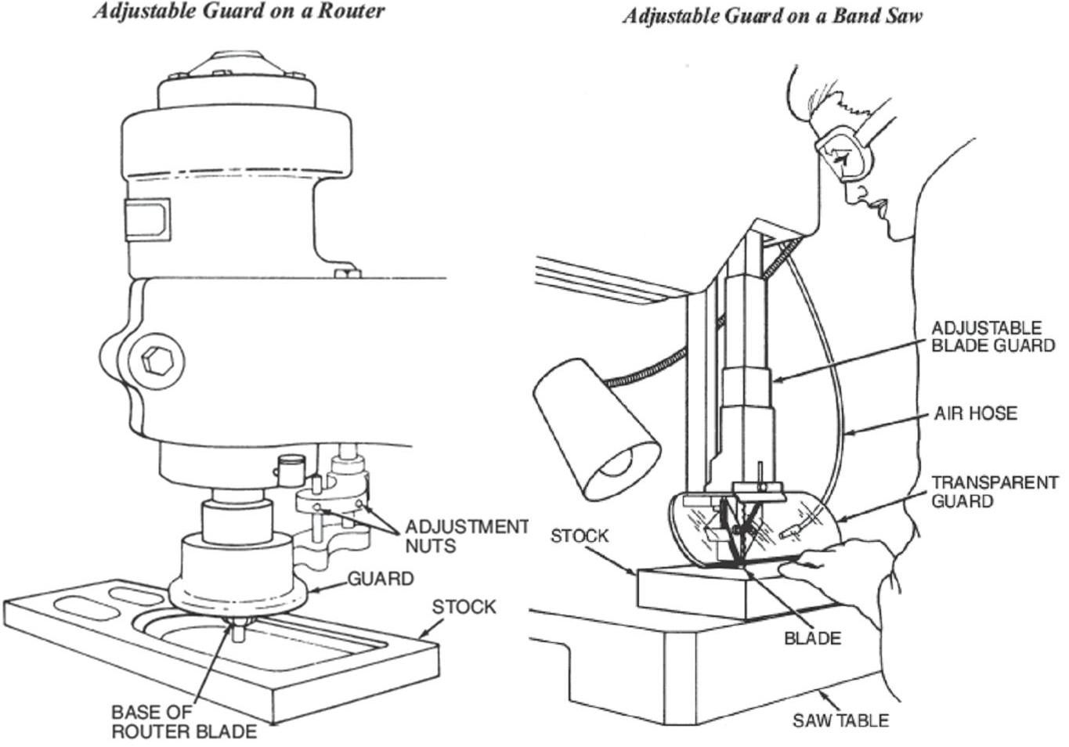
Adjustable Guard

Slide 17
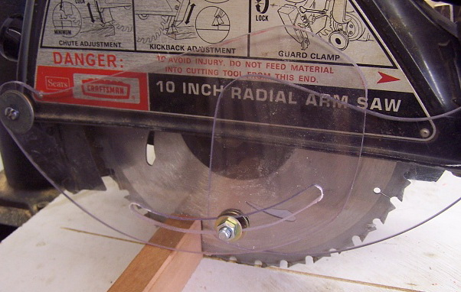
Retractable Guard

Slide 18
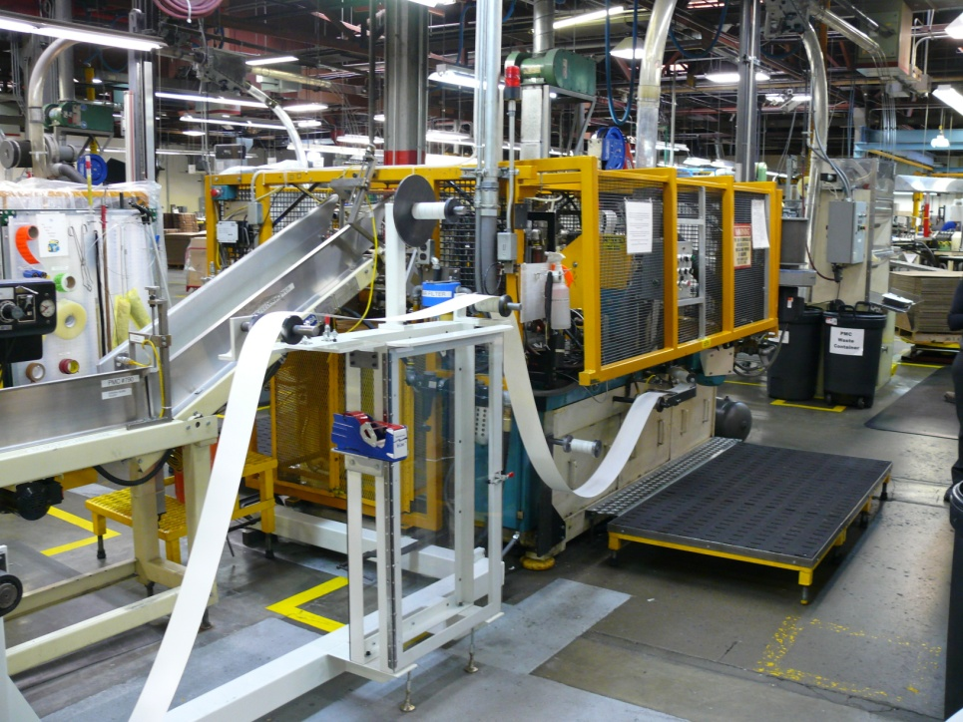
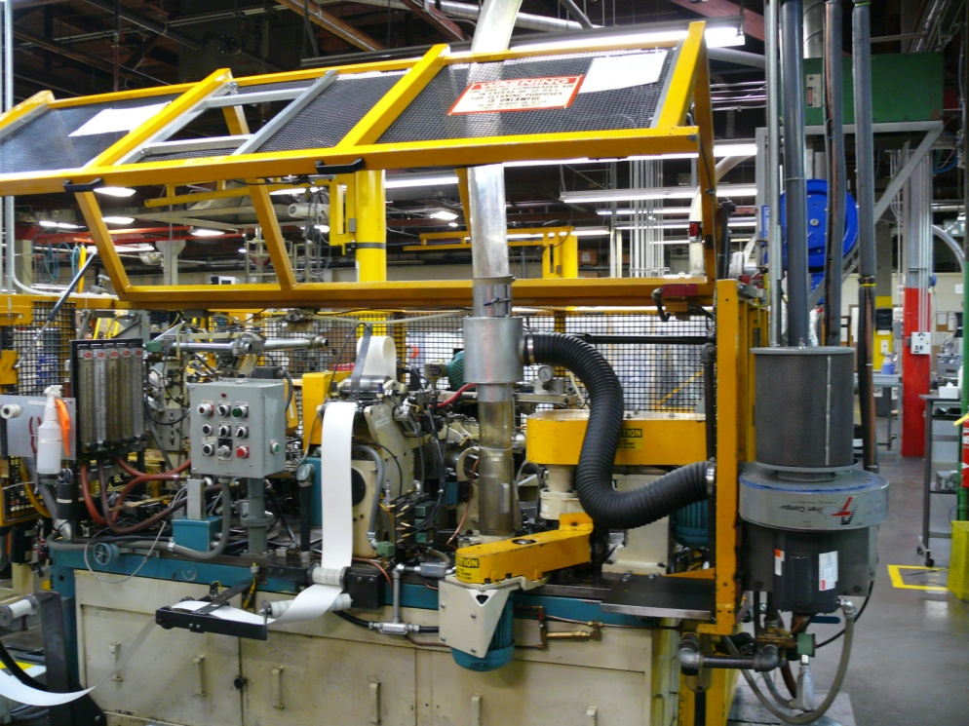
Interlocked Guard

Slide 19
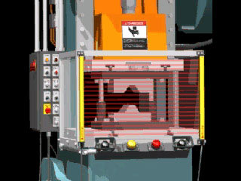
Presence Sensing Devices

Slide 20
Training
Safety training (well designed, consistently implemented, documented, refresher courses as necessary)
Procedural controls, such as:
    Lock out/ tag out
    Limiting hours (no working at 2 am)
    Buddy system

Slide 21
Examples of Personal Protective Equipment
Safety glasses
Gloves
Hard hats
Steel-toed boots
Lab coats
Safety harnesses for fall protection
Ear plugs

