Slide 1
RTP Workshop for Chairs and DRTPCs
OFFICE OF FACULTY AFFAIRS
Fall Semester 2018
Presented by
Martin F. Sancho-Madriz, Ph.D.
Associate Vice President of Faculty Affairs

Slide 2
Reappointment, Tenure, and Promotion (RTP) Big Picture, Governing Polices, and Application Form
Designed to be a supportive and fair process
Includes evaluative as well as developmental components
Governed by:
Collective Bargaining Agreement (CBA)
Articles: 10 (Grievance Procedures), 11 (Personnel Files), 12 (Appointment), 13 (Probation and Tenure), 14 (Promotion), and 15 (Evaluation)
Campus Policies:
Policy 1328 RTP Policy and Procedures
Policy 1329: Student Evaluation of Teaching
Policy 1330: Faculty Performance Review Form (Green paper for 2018-2019 RTP cycle)

Slide 3
How to find CBA and Campus Policies?

Slide 4
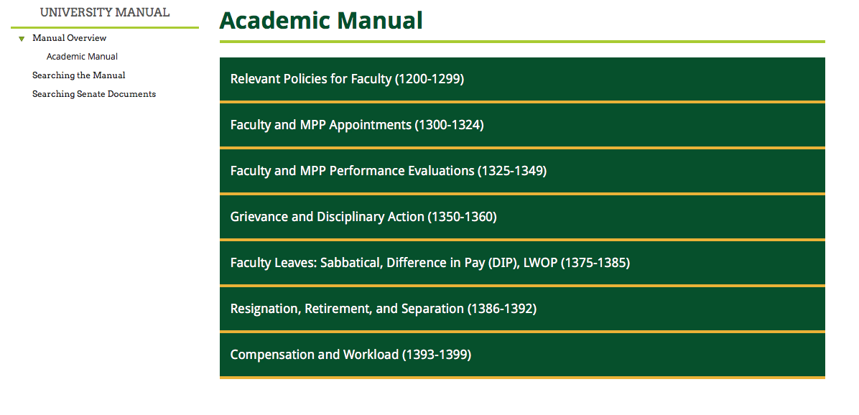
How to find CBA and Campus Policies?
➔

Slide 5
➔

Slide 6
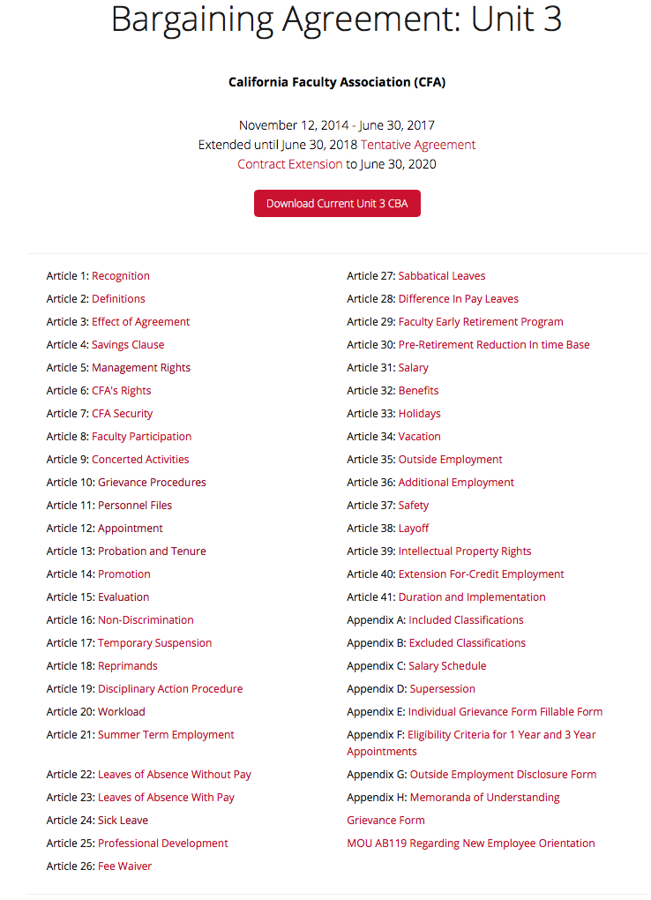
➔

Slide 7
Reappointment, Tenure, and Promotion (RTP) Big Picture, Governing Polices, and Application Form
Department RTP Criteria
Per campus policy Department Chair to provide Criteria document no later than 14 days after the first day of instruction of the academic term
Candidates for reappointment must use department RTP criteria in effect during the first year of appointment.
Candidates requesting tenure/promotion may use either the criteria in effect during the first year of appointment in rank or the criteria in effect during the year of RTP action request.

Slide 8
How to find RTP Calendar?
➔
➔

Slide 9
➔
➔
➔
➔

Slide 10
RTP Process at CPP
Currently done via printed copies of completed RTP forms
For RTP Cycle 2018-19 use green paper
Plans in place for using electronic submission through Interfolio
Pilot for 2018-19: Interfolio Pre-RTP submissions due February, 04
Training will be provided for DRTPC Chairs

Slide 11
Reappointment, Tenure, and Promotion (RTP) DRTPC Duties
Check for completeness: Signatures, Cover Page, DRTPC checklist, etc.
Remove inappropriate materials: solicited letters, materials outside period of review – notify candidate, Department Chair, Dean, URTPC and AVP Faculty Affairs
Evaluate record based on departmental criteria
Produce DRTPC evaluation by deadlines
Maintain security and confidentiality

Slide 12
Reappointment, Tenure, and Promotion (RTP) Appeals of DRTPC recommendation
The candidate has ten (10) calendar days following receipt of the DRTPC’s recommendation to appeal the DRTPC action to the CRTPC
In cases of appeal, the Office of Faculty Affairs will create a special separate calendar to track these cases

Slide 13
Reappointment, Tenure, and Promotion (RTP) DRTPC – Additional Duties
Oversee class peer evaluations
Mentor probationary faculty
Review DRTP criteria as needed or if expired (Deadline for submission to the DRTPC and the Dean is April 1st each year)

Slide 14
Reappointment, Tenure, and Promotion (RTP) RTP Process
Evaluative and Developmental
Help, not blindside – offer criticisms with specifics
RTP is reactive if not paired with intensive faculty development program at department and college levels
Recruitment one side of the coin, retention is the other
If someone is not performing provide explicit feedback – let the person know that he/she is in trouble

Slide 15
Reappointment, Tenure, and Promotion (RTP) General Principles
The President (or designee) makes final decisions on RTP matters based on recommendations of faculty RTP faculty committees, Department Chair if applicable, and Dean
Evaluation must be based solely on applicable department RTP criteria
The primary responsibility for demonstrating criteria is met rests with the faculty member requesting RTP action
Evaluation and recommendation is based on materials included in the RTP packet and Personnel Action File (PAF)
RTP packet is also referred to as the Working Personnel Action File

Slide 16
Reappointment, Tenure, and Promotion (RTP) 4 levels of review, potentially 5
Department RTP Committee (DRTPC)
Department Chair (if not part of the DRTPC and explicitly stated in department RTP criteria), must be done independently from DRTPC review
[College RTP Committee (CRTPC) – if triggered by appeal]
Dean
University RTP Committee (URTPC)
Provost and Vice President for Academic Affairs

Slide 17
Reappointment, Tenure, and Promotion (RTP) RTP packet = Working PAF
Every page of RTP packet should be signed and dated by RTP candidate
The DRTPC Chair: official custodian of the RTP packet for the period between the submission of the packet to the DRTPC by the candidate and the forwarding of the packet to the Dean's office. During this period, only DRTPC chair shall be responsible for additions or changes to the packet
After RTP packet is submitted to DRTPC, the only insertions allowed are limited to official evaluations by RTP committees and Dean, and responses and rebuttals (if any) by RTP candidate

Slide 18
Reappointment, Tenure, and Promotion (RTP) RTP packet = Working PAF
The candidate will sign all pages of the Faculty Performance Review Form as they are completed. The purpose of this provision is to ensure that the candidate is completely aware of the content of the RTP packet at all times
Any other insertion or deletion of materials must have the approval of the URTPC and shall be limited to items that became available after the due date. RTP candidate should be notified. The RTP candidate must sign and date all inserted materials

Slide 19
Reappointment, Tenure, and Promotion (RTP) RTP packet = Working PAF
All student evaluations for the period of review shall be included in the RTP packet.
All peer evaluations for the period of review shall be included in the RTP packet.
A copy of the applicable department RTP criteria document must be attached to the RTP packet by the candidate

Slide 20
Reappointment, Tenure, and Promotion (RTP) RTP packet = Working PAF – Continued…
RTP committee evaluation report and recommendation shall be approved by a simple majority
Before recommendations are forwarded to next review level, the candidate shall be given a copy of the recommendation, which shall state in writing the reasons for the recommendation.
The candidate shall have the right to respond or submit a rebuttal statement or response in writing no later than ten (10) calendar days following receipt of the recommendation.

Slide 21
Reappointment, Tenure, and Promotion (RTP) RTP packet = Working PAF – Continued…
A copy of the response or rebuttal statement shall accompany the RTP packet and also be sent to any previous levels of review.
The candidate may request an opportunity to discuss recommendation with the recommending group or individual, who shall honor such a request. Such requests shall not require that RTP timelines, as specified in the current University Calendar for RTP Actions, be extended.
Under rare circumstances beyond the control of individual(s) at a given review level, a request may be submitted to the URTPC for extending a deadline. After consulting with AVP for Faculty Affairs, URTPC Chair responds to the request.

Slide 22
Reappointment, Tenure, and Promotion (RTP) Supplementary Materials
Examples: teaching portfolio, publication reprints, performance DVDs
Do not include them in RTP packet.
Provide an index of all supplementary materials in RTP packet.
All supplementary materials shall be made available to evaluators upon request.

Slide 23
Reappointment, Tenure, and Promotion (RTP) Confidentiality of Review Process
Deliberations on reappointment, tenure, and promotion shall be confidential
Access to materials and recommendations pertaining to the candidate shall be limited to the RTP candidate, DRTPC and URTPC members, the department chair (in the case where the chair makes a separate evaluation), appropriate administrators, and the President
In the event where the College RTP Committee (CRTPC), has been called to deliberate on an action, these materials and recommendations shall also be made available to the said committees.

Slide 24
Reappointment, Tenure, and Promotion (RTP) Areas of Evaluation
Teaching
Research, Scholarly, and Creative Activities
Service

Slide 25
Reappointment, Tenure, and Promotion (RTP) Evaluation of Teaching
Student evaluation of teaching
Governed by Policy 1329: Student Evaluation of Teaching
All classes evaluated with a few exceptions
No solicited comments other than official evaluation forms
Peer evaluation of teaching
Governed by Policy 1328: RTP Policy and Procedures
Minimum of two peer observations per academic year
Responsibility of DRTPC to ensure minimum number is conducted and that the report is submitted to the faculty member and placed in faculty member’s PAF within two weeks of the classroom visit.

Slide 26
Reappointment, Tenure, and Promotion (RTP) Evaluation of Research, Scholarly, and Creative Activities
Based on department RTP criteria
Expectations vary by department and/or college

Slide 27
Reappointment, Tenure, and Promotion (RTP) Evaluation of Service
Description and documentation
Based on department RTP criteria
Expectations vary by department and/or college
Candidates should receive advice on types of service, especially for first year

Slide 28
Reappointment, Tenure, and Promotion (RTP) Process
Currently at CPP: probationary TT faculty are evaluated each year at all levels
Normally initial two-year appointment
Subsequent reappointment each year until tenure is awarded

Slide 29
Reappointment, Tenure, and Promotion (RTP) Policy #1328, 7.4 C
Candidates for reappointment must discuss their progress toward meeting department requirements for tenure
All candidates must discuss progress made on any recommendations for improvement given in the previous RTP cycle

Slide 30
Reappointment, Tenure, and Promotion (RTP) Policy #1328, 7.4 D
The DRTPC must also include a discussion of progress made on any recommendations for improvement given in the previous RTP cycle

Slide 31
Reappointment, Tenure, and Promotion (RTP) Process
Candidates apply for tenure (and promotion to Associate Professor) at the start of the 6th year – unless awarded service credit.
For tenure-track faculty starting in 2018/19 academic year, tenure and promotion actions will be requested in 2023/24 academic year and, if successful, service tenured in new rank (Associate Professor) will start in 2024/25 academic year.
Promotion to the rank of Professor shall normally be effective the beginning of the sixth (6th) year after appointment to Associate Professor.
For tenure-track faculty starting in 2018/19 academic year, if promotion to Associate Professor proceeds on schedule, the request for promotion will be submitted in 2028/29 academic year and, if successful, service at the rank of Professor will start in 2029/30 academic year.

Slide 32
Reappointment, Tenure, and Promotion (RTP) Pre-RTP Cycle this year – 2018-2019
Pre-RTP – dry run – still part of Personnel Action File (PAF), due 2/4/19
No action associated – the goals are to practice and receive feedback and/or recommedations
Review by DRTP Committee, Department Chair (if not in DRTPC), and Dean
Pre-RTP Workshop: provided during new faculty orientation (December session)

Slide 33
Contact Information
Martin Sancho-Madriz, Ph.D.
Associate Vice President for Faculty Affairs
mfsancho@cpp.edu
Mary Jane Wade
Assistant to AVP
X-3418
mjawade@cpp.edu
http://www.cpp.edu/~faculty-affairs/

