Slide 1
Cal Poly Pomona – Graduate Student Orientation
WELCOME!
Jennifer Andelin
Associate Registrar
Registrar’s Office
http://www.cpp.edu/registrar
(909) 869-3000
SSB 121, 1st Floor – Blue Counter (shared with the Bronco Advising Center and Financial Aid)
The Registrar’s Office

Slide 2
REGISTRAR’s Office Overview
Cal Poly Pomona - Graduate Student Orientation
Registration/Grading
Academic Standing
Leave of Absence
Conditional/Unconditional Status
Official Transcripts
Veteran’s Benefits
Degree & Enrollment Verification
The Registrar’s Office

Slide 3
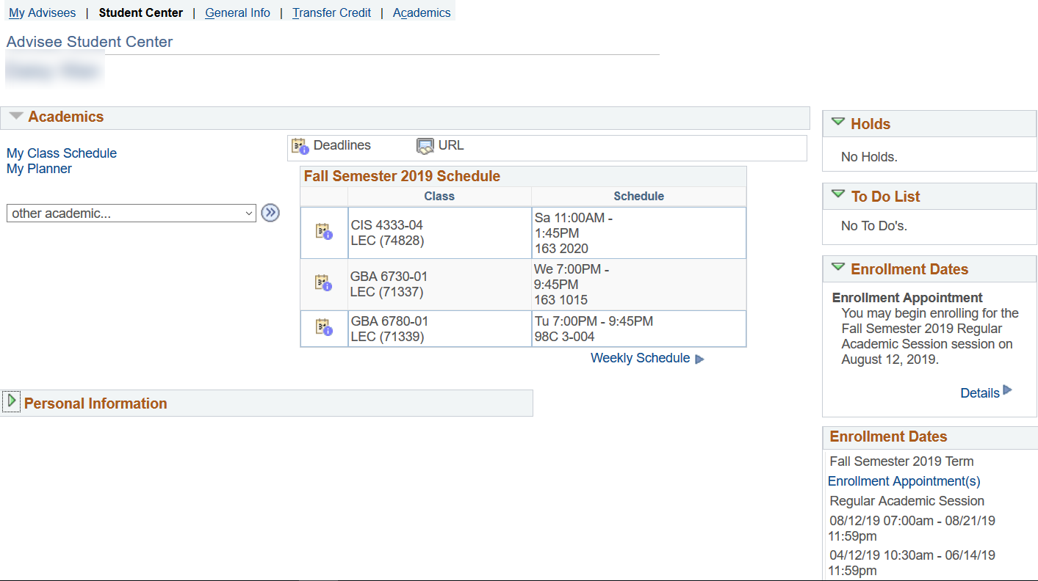
STUDENT CENTER
Cal Poly Pomona - Graduate Student Orientation
The Registrar’s Office
Notes:
ADD HOLDS!!!~
Slide for different kinds of holds – Emergency Contact,

Slide 4
ENROLLMENT APPOINTMENTS
Cal Poly Pomona - Graduate Student Orientation
Future enrollment appointments are assigned by Registrar’s Office and viewable in your Student Center shortly before registration opens
Limited to 16 units during regular registration, then 18 units during Add/Drop
Check for pre-requisites or co-requisites
Add/Drop for Fall 2019: August 12 – September 5
The Registrar’s Office

Slide 5
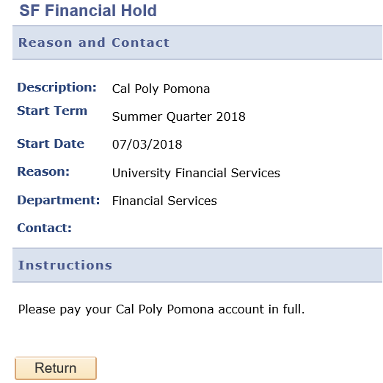
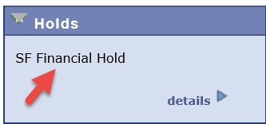
Registration Holds
Cal Poly Pomona – Graduate Student Orientation
Financial hold
Master’s Contract hold
Emergency Contact hold
Academic Standing hold (ex: Probation)
Title IX training hold
The Registrar’s Office

Slide 6
AcADEMIC POLICIES Academic Standing
Cal Poly Pomona – Graduate Student Orientation
3.0 minimum GPA required (“B” average)
Overall/Cumulative (includes any transferred courses)
CPP courses
Contract of Study courses
NOTE: 1000-2000 level courses (lower division) do NOT count in your graduate GPA
Falling below a 3.0 GPA overall leads to probation and/or disqualification
There is no repeat/course forgiveness option available for graduate students
The Registrar’s Office
Notes:
Currently, you DPR is still being updated by your TGA. Your DPR should reflect your transfer coursework by winter registration

Slide 7
ACADEMIC POLICIES Leave of Absence
Cal Poly Pomona – Graduate Student Orientation
Students are permitted to “stop out” (not be enrolled) for 1 semester (not including summer)
If a student needs to be away longer than 1 semester (financial, medical, emergency reasons) a Leave of Absence can be filed with the Registrar’s Office for up to 4 semesters (not including summer) – form available online
NOTE: The 7-year contract time limit does not stop during this period.
The Registrar’s Office
Notes:
Currently, you DPR is still being updated by your TGA. Your DPR should reflect your transfer coursework by winter registration

Slide 8
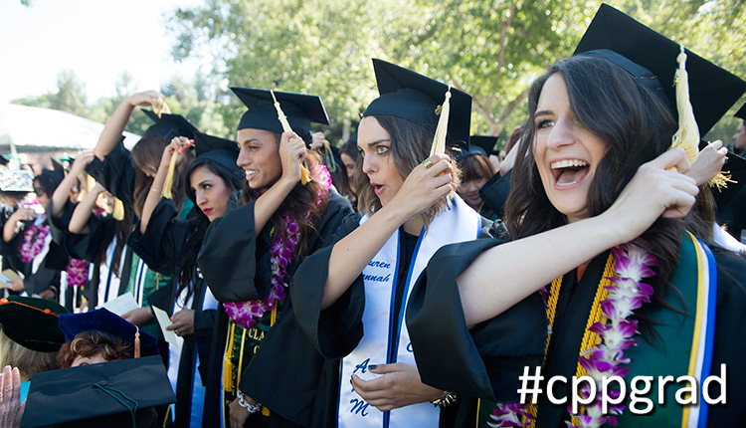
Welcome broncos! We look forward to your graduation day!
Cal Poly Pomona - Graduate Student Orientation
The Registrar’s Office

