Slide 1
How to Submit Additional Study Submissions -Amendments/modifications -Renewals -Closures

Slide 2
How to use this tutorial
This tutorial is for researchers (PIs) who already have an approved IRB protocol and wish to submit an amendment/modification, renewal, incident (adverse event) or closure type protocol.
If the protocol has not been reviewed and approved, then the researchers can submit a withdrawal type protocol. That process is similar to what is described here; the details are at the end of this tutorial.
In Cayuse, the first protocol is known as the “initial” study.
Before approval, PIs can withdraw their protocol from further review. Once approved, then the protocol can be amended/modified, renewed, or closed.
Use your keyboard’s left/right/up/down arrow (or your mouse/trackpad scroll or the spacebar) to move through the PowerPoint. Instructions are animated.

Slide 3
Copy and Paste to Log in to Cayuse:
https://cpp.cayuse424.com/#https://cpp.cayuse424.com/

Slide 4
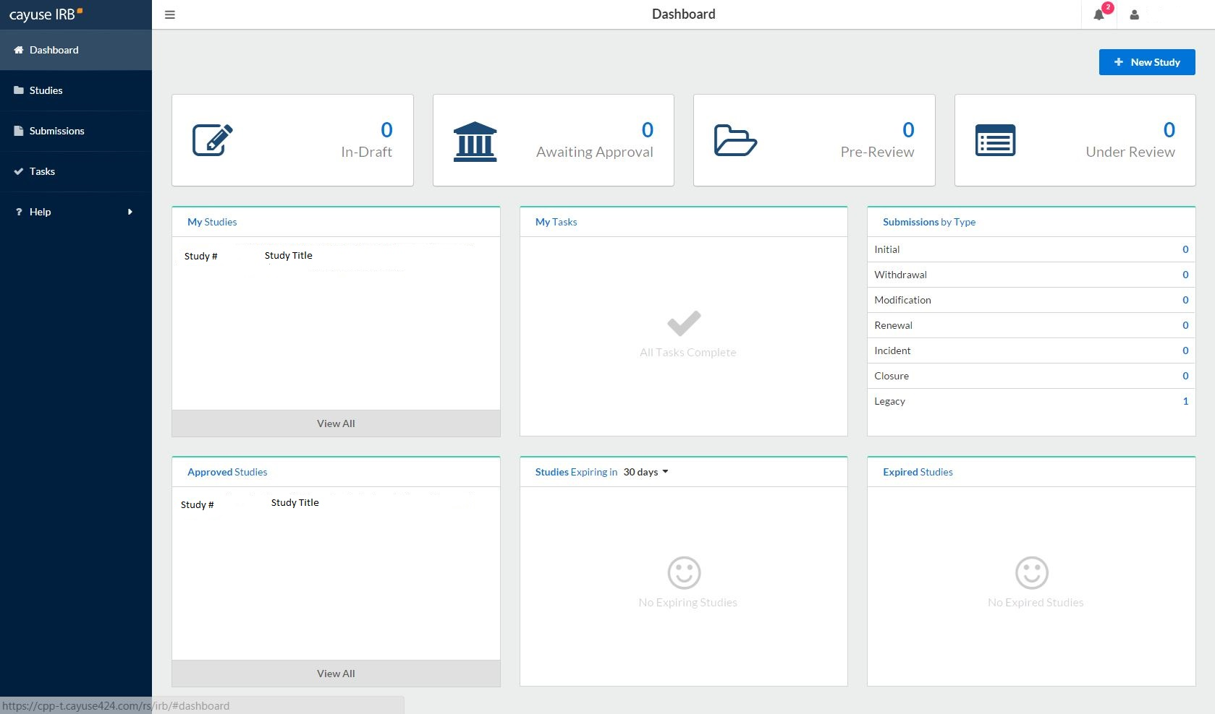
Select your study

Slide 5
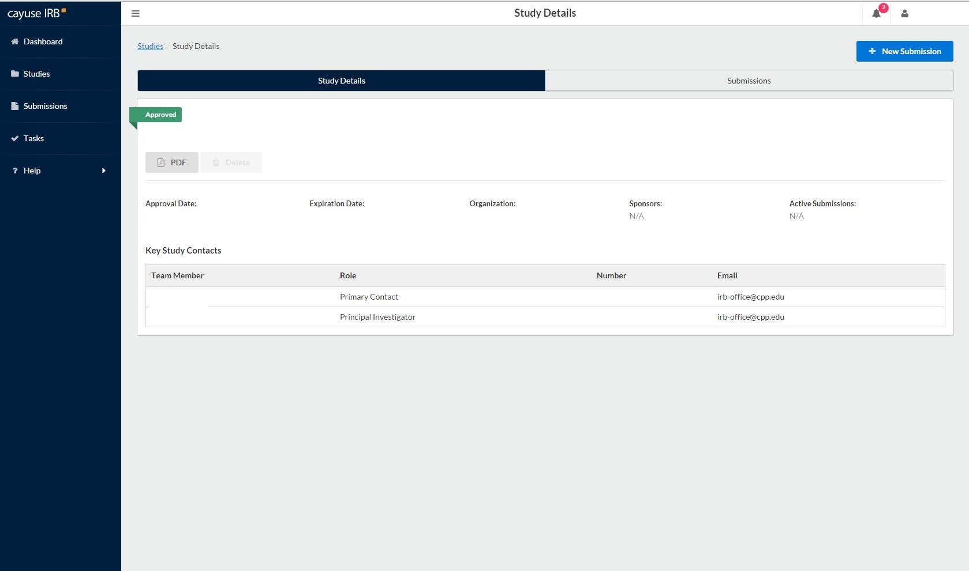
You’ll be taken to this page. Click on the blue button for “New Submission.”
Office of Research Compliance v2-2017

Slide 6
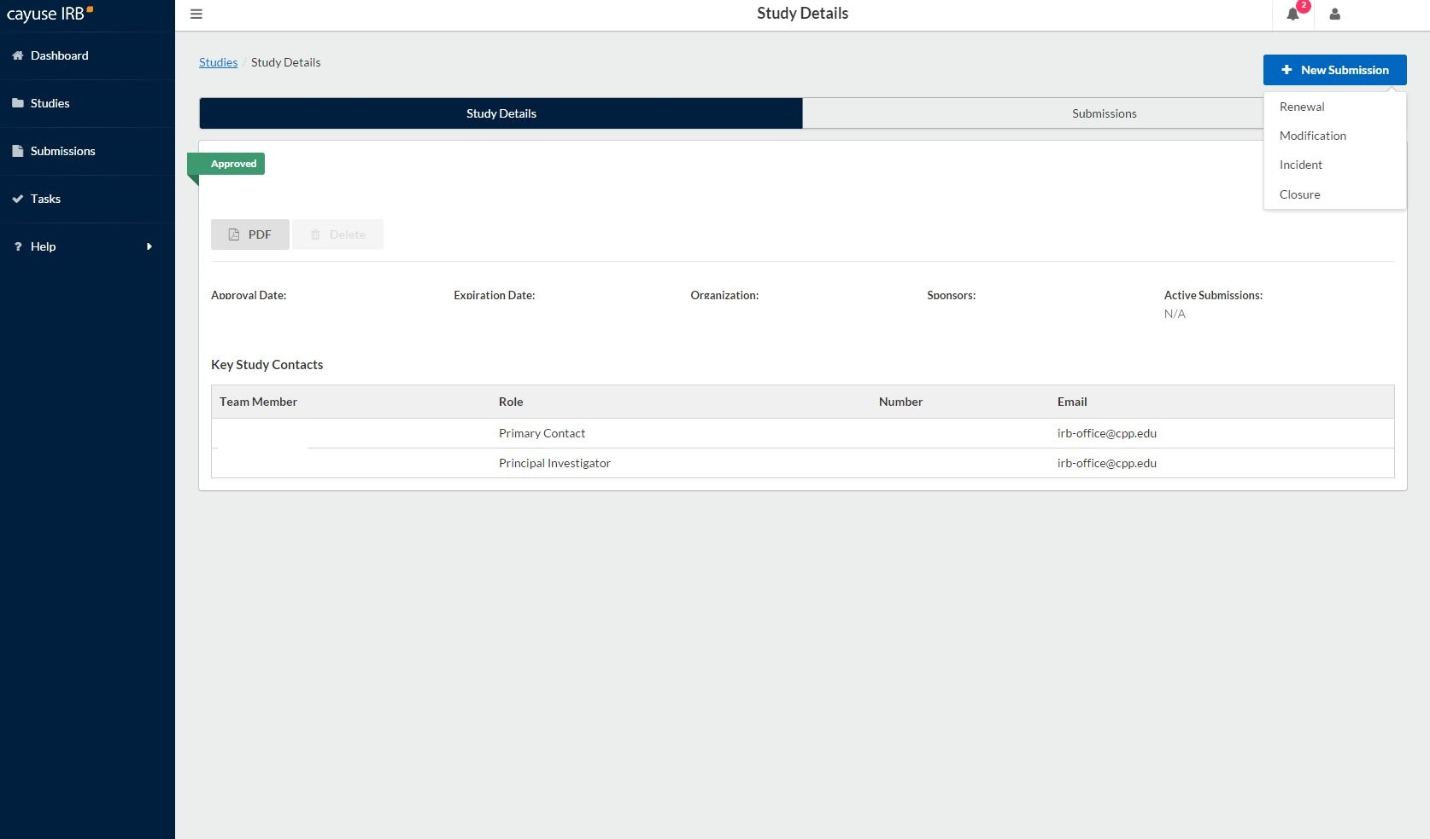
Select the type of submission you want to complete.
Renewal = extending the study for up to a year, before the approved protocol expires.
Modification = submitting a change or amendment to the protocol
Incident = reporting an adverse event
Closure = you are finished collecting data for the study

Slide 7
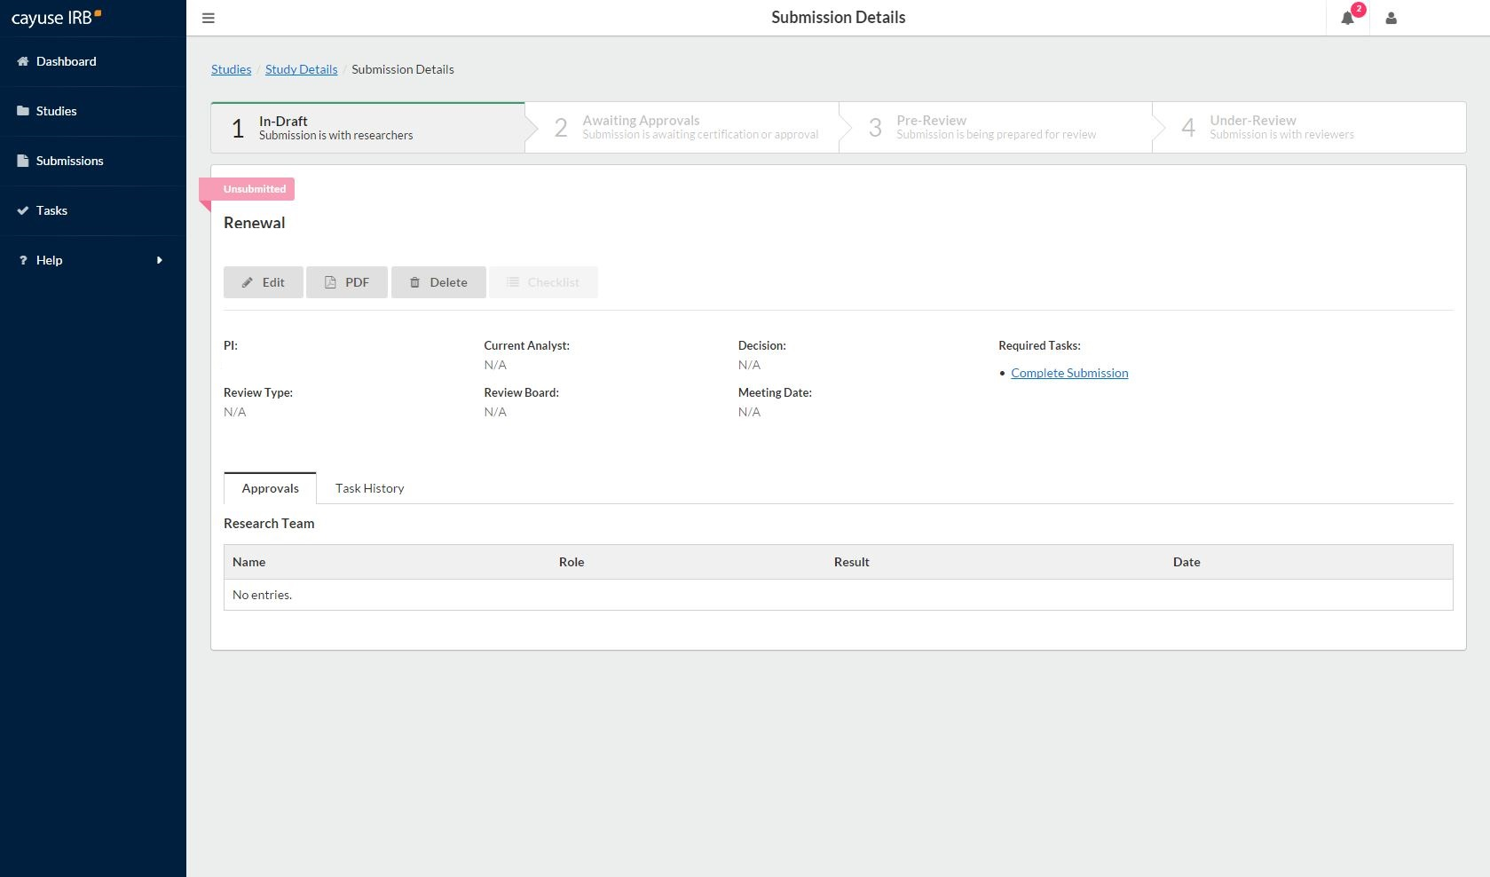
You’re taken to this page.
Click on “Edit” to provide details about the submission to the IRB.

Slide 8
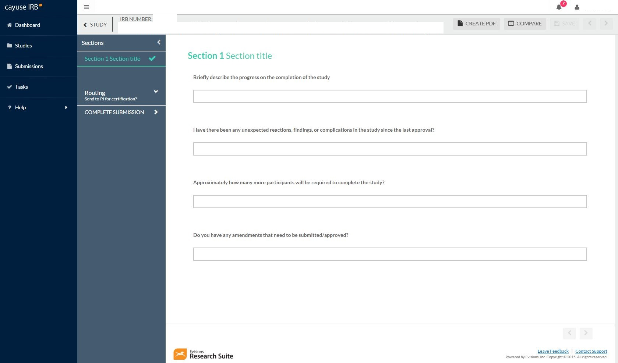
Fill out the “protocol.” Remember this is not the same as the initial protocol you did before .
When you are finished, click on “Complete Submission”.

Slide 9
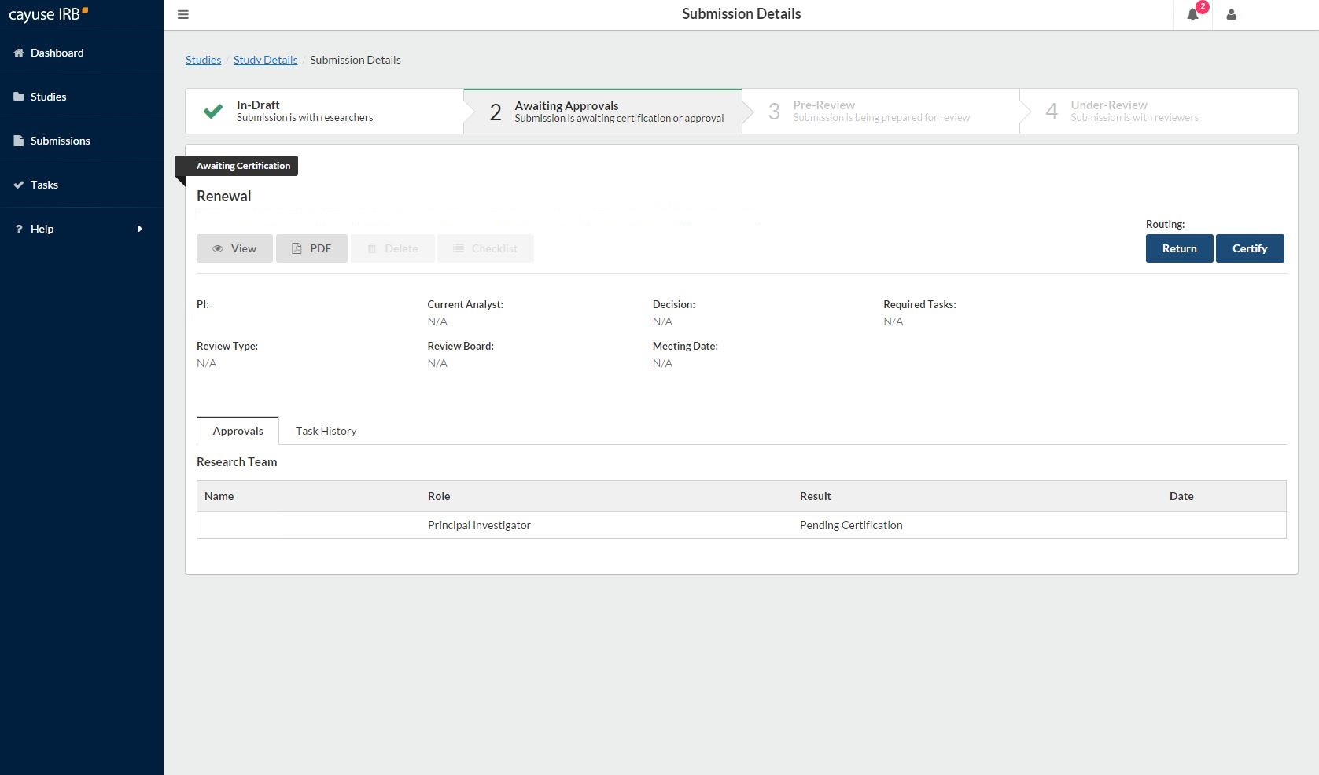
You’ll be redirected to this page. You will need to “Certify” in order to finalize the submission. Certification says you knowingly mean to take this action (to renew, amend/modify, or close).

Slide 10
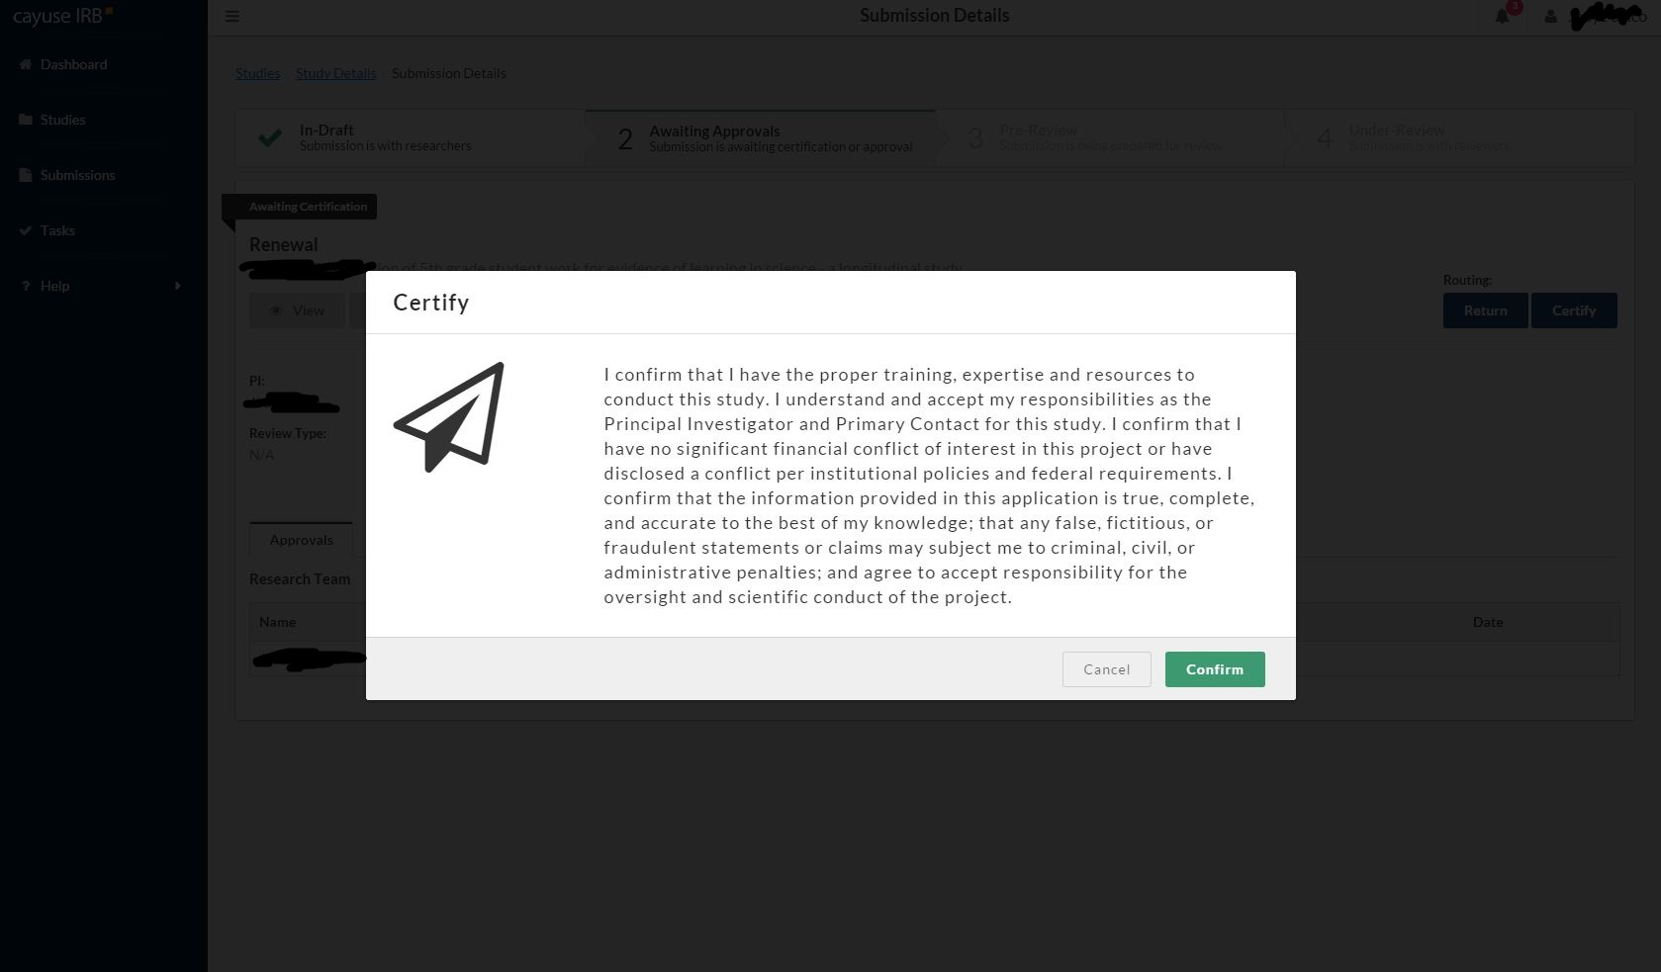
Read and select “Confirm”.

Slide 11
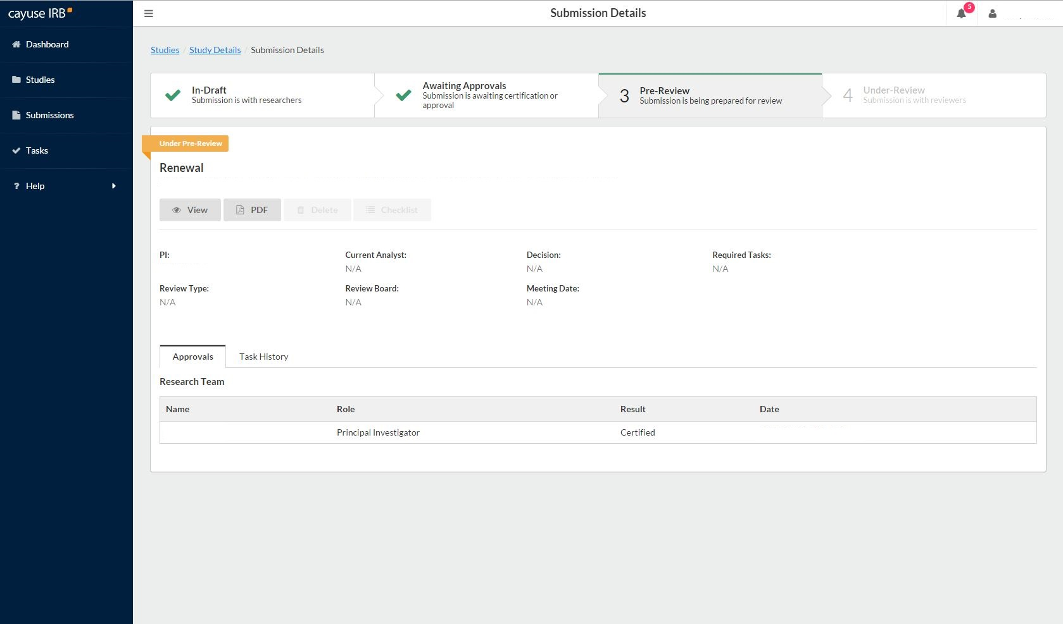
After you have certified, the submission details page should look like this. Notice that the study protocol is “Under Pre-Review” which means it’s with the IRB office. You and any co-PIs should receive an email confirmation of the action and submission type you did.

Slide 12
For a withdrawal ….
X
For a withdrawal, your not-yet-approved study protocol won’t appear in the X’d box, of course. Find it in the box with the red arrow. Then select “Withdraw” from the “New Study” tab and follow the processes.

Slide 13
If you have any issues or questions, please contact the IRB Office: irb-office@cpp.edu or (909) 869-4215 (Maya) and for IRB document examples and links, visit our website at http://www.cpp.edu/~research/irb/getting-started-with-a-protocol.shtml

